Slide 1


AmassInsights.com
info@amassinsights.com
(646) 770-2791
Notes:
Notes:
Intro
Thank Bill for putting us first
Data + FinTech in NYC
Script:
(smile and wave)
Hi everyone! My name is Jordan Hauer, and I’m the Cofounder and CEO of Amass Insights.
Firstly, I just want to thank Bill for giving me the honor (or curse?) of being the first presenter in this murderer’s row of promising AlphaTech startups.
We’re a data & fintech company based right here in New York City.
You can see here our contact information, which I’ll show you again at the end of the presentation.

Slide 2




I GOT 99 DATA PROBLEMS
Amass Insights
DATA PROVIDER
DATA CONSUMER
Is my data valuable?
Who’s interested in buying my data?
How should I improve my data?
What are my competitors offering?
Where is a comprehensive list of data providers?
Which are popular/unknown?
Which are reputable and pass my compliance?
Which pertain to my strategic objectives?
How should I prioritize them?
Confidential
Notes:
Notes:
Cater to two main groups to help them solve their struggles with data
Data Provider:
Value
Buyers
Product Improvements
Marketing
Data Consumer:
Discovery
Popularity
Reliability & Compliance
Suitability
Value
Our goal is to answer all the questions
Script:
Jumping right in here, we cater to two main groups of people: Data Providers (or those aspiring to sell their data) & Data Consumers (mainly data-driven hedge funds & asset managers, including private equity and VC)
Each of these groups seem to run into any endless array of problems with data.
If I’m a Data Provider, I’m probably asking myself:
1.) How valuable is my data? How much should I charge a hedge fund for it?
2.) Who specifically would be interested in my data? Hedge funds? Banks? Insurance companies? How do I get in touch with them?
3.) Is my data structured correctly and ready to be consumed by asset managers?
4.) How do I make it more marketable? Do I measure up to my competition?
If I’m a Data Consumer, I’m probably asking myself:
1.) Where do I find all these data products? How do I differentiate between them?
2.) Which are table-stakes? Which are up-and-coming?
3.) Is the data reliable? Will it pass my rigorous compliance process?
4.) Which ones pertain to my investment strategy? Which can help me answer my unique research questions or theses?
5.) Most importantly, which will add alpha to my portfolio and make me the most money?!
Our goal here is to help you answer all these questions.

Slide 3
ABOUT US
Amass Insights
Amass is a Data+FinTech company which introduced a multi-sided data market network called ‘Insights.’
Our technology systematically sources and profiles both traditional and non-traditional (i.e. alternative) datasets (data providers), then matches them with asset managers (data consumers) based on their research objectives.
Confidential
Notes:
Notes:
Insights is a multi-sided data market network
90% of data created in last 2 years, only 1% analyzed or used
Source traditional & alternative datasets and match to asset managers
Meta-search engine
Script:
Now, who are we?
At Amass, we’re a FinTech company that introduced a multi-sided data market network called Insights.
We’ve all heard about how 90% of the world’s data was created in the last two years, but did you know that less than 1% of it is being used or analyzed in any form?
In order to solve that, we’ve built technology that systematically sources and profiles both traditional and non-traditional or alternative datasets quicker than any entity in the world, then consummates matches with asset managers or data consumers based on their research objectives.
Basically, we’re a meta-search engine for both traditional and alternative datasets.

Slide 4







TEAM
Amass Insights
Pioneer of Email Transactional Data
First Technologist at Hunter Global Investors
Graduated Cum Laude in Information Science from Cornell Engineering in 2008
Jordan Hauer
(Co-Founder & CEO)
Former Head of BD at Nirvana Solutions
Worked at QS Investors (Deutsche Bank) & Allianz
Finance and Econometrics Graduate from Northeastern in 2012
Mark Donovick
(Co-Founder & COO)
Confidential
Notes:
Notes:
Why are we the right people?
Pioneered email transactional data
Tech, Data + hedge fund backgrounds
18 years combined experience in alternative data
Script:
Why are we the right people to tackle this problem?
I’m Jordan Hauer, and several years ago, I pioneered a new type of alternative data, which I called email ecommerce transactional data. That was the first time anyone aggregated anonymized ecommerce receipts coming from consumer emails, in order to perform unique data-driven investment research on large email-centric companies like Netflix and Amazon.
Between my cofounder, Mark and I, we have more than 18 years of experience within the alternative data industry.

Slide 5
OUR MISSION
Amass Insights
Organizing the world’s data and bridging the gap between companies possessing valuable, unique data assets and data consumers who can generate granular insights in ways previously unimaginable, while increasing transparency for the entire data ecosystem.
Confidential
Notes:
Notes:
Organize the world’s data and make it easily discoverable
Top of the funnel: searching & profiling
Investors find valuable data and discover new data
Providers monetize their datasets
Transparency and exposure
Script:
Our Mission is simple: Organize the world’s data and make it easily discoverable.
There are numerous companies who focus on “alternative” data: hosting, modeling, distribution, research, analysis etc... Our focus is the very top of the data funnel: SEARCHING and PROFILING. We make it easy for an investor to find the data they are looking for and to discover data they hadn’t even conceived of. We make it seamless and risk free for any company to monetize their datasets. No cost, no strings attached, just transparency and exposure.

Slide 6

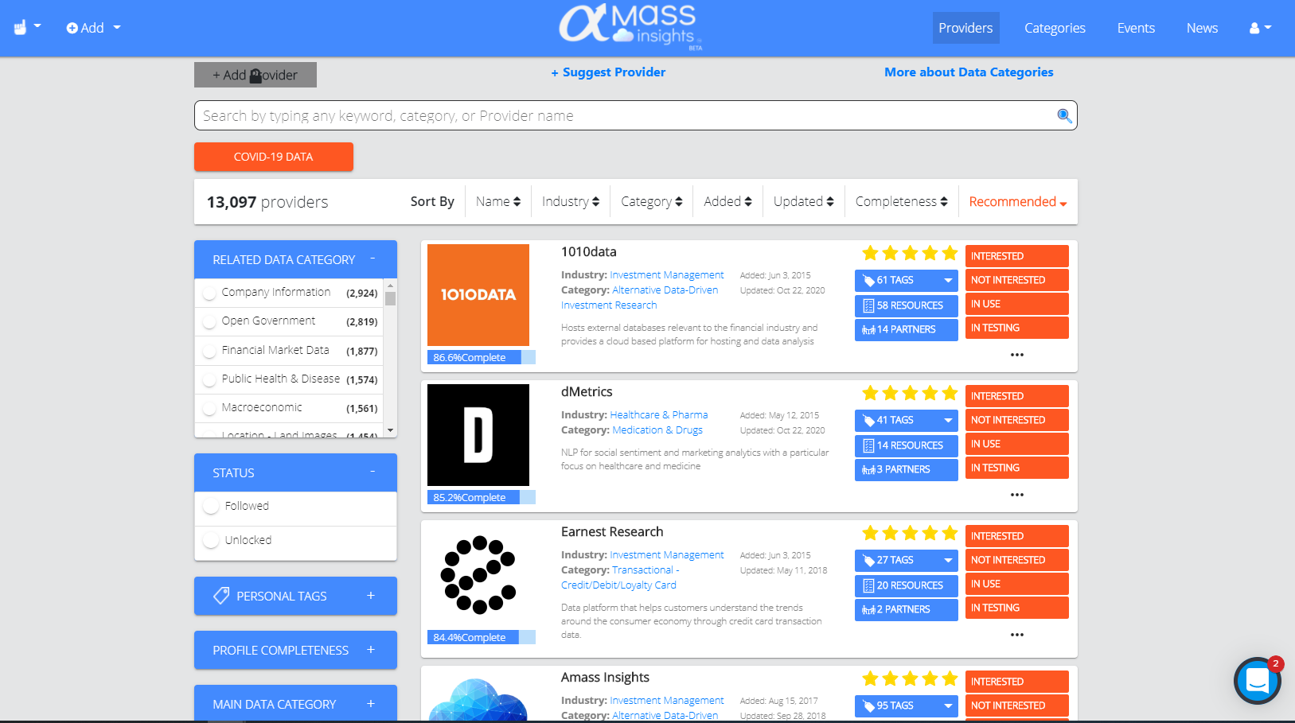




INTRODUCING INSIGHTS
Amass Insights
Everything searchable, including 1m+ tags
Over 13k 20k data provider profiles & add ~250 new per month
120+ metadata
fields captured
Confidential
Notes:
Notes:
Intro to Insights – connecting data to asset managers
>20k data providers
Adding 250+ per month
How?
Built proprietary sourcing technology to gather information via NLP & web scraping
Leveraging vast network
Self-service data profile editing
120 metadata fields captured
10’s of thousand of tag types
1+ million tags
Script:
I’d like to introduce you our web platform product called INSIGHTS, which connects the data world to the asset management world.
Here you see just one of the 4 portals in our platform, a list of Data Providers and their metadata. As of this morning, we have a little over 20k data providers on the platform and continue to increase that number by onboarding about 250-300 per month.
One might ask, how the hell are you doing this? Well, Instead of scouting for providers manually through direct relationships or events, like most companies, we gather information using proprietary NLP & Web-scraping technology along with humans in-the-loop to ensure accuracy & completeness. And we’re leveraging our vast network that we’ve built in the past decade in this space. We even allow data providers to take ownership of their own profiles and help build their business within our business.
We fill over 120 metadata fields for each data provider, choosing from tens of thousands of different types of tags. This results in over 1 million total tags that are all searchable within our platform.

Slide 7






SOLUTION: ASSET MANAGER
Amass Insights
Source Unique Datasets
Build Relationships & Pass Compliance Checks
Search & Match to Providers
Continuous Tracking
Obtain Clean Data
Confidential
Notes:
Notes:
Solutions for asset managers
Sourcing, vetting, tracking, data cleaning & analysis, vendor communications
Centralized repository of data
Insights does all this and more
Learn about providers
Matching
Data samples
Compliance & onboarding process
Script:
So, if I’m an asset manager, what does Amass’ Insights solution mean to me?
As a modern hedge fund, I’m probably dedicating countless hours and resources to sourcing, vetting, tracking, data cleaning & analysis, and back-and-forth vendor communication in the search for the hot new dataset that fits my research goals. I wish I could view a centralized repository of all the data providers that are out there, whether internal or external datasets, no matter the platform they’re on (whether its Crux, Eagle Alpha, AWS Data Exchange or Google Cloud Platform), as long as they are relevant to the capital markets.
What’s great is that Insights allows me to do all of these things and more.
1.) I can navigate to data providers of interest and learn all about them
2.) Amass can match me directly to providers using their extensive expertise or their proprietary matching solutions. Wait, and I can get this on an ongoing basis, based on my changing preferences?! Wow
3.) I can even retrieve data samples and streamline the legal hurdles in acquiring data?

Slide 8




SOLUTION: DATA PROVIDER
Amass Insights
Customize Data Profile
Promote New Data Products
Search & Match to Asset Managers
Validate &
License Data Products
Improve Tech Tooling & Data Products
Confidential
Notes:
Notes:
Solutions for data providers
Monetize our data
Competitive research
Complementary data
Insights does all this and more
Amass built me a data profile
Inbound matches
Efficient trialling & onboarding
Standardized legal templates
Create derivative products
Script:
As a growing technology company, what does Amass’ Insights solution mean to me?
I am probably sitting on a lot of data and would like to know how much a hedge funds would be willing to pay for it.
I’d like to know more about what my competitors are offering and whether my data products match up to theirs. I’d like to find complementary data that I can layer in with mine to improve my offerings.
What’s great about Insights is that they’ve already built a partial data profile for us and now I can quickly login, customize it, and upload more details. Alternatively, I can allow Amass’ experts to do this on my behalf.
Once my profile is fully built, asset managers constantly reach out to me, eventually leading to more trial agreements and sometimes sales.
Amass is even helping us streamline our trial and license process by leveraging their preexisting relationships and extensive library of legal templates.
And now we’ve started to leverage Amass’ 3rd party data tools to create derivative analytical products in order to offer our products to a wider group of data consumers.

Slide 9
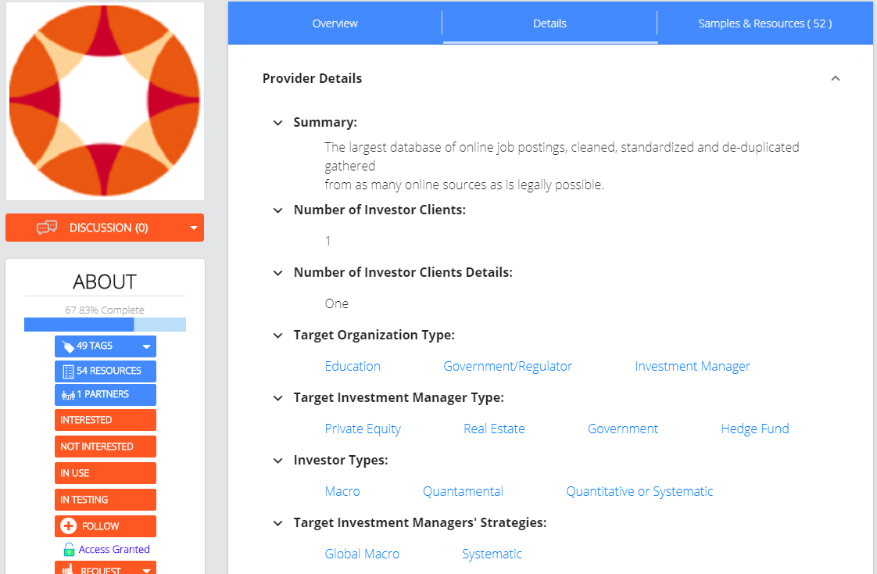
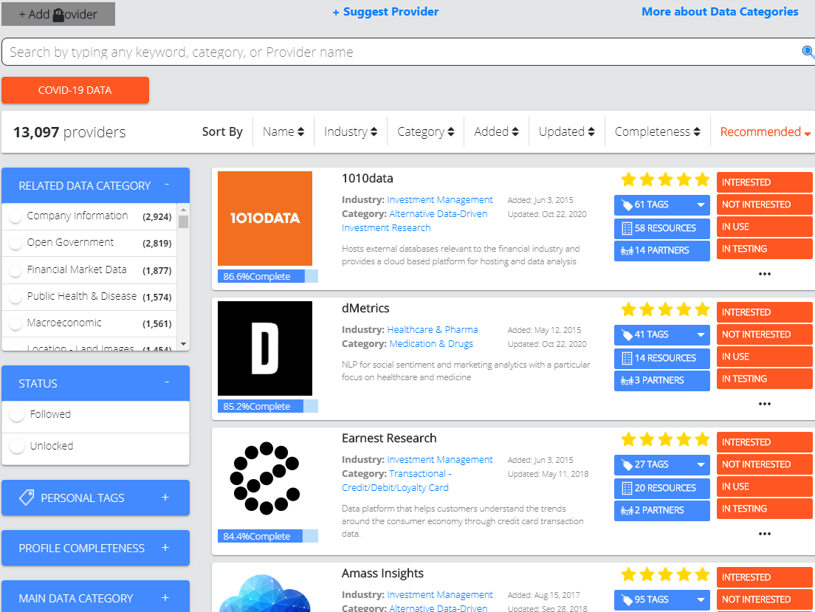
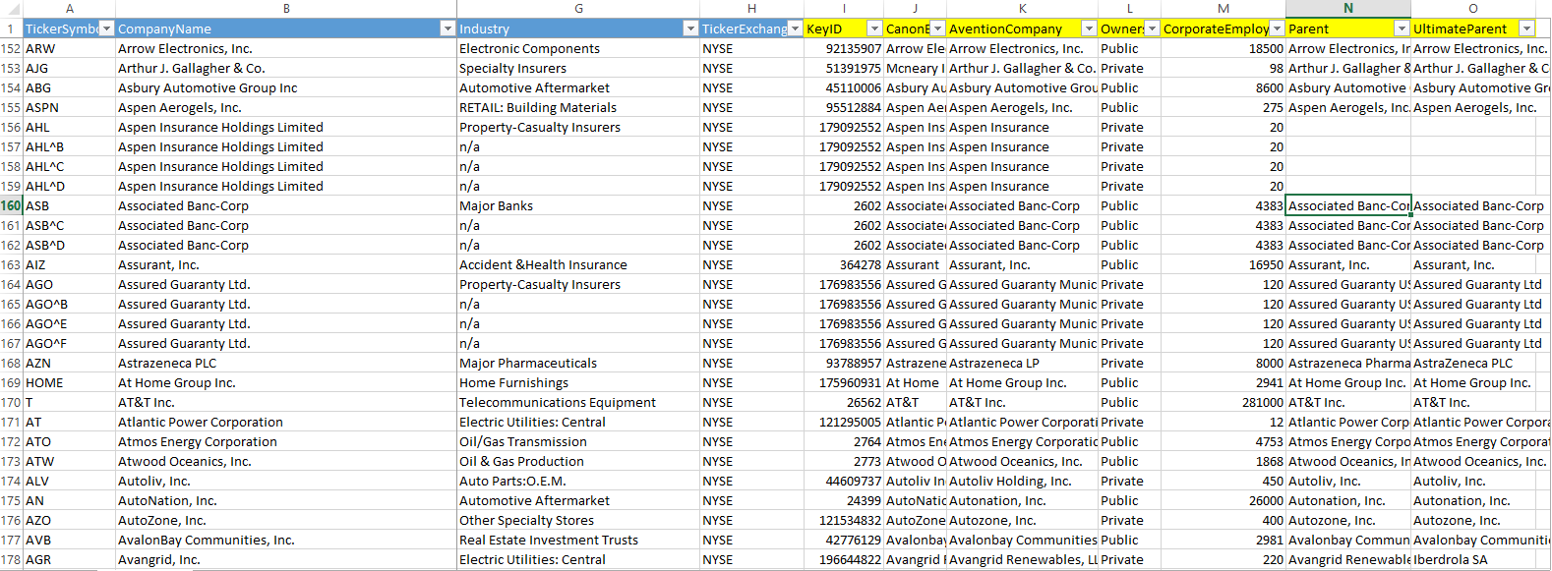
ADDITIONAL INSIGHTS
Amass Insights
View Full Data Profile
Browse, Search, Filter, Sort
View Data Samples & Dictionaries
Confidential
Notes:
Notes:
Data Providers Page
quick searching, filtering and sorting
Robust taxonomy
Data Provider’s Profile Page – every detail about a provider
Overview
Product Details
Data Partners & Sources
Geographies
Asset Classes
Historical Data
Our Scoring
Trails & Pricing
Resources
Data Dictionaries
Data Samples
Yelp for data
Script:
Here you’ll see some more screenshots of Insights. You already saw on the left on a previous slide the Providers Page where you can search, browse, filter and sort quickly – we have a robust, comprehensive taxonomy which allows you to quickly navigate to the profiles that pertain most to what you’re looking for.
In the middle you can see our Data Profile Page, which describes in detail every aspect of a data provider’s offerings in more depth than any other platform in the market. It includes an overview of the company, news & product highlights, the provider’s upstream or downstream data partners, underlying data sources, the geographies or asset classes their data is relevant to, the amount of historical data offered, and much more… We even add our own impressions about the positioning of this provider’s products in relation to their competitors, as well as the commercials for obtaining a trial or production license. And lastly, on the right, you can view additional resources and documentation, such as data dictionaries and data samples/snapshots.
Think of this catalog like Yelp, where instead of hunting for delicious food, you’re searching for tasty data.

Slide 10
DIFFERENTIATORS
Amass Insights
Largest catalog of data providers
Meticulously detailed, proprietary taxonomy
Unbiased approach
Vast network of relationships throughout the buy-side and technology industries
Flexible, multi-faceted business models including
self-service products & managed services
Confidential
Notes:
Notes:
20,525 providers, bigger by an order of magnitude
Complex metadata
Don’t favor a provider because of a prior relationship with them
Vast network
Business models that suit any flavor of data provider or data consumer
Tech-first
Script:
You may be asking yourself; I know of some other catalogs out there, how is Amass Insights different?
20,525 providers profiled, bigger than our competition by an order of magnitude
Our metadata is painstakingly detailed and complex, allowing us to detail every aspect of a provider’s offerings
We don’t favor any provider based on our prior relationships. If the data is the right fit, we match you.
We’ve been in the data and capital market industry for quite a while and have built a vast network of relationships with the right decision makers.
We’re open to working with data providers and data consumers in a number of different forms and fashions and finding the right model to create a win-win for all parties.

Slide 11
DATA MARKET NETWORK
Amass Insights
DATA PROVIDERS
Investment Research
Transactional
Web Scrapers
Satellite Imagery
AI + NLP Tech
Wifi + Mobile Networks
IoT
DATA CONSUMERS
  Hedge Funds
  Asset Managers
  Private Equity
  VC
Government
Retailers
Universities
DATA TOOLS
Consultants
Data Cleaning
Research Firms
Backtesting Tools
Analytical Tools
Current Platform
Future Platform
Confidential
Notes:
Notes:
How we view the data world
Information suppliers
>20k we’ve identified
Information consumers
Catering to the investment management industry
most pressing need for data
will expand to other industries
Data Tools
Not yet launched
Improve the value of the data
Facilitate interactions and transactions
Inefficiencies w/o Amass
Price gouging
Backtesting worthless data
Improve transparency
Increase the flow of data & the flow of money
Script:
How do we envision the data world? We see three distinct groups that continually need to interact and transact.
There are the Information Suppliers or “data providers” as we call them in our platform. We’ve currently identified over 20k of these.
There are the Information Consumers who are seeking to improve their businesses by better utilizing information. Currently, we are solely catering to the Investment Management space, a highly specialized market with a deep need for data and a high velocity of money. LONG-TERM: We'll expand into other market segments deliberately, leveraging 3rd party data tools & partners to disseminate our offerings more widely in different industries.
That brings up to the third group, which we have not yet launched: data tools, such as software/BI products, data experts, or any other avenue that can be used to improve the value of this data, whether that’s through subject matter expertise, deeper analysis or research.
Our goal is to facilitate as many interactions and transactions as possible between all three of these groups. Before Amass, this process has been very opaque leading to significant inefficiencies. For example, datasets with cheaper direct replacements may be sold for a price that’s a factor of 10 higher than it should be, just due to a buyer not understanding their options. Or a hedge fund analyst may spend an inordinate amount of time analyzing a messy, commoditized dataset before realizing there’s no additional alpha to be gleaned from it. We’re increasing the transparency in this industry, making business interactions more efficient and increasing the flow of data & the flow of money between all parties.

Slide 12
THANK YOU!
Jordan Hauer, CEO & Co-Founder
Sign Up For Insights
jordan@amassinsights.com
(646) 770-2791
Notes:
Notes:
Thanks to Bill and S3 Partners
Data providers & asset managers, sign up and we’ll grant access
Reminder to come speak with me afterwards or at the roundtable
Script:
That’s it! Thanks for your time.
Remember, If you’re a data provider or asset manager, sign up on our website. We’ll immediately grant you access to valuable Insights. Otherwise, feel free to reach out and I’d love to connect and talk about anything DATA!
Cheers!
(Smile and wave)

