Slide 1
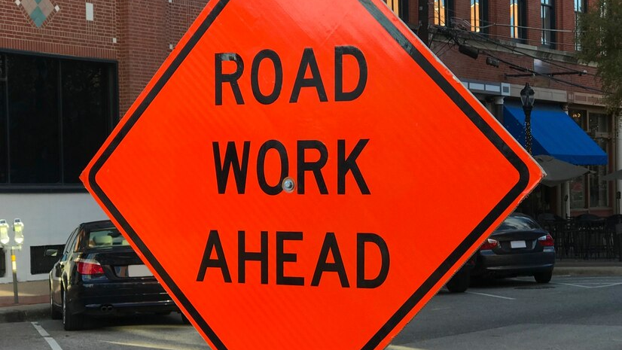
WELCOME
PLEASE BE SEATED
The meeting will start soon.

Slide 2
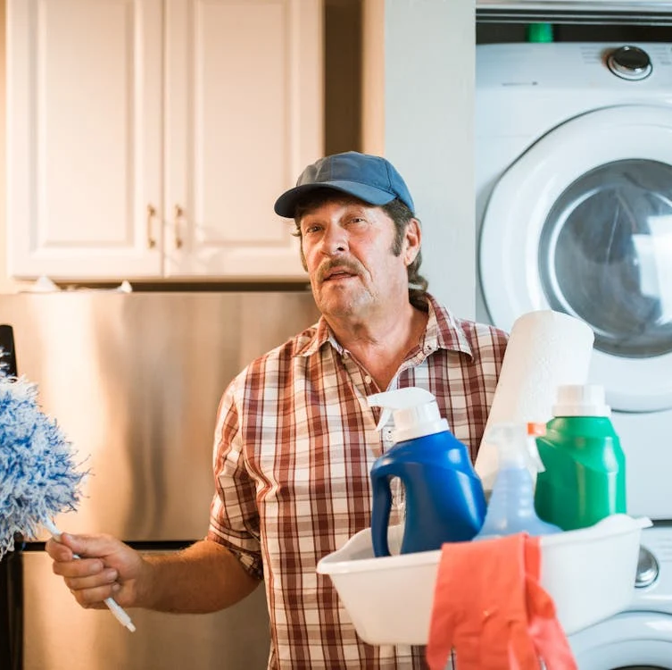
Welcome to the Cherokee Rd Traffic Safety Improvements Discussion
HOUSE KEEPING ITEMS & INTROS
City of Richmond - Project Manager - Jerry Allen, PMP
We will be respectful (language, volume level, raise hand)
Exits
Restroom
Time – Presentation, then break to view boards and discuss, close around 7pm, and submit meeting feedback.
Timmons Group, Inc. – Design Engineer - Chris Kiefer, PE, Assoc. DBIA
Council President Introduction - The Honorable Kristen M. Nye
Liaison Timmy Siverd - Timmy.Siverd@rva.gov

Slide 3
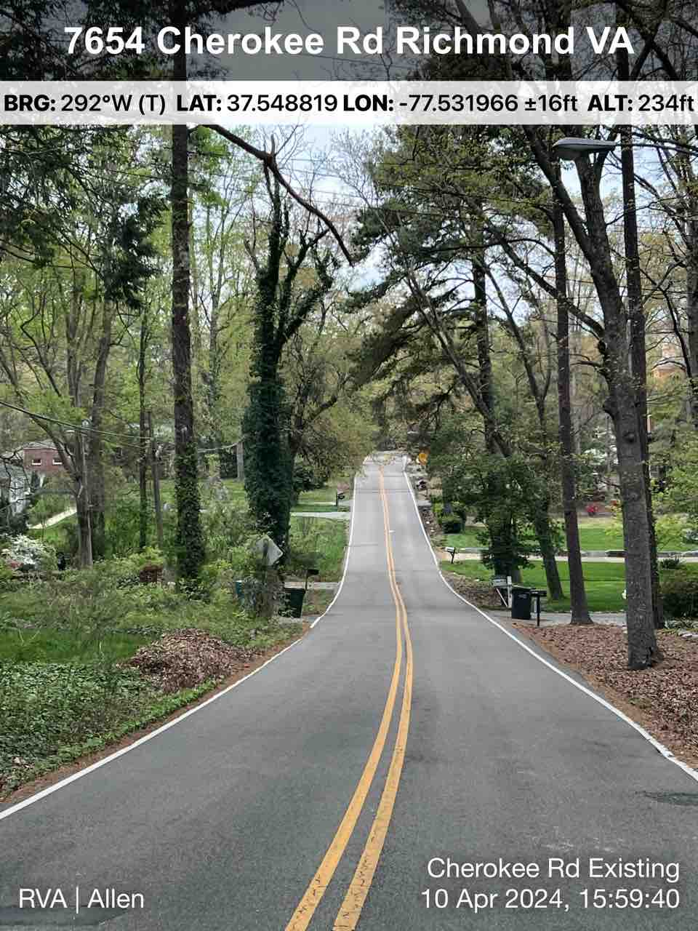


Traffic Safety Improvements Cherokee Rd. (Forest Hill Ave to N. Huguenot Rd.)

Slide 4
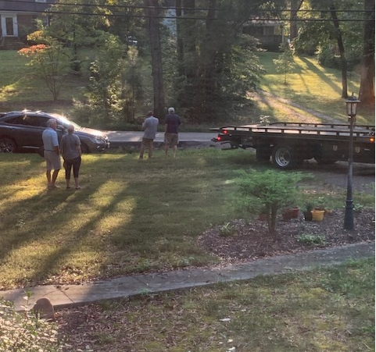
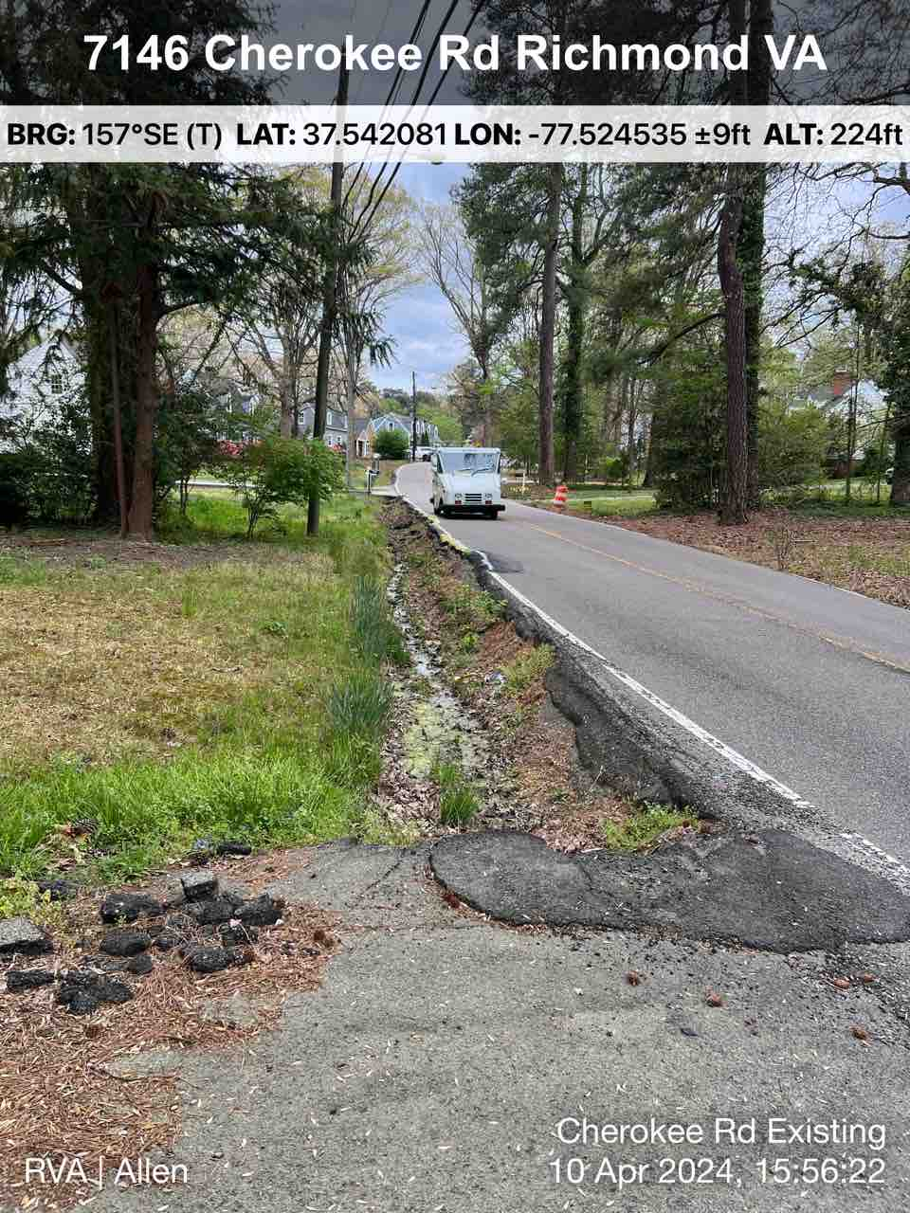
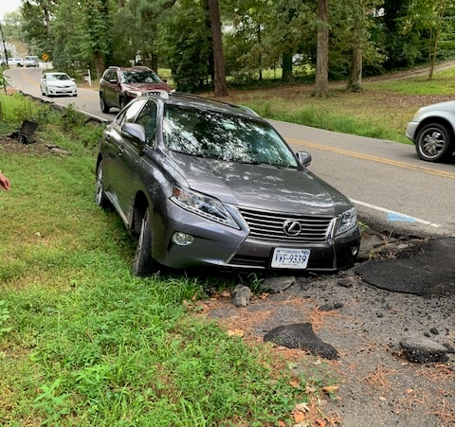
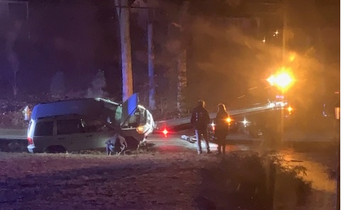
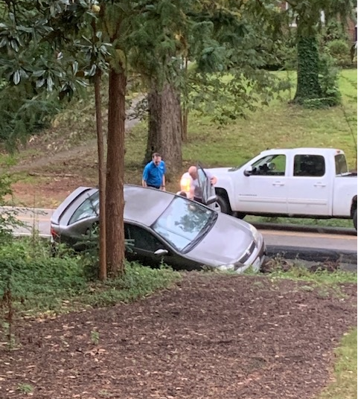
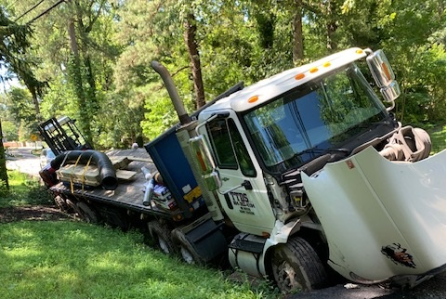
VDOT Crash Data January 2016 to July 2024

Slide 5
Brass Tacks: Identify the Project & Agenda
The intent of this project is to provide a safer street for drivers, pedestrians, and cyclist while limiting the impact to residents as much as possible.
There will be an impact (the give); money, construction, right-of-way needs.
There will be a benefit (the take); safer road for residents and through-drivers, safer for pedestrians, less vehicle damage, more time for residents to take care of personal matters instead of pulling a car out of a ditch, and subjectively more aesthetically pleasing.
To share the four options currently being considered
To gather input and suggestions from the public
Collect opinions and comments on the four options

Slide 6
THE FOUR OPTIONS
Option 1
Two 10’ travel lanes with 4’ shoulder on both sides
Option 2
Two 10’ travel lanes with 4’ shoulder on both sides, 5’ sidewalk on one side behind the ditch. (Photo comparison provided)
Option 3
Two 10’ travel lanes with 4’ shoulder on one side and an 8’ multi-use shoulder on the other side with ditches relocated.
Option 4
Curb and gutter on both sides (24’ F/C to F/C) and a 5’ sidewalk on one side. (Photo comparison provided)

Slide 7
Things to consider…
Pedestrian safety – visibility, away from moving vehicles, ADA/PROWAG, lighting at crossings, etc.
Motorist safety – speed, curves, headlights in sags and curves, etc.
Equitable access for pedestrians and cyclist
Crash data – runoffs and deaths
Current integrity of roadway – collapsing at “shoulders”
Drainage – sufficient for increased rainfall?
Lighting in crest and sags
Right-of-way impact
Costs
You tell us…

Slide 8
Timmons Group, Inc Presents
Principal – Transportation Design Group Leader
Chris Kiefer, PE, Assoc. DBIA
Website: www.timmons.com
An efficient and high-quality design consultant who has been in the business for many years and has a great relationship with their stakeholders in the community.

Slide 9
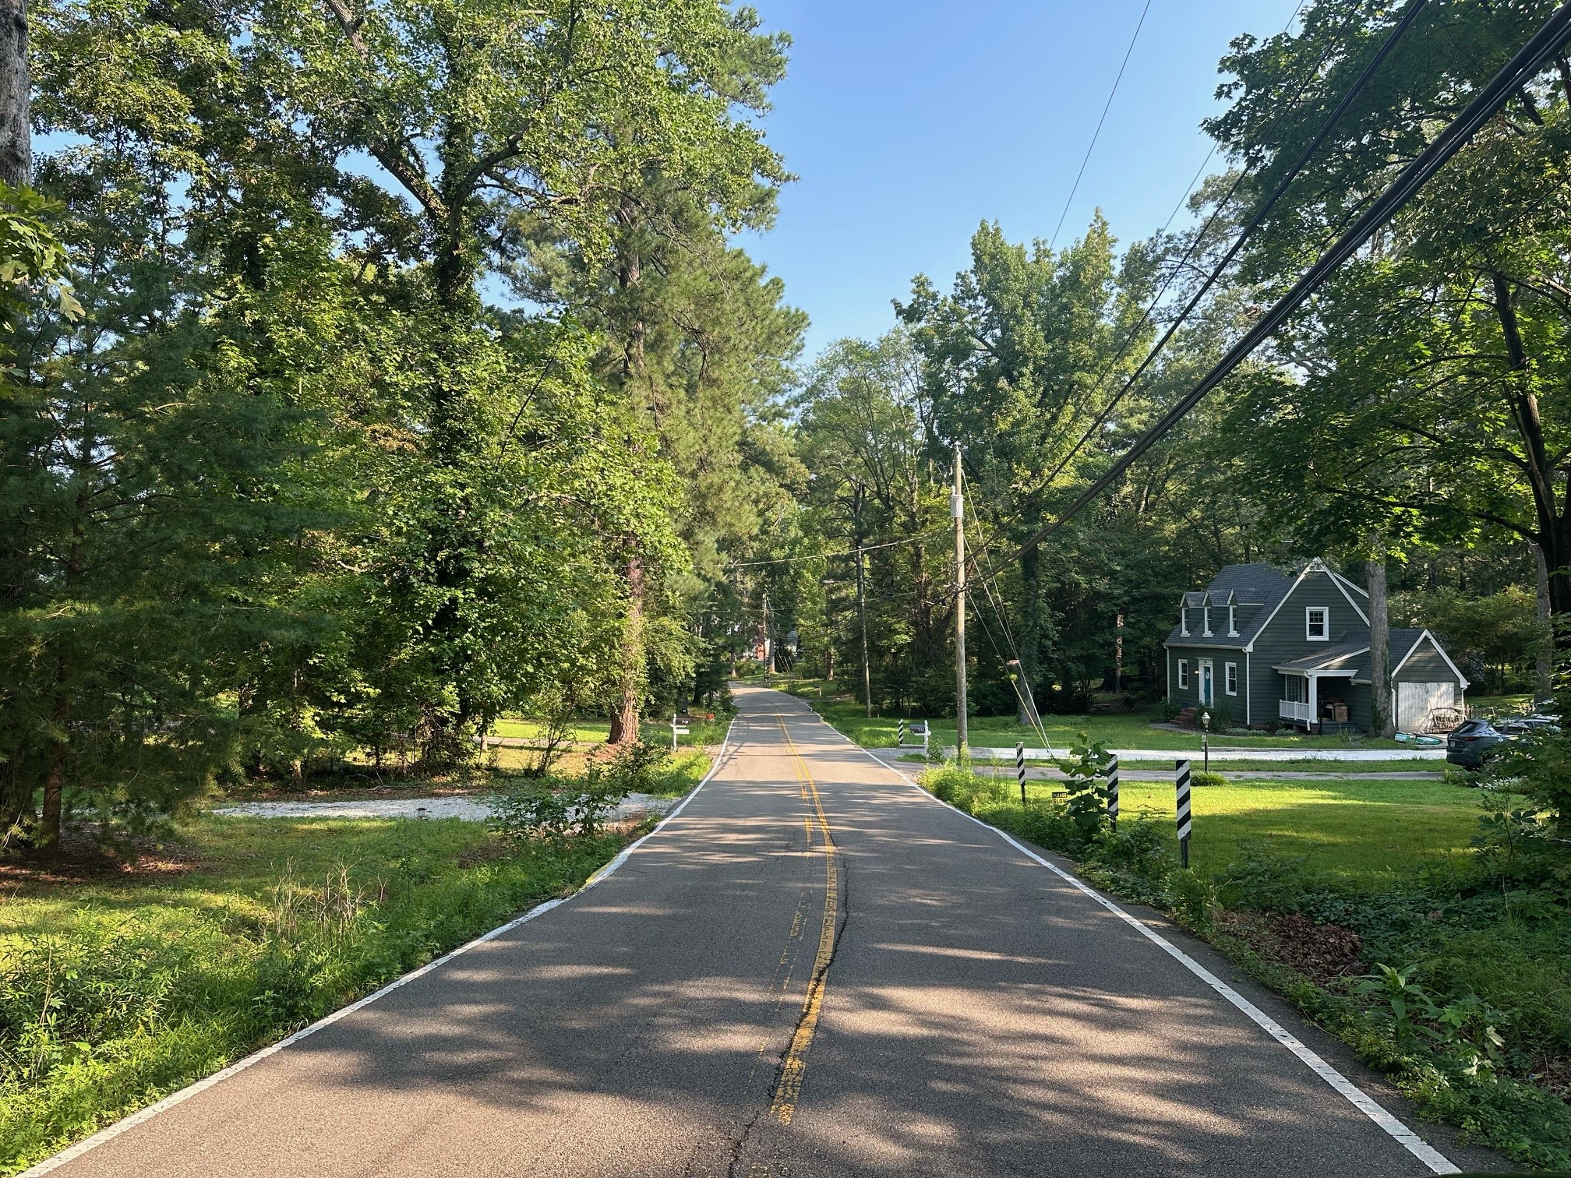
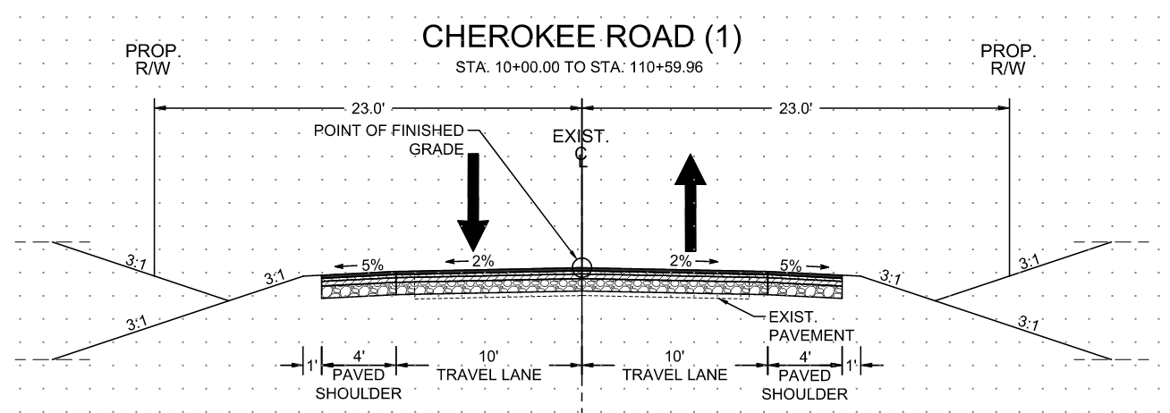
Option 1 Comparison - Improvements
Existing Condition
Option 1 Condition

Slide 10
Option 1 Estimated Costs per Phase
Total Costs $9,950,000
Preliminary Engineering (Design) $1,040,000
Right-of-Way $2,970,000
Construction $5,940,000

Slide 11
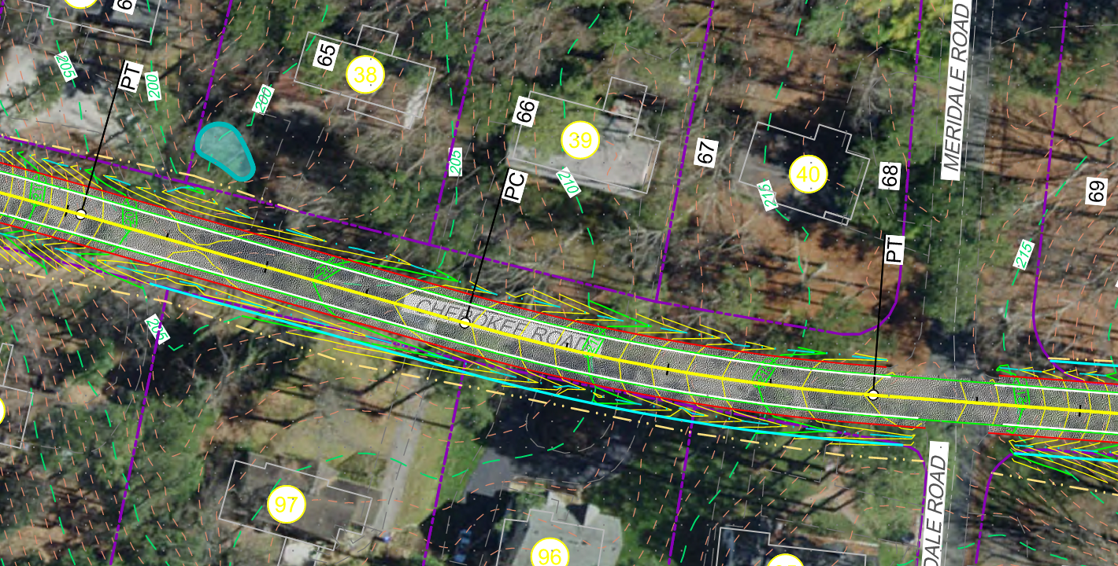
Option 1 Right-of-Way: Potential Impacts

Slide 12
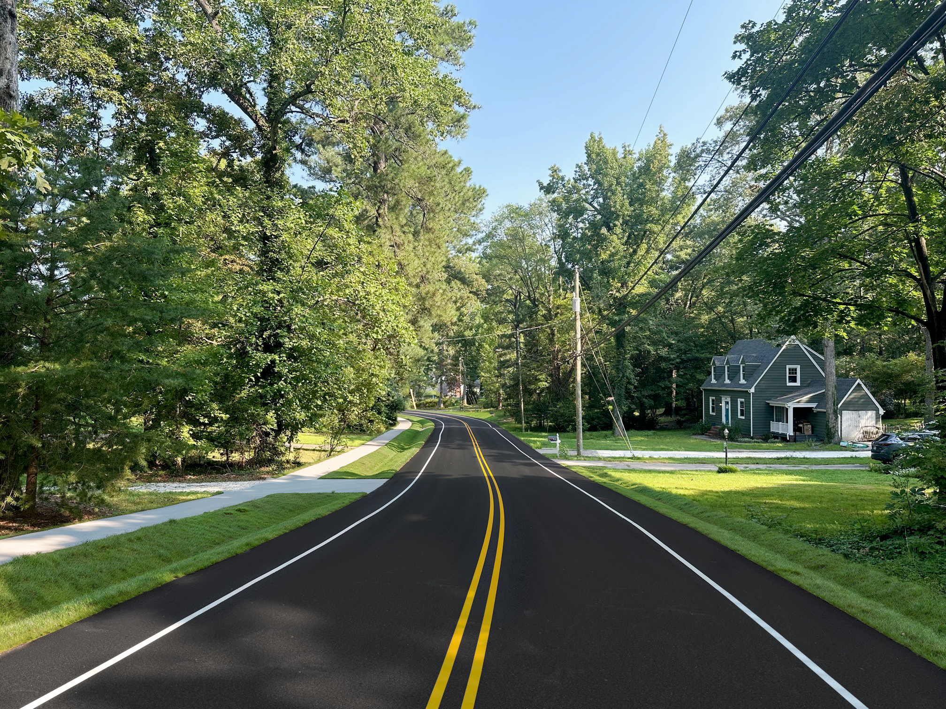
Option 2 Comparison - Improvements
Existing Condition
Option 2 Condition

Slide 13
Option 2 Estimated Costs per Phase
Total Costs $13,370,000
Preliminary Engineering (Design) $1,360,000
Right-of-Way $4,260,000
Construction $7,750,000

Slide 14
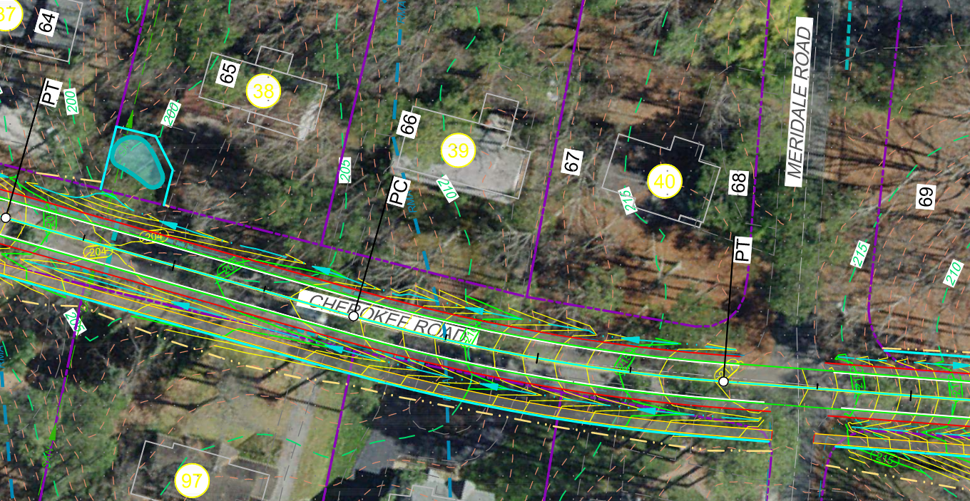
Option 2 Right-of-Way: Potential Impacts

Slide 15
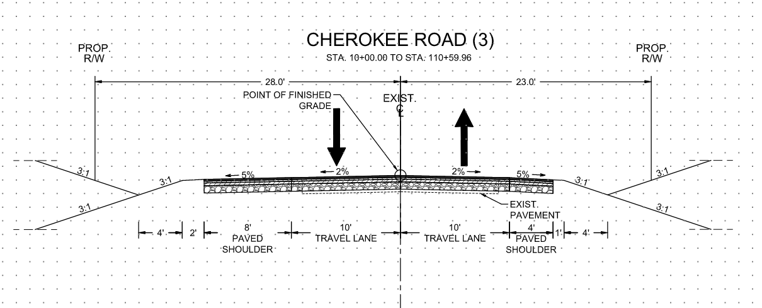
Option 3 Comparison - Improvements
Existing Condition
Option 3 Condition

Slide 16
Option 3 Estimated Costs per Phase
Total Costs $11,820,000
Preliminary Engineering (Design) $1,200,000
Right-of-Way $3,770,000
Construction $6,850,000

Slide 17
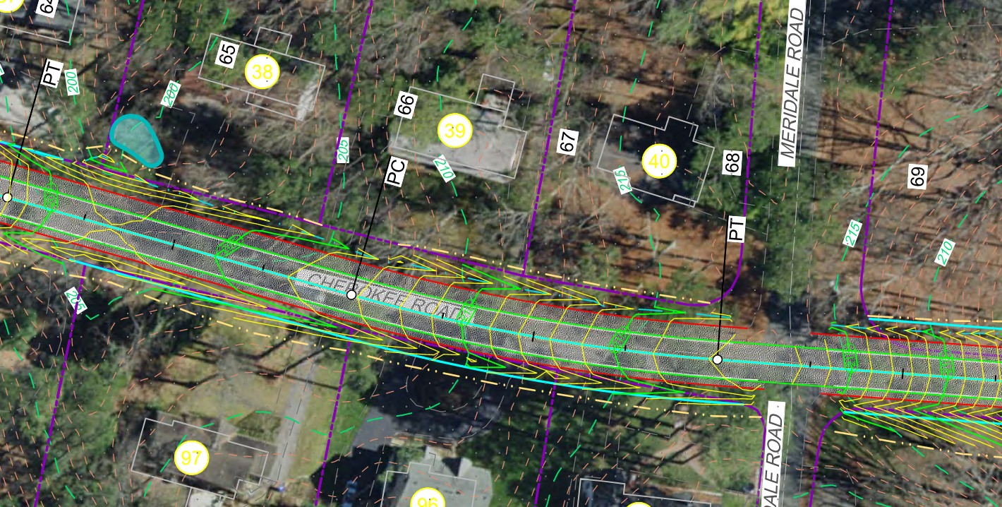
Option 3 Right-of-Way: Potential Impacts

Slide 18
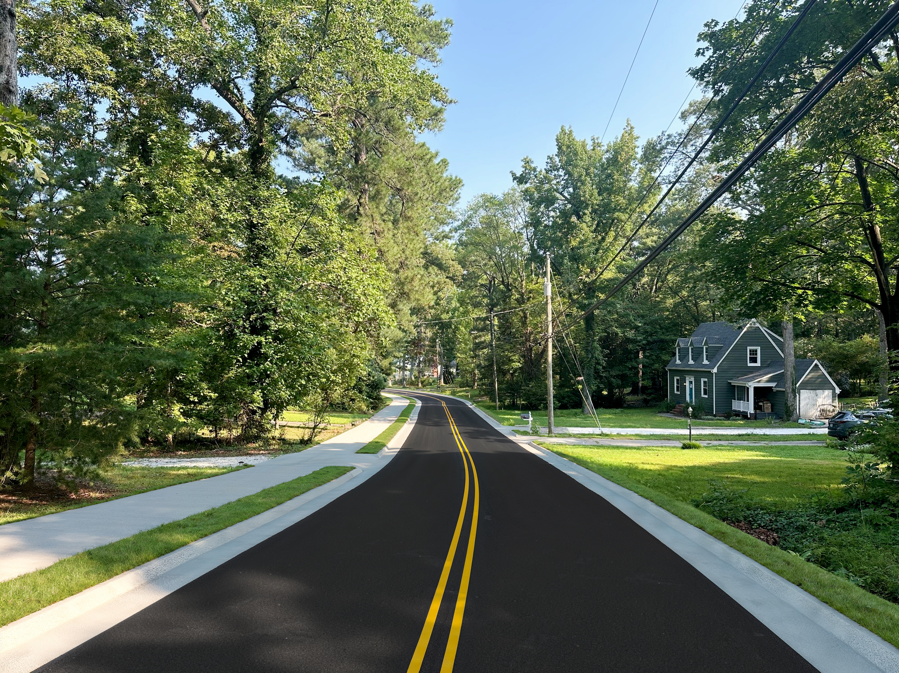
Option 4 Comparison - Improvements
Existing Condition
Option 4 Condition

Slide 19
Option 4 Estimated Costs per Phase
Total Costs $18,450,000
Preliminary Engineering (Design) $2,780,000
Right-of-Way $3,010,000
Construction $12,660,000

Slide 20
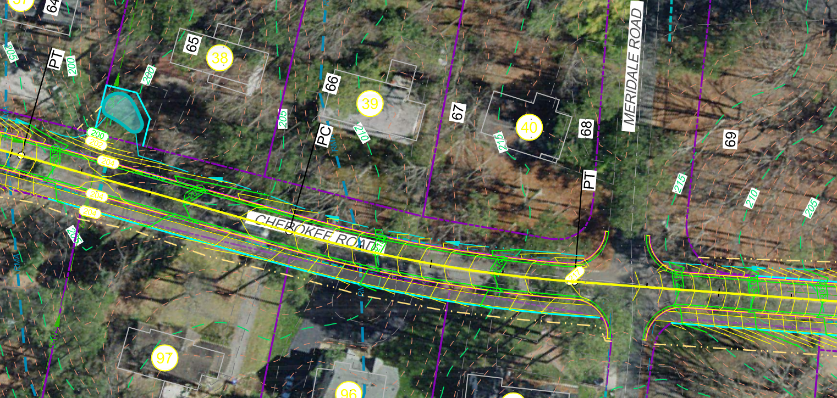
Option 4 Right-of-Way: Potential Impacts

Slide 21
There are TWO Surveys Now-and-Later
1 (now)
Survey ONE pertains to feedback for this meeting only.
Please submit feedback for this meeting via the QR Code on the brochure or utilize a hard copy Comment Sheet (available upon request) to be mailed to City Hall.
2 (later)
Survey TWO will involve selection of a design option and will be mailed out to each property and be addressed to the owner.
Survey results will be due in by October 25, 2024.
The City will take this feedback into consideration when selecting a design option.

Slide 22
Before we break… QUESTIONS for the group?

Slide 23
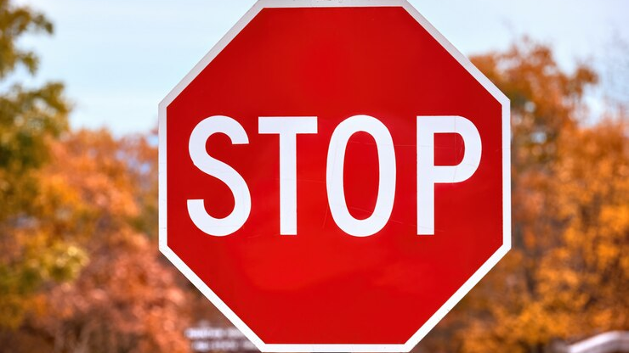
Thank you for viewing this presentation. Please stay, review displays, and meet with staff.

