Slide 1
Rebar Modeling in Revit:
Can You Model All Reinforcement?
Håvard Vasshaug
Dark

Slide 2
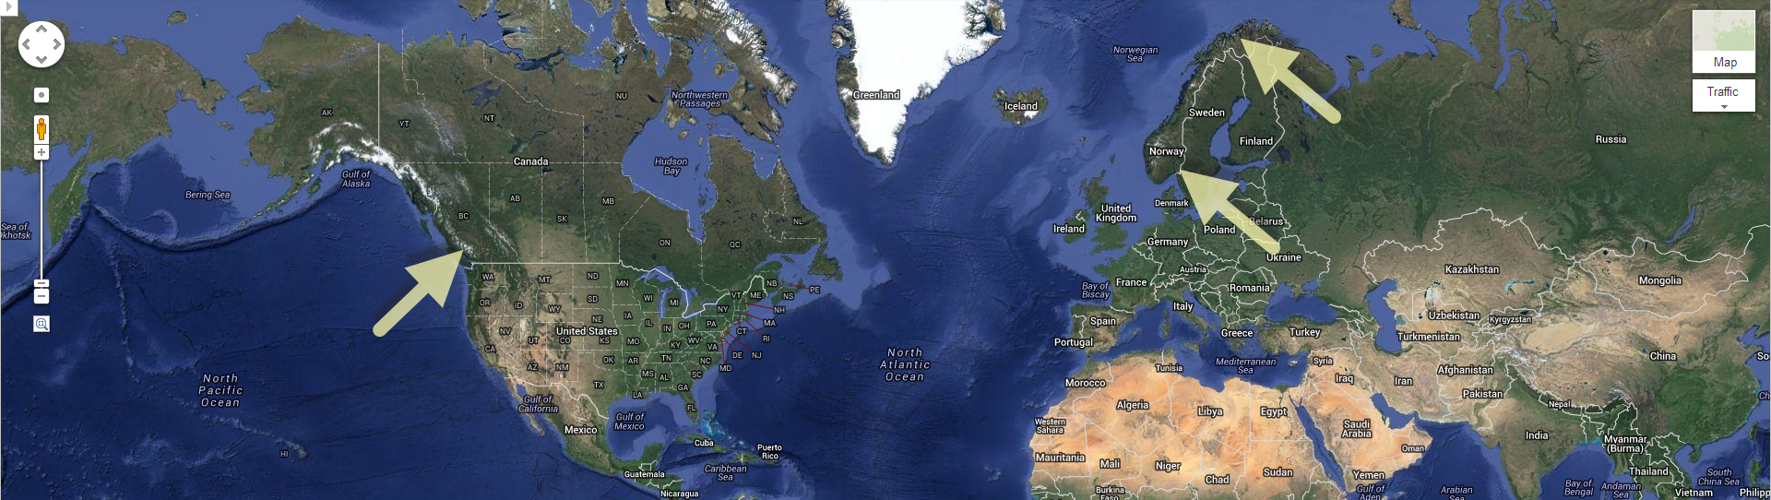

Slide 3
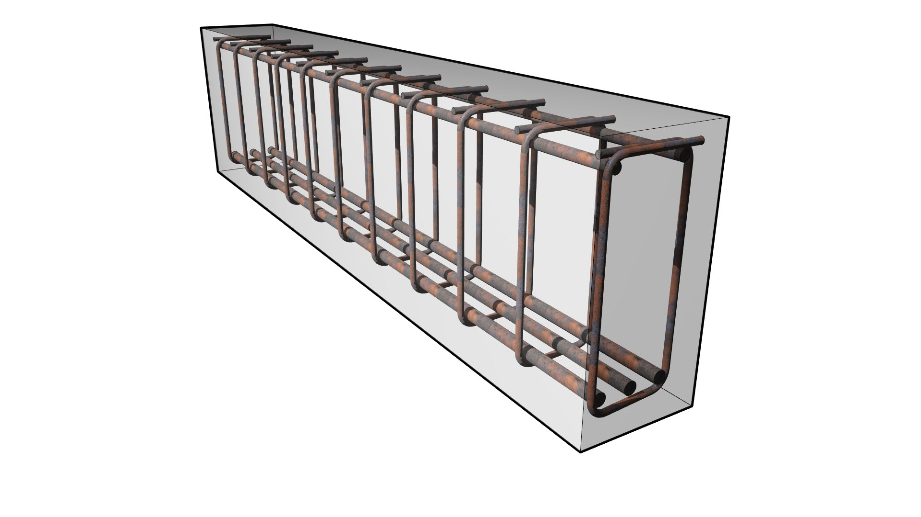
Design
Construction

Slide 4
Difficult

Slide 5
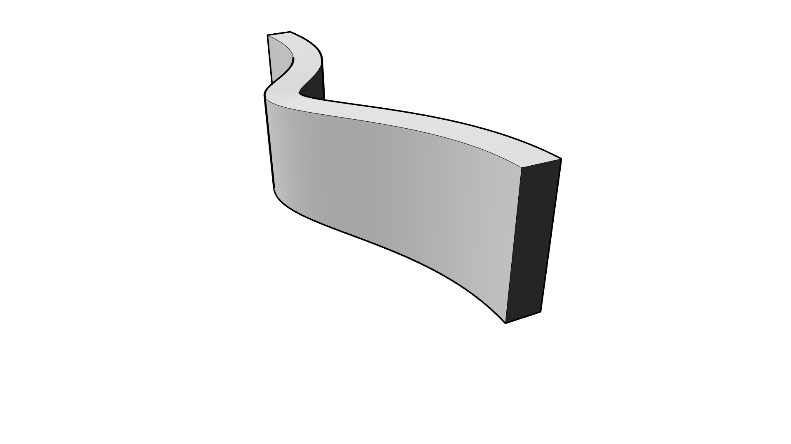
Difficult
Tapered

Slide 6
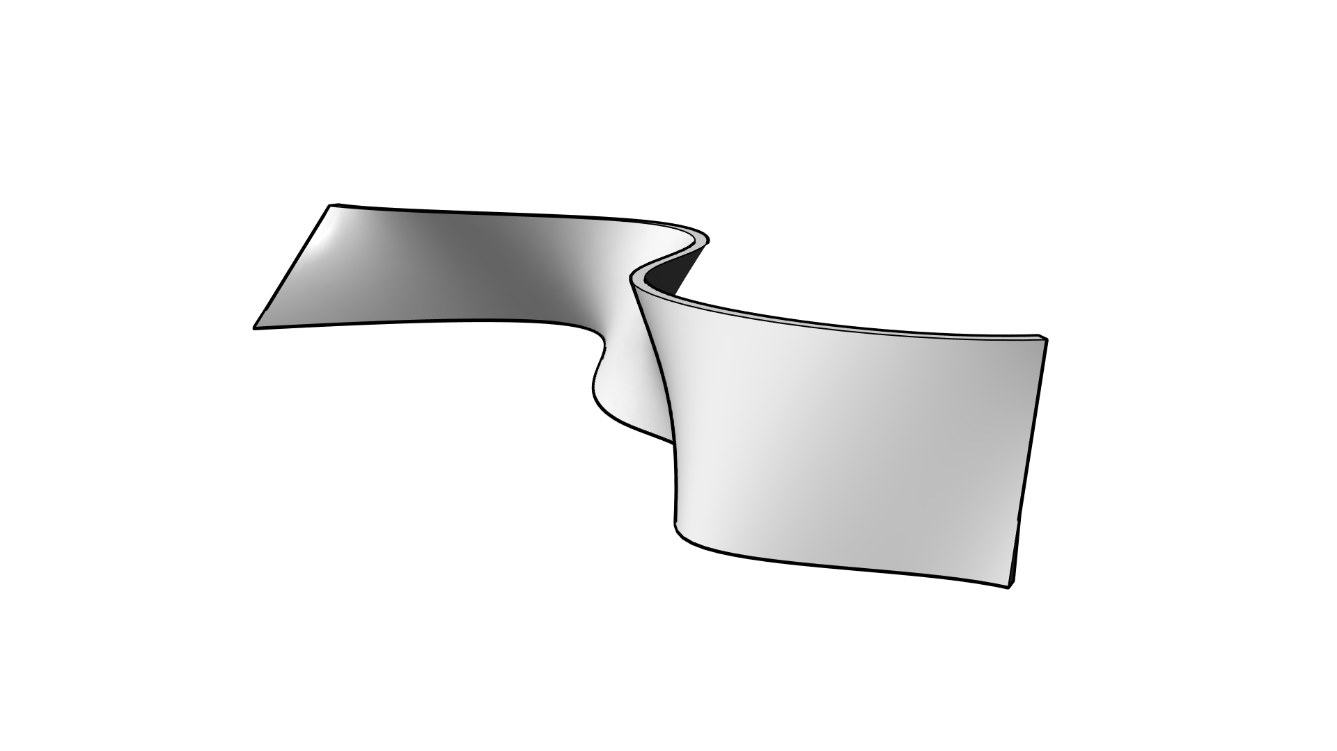
Difficult
Tapered
Curved

Slide 7
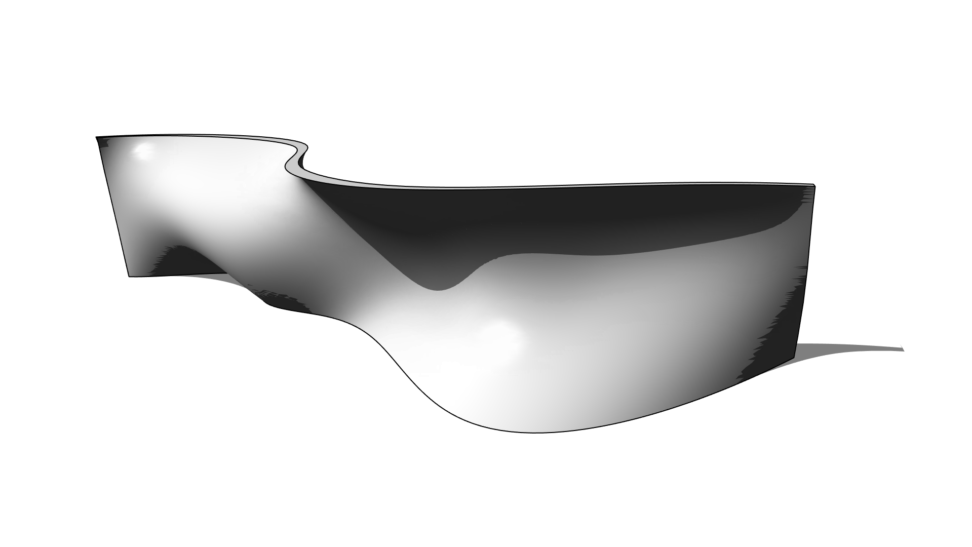
Difficult
Tapered
Curved
Double-curved

Slide 8
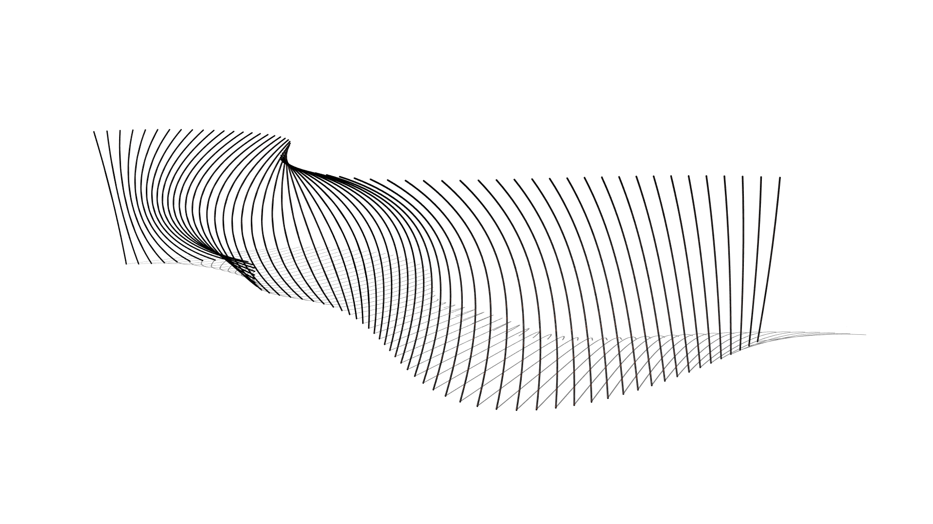
Difficult
Tapered
Curved
Double-curved

Slide 9
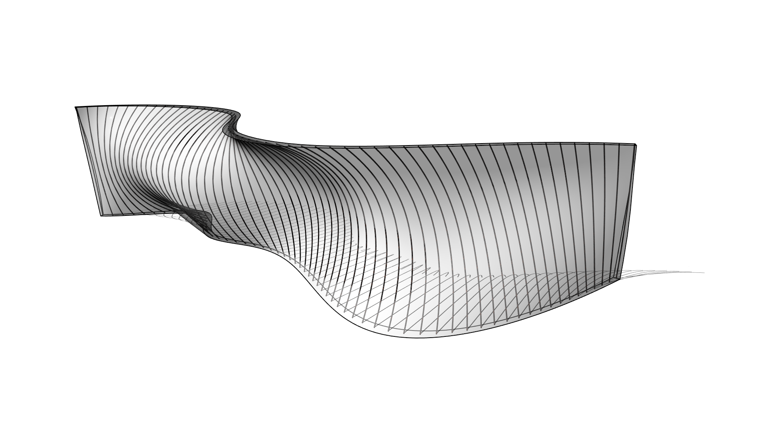
Difficult
Tapered
Curved
Double-curved

Slide 10
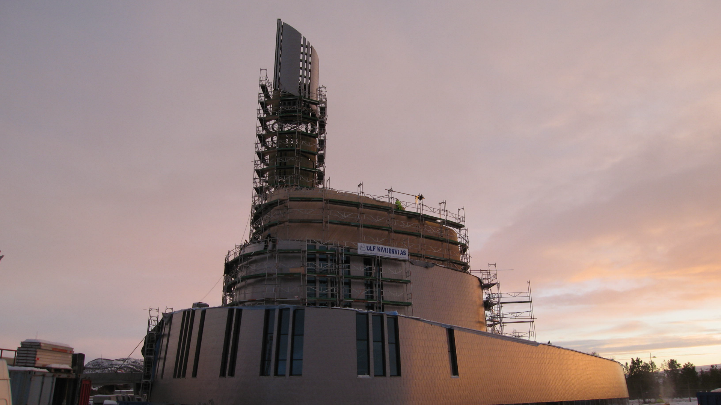
Difficult
Tapered
Curved
Double-curved

Slide 11

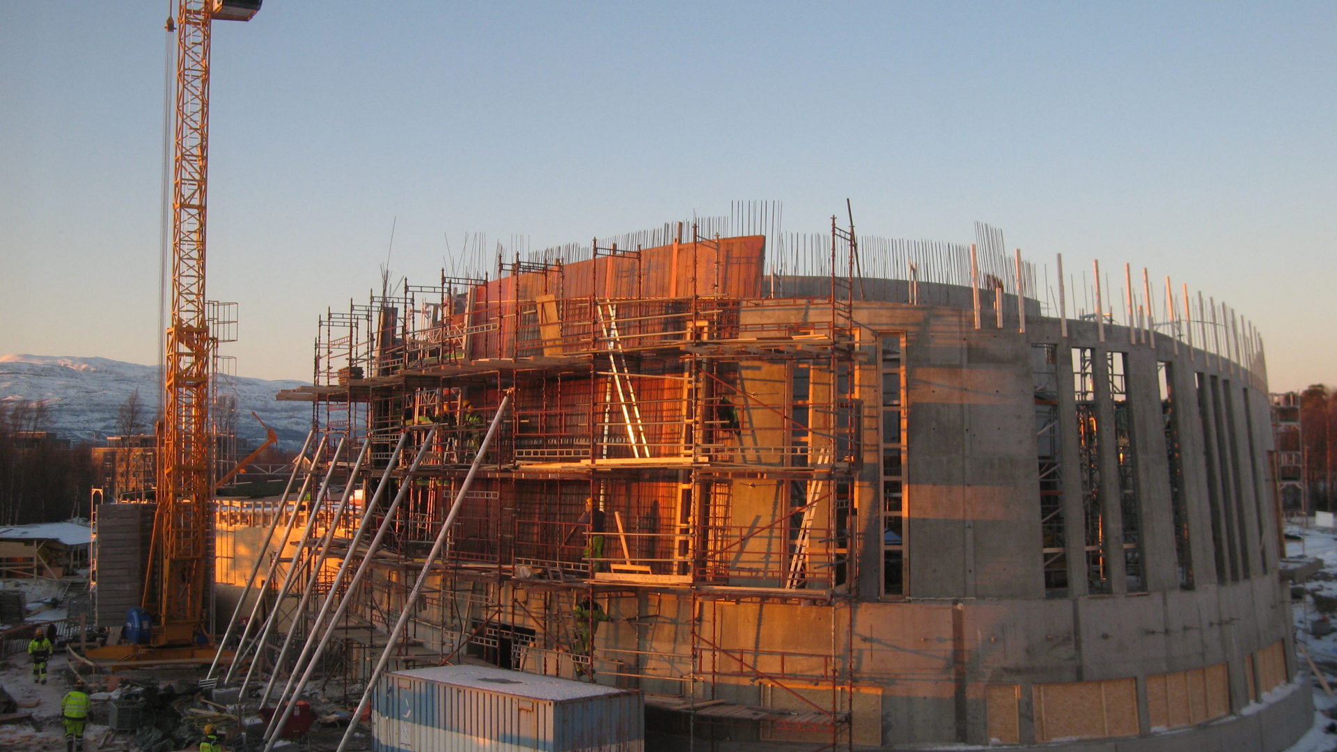
Difficult
Tapered
Curved
Double-curved

Slide 12
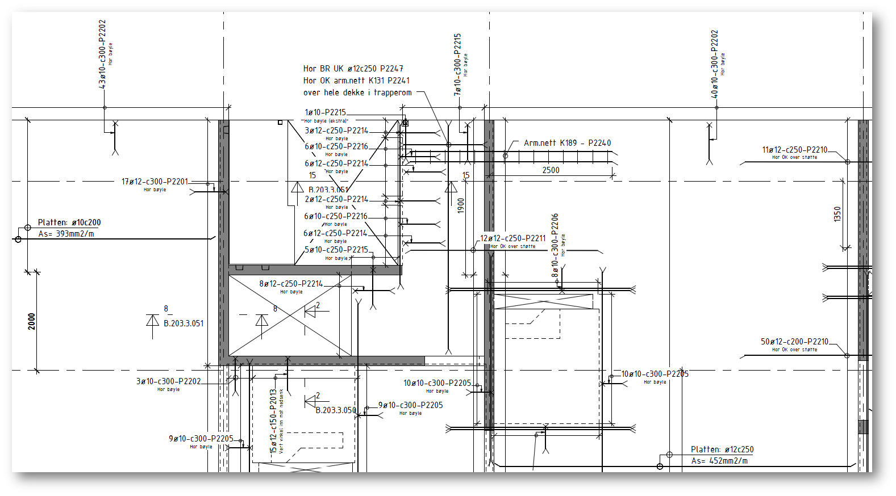
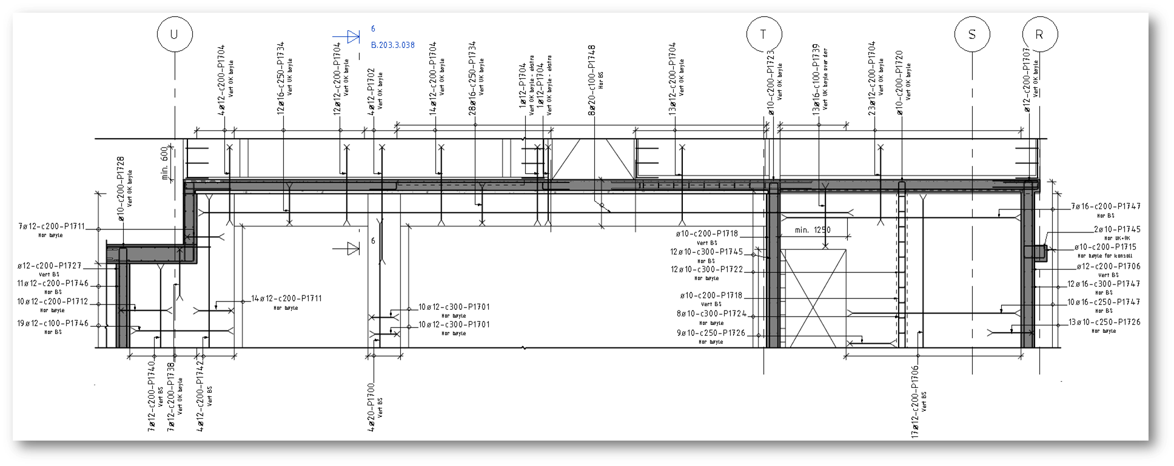
Difficult
Plans
Elevations

Slide 13
Easy

Slide 14
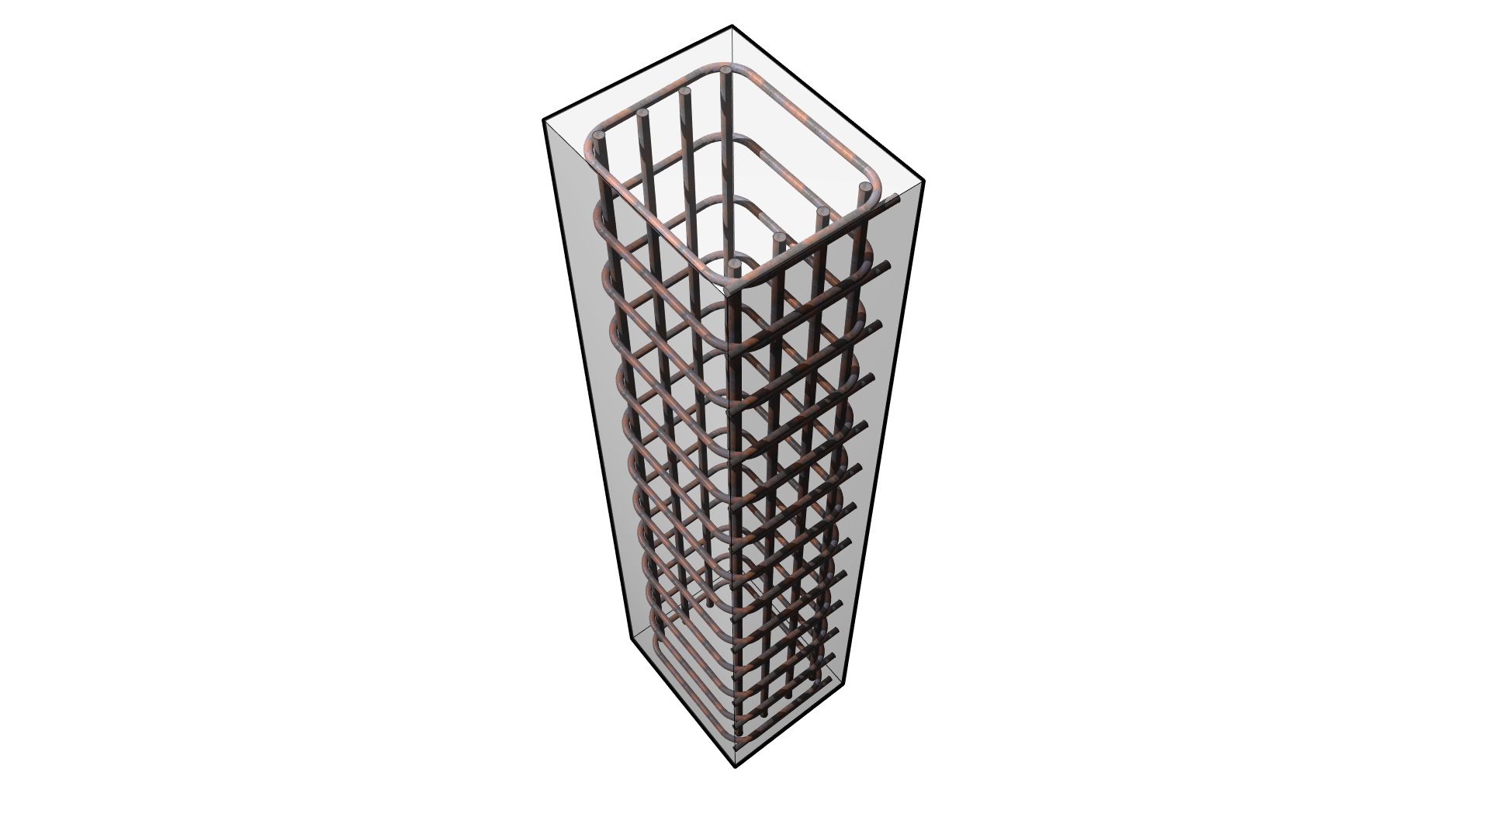
Easy
Rebar

Slide 15
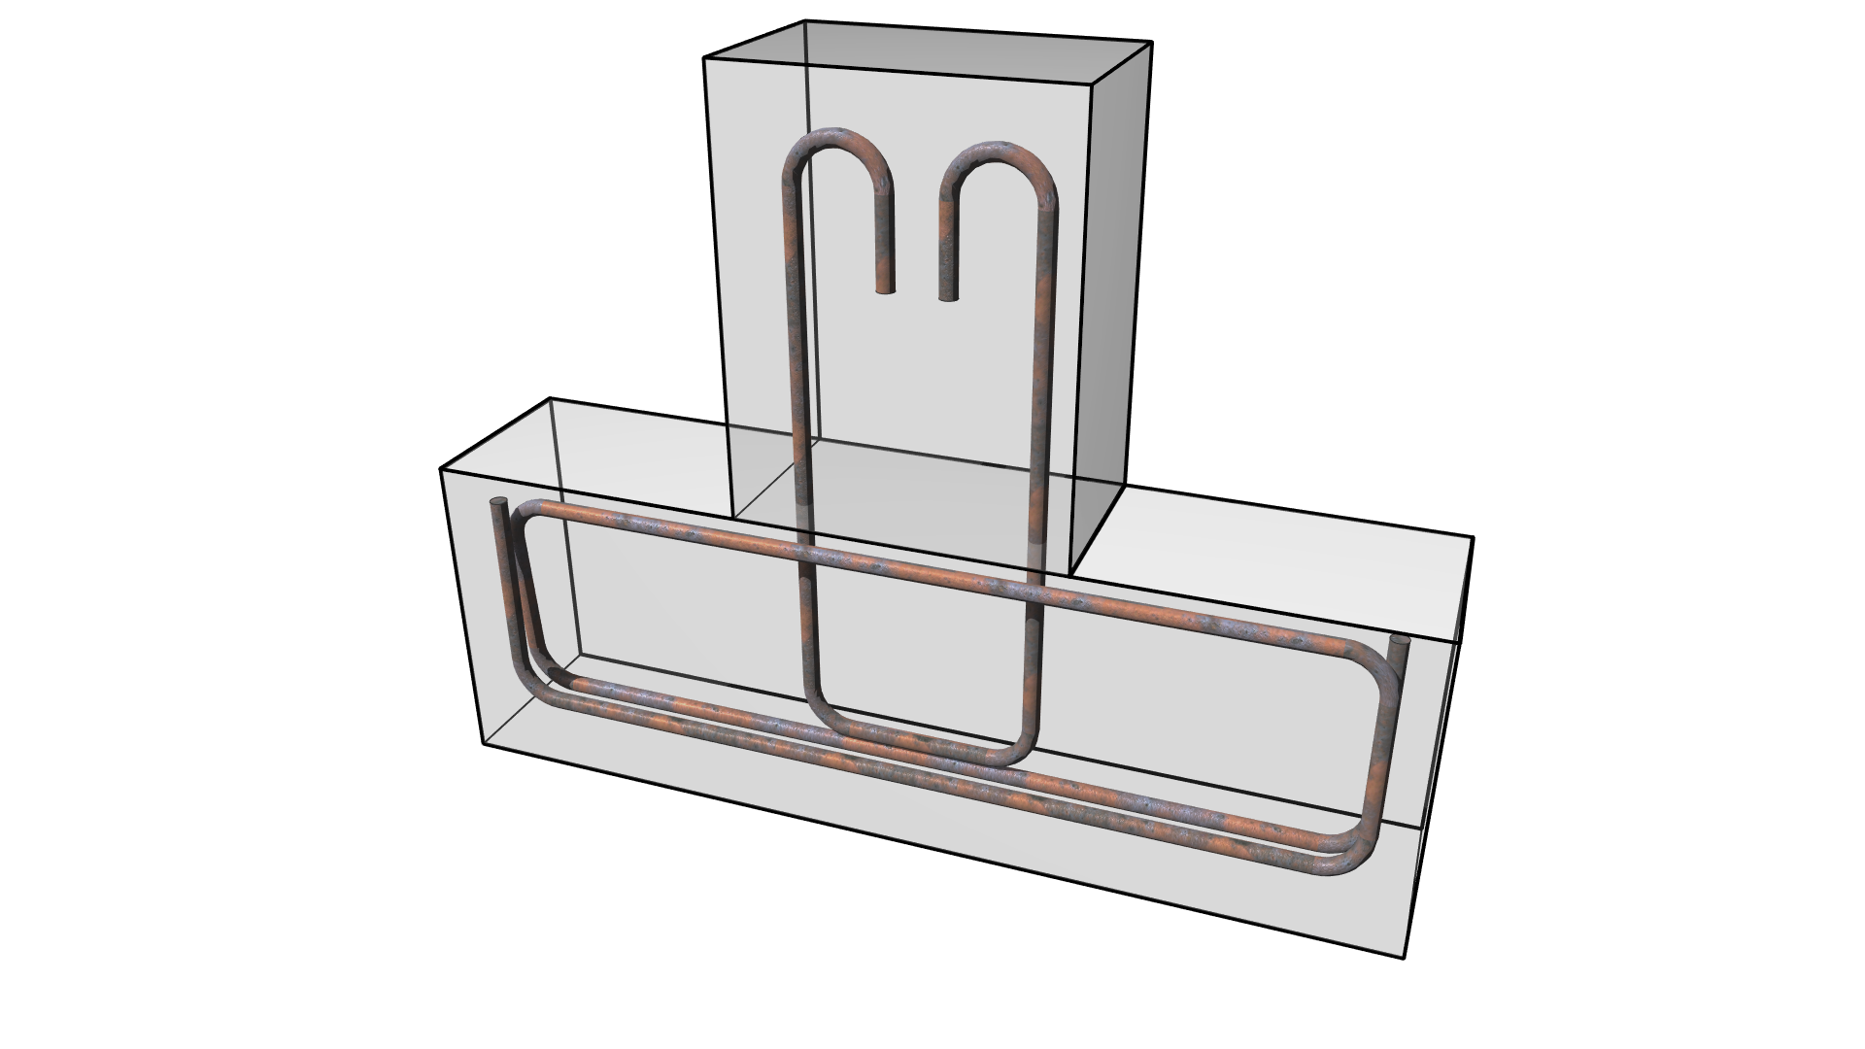
Easy
Rebar
Hooks & Shapes

Slide 16
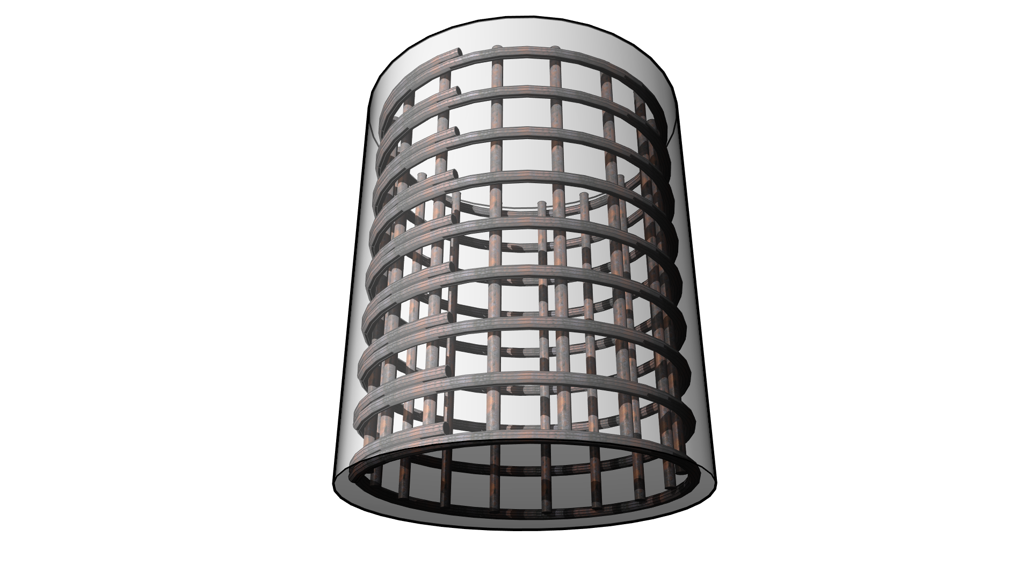
Easy
Rebar
Hooks & Shapes
Custom Shapes

Slide 17
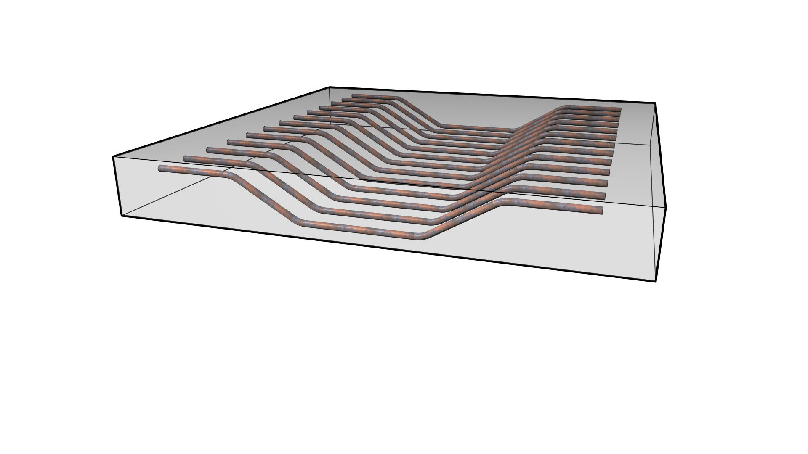
Easy
Rebar
Hooks & Shapes
Custom Shapes
Angle-driven Shapes

Slide 18
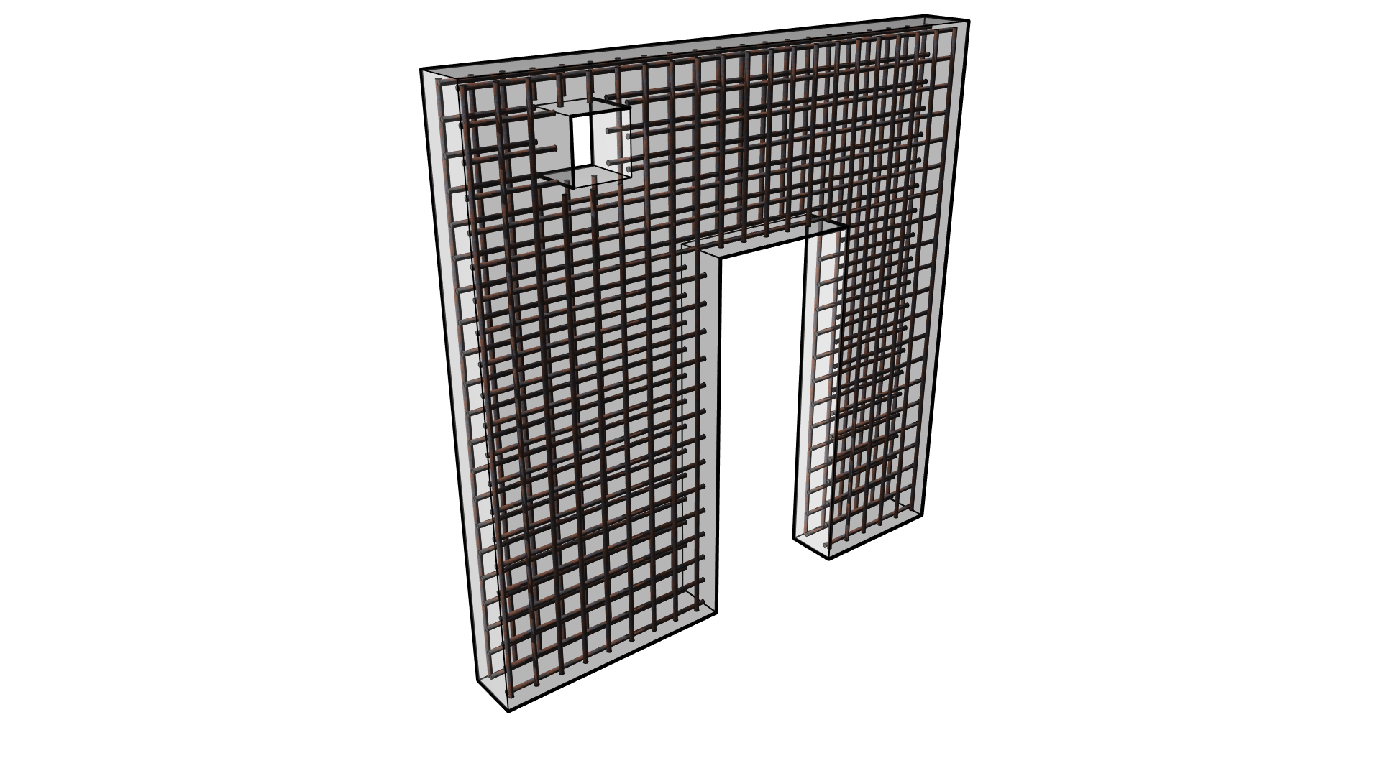
Easy
Rebar
Hooks & Shapes
Custom Shapes
Angle-driven Shapes
Areas

Slide 19
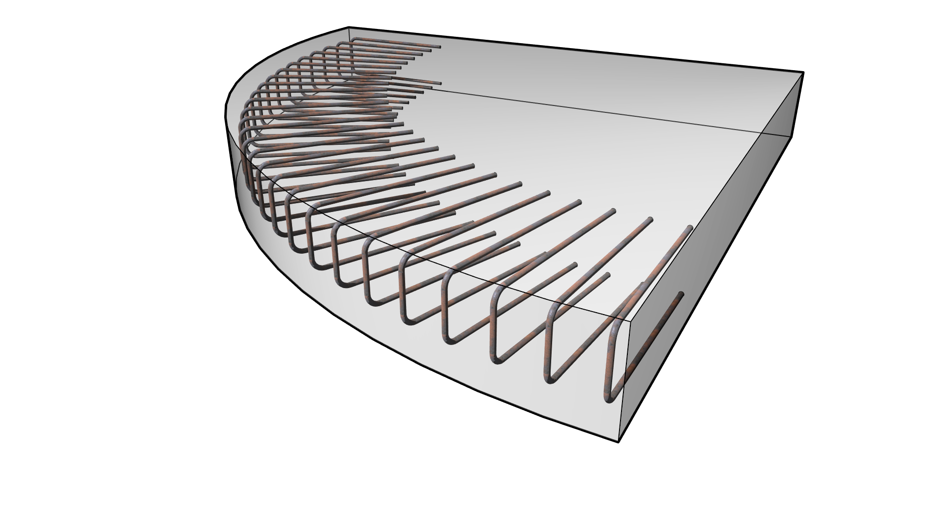
Easy
Rebar
Hooks & Shapes
Custom Shapes
Angle-driven Shapes
Areas
Paths

Slide 20
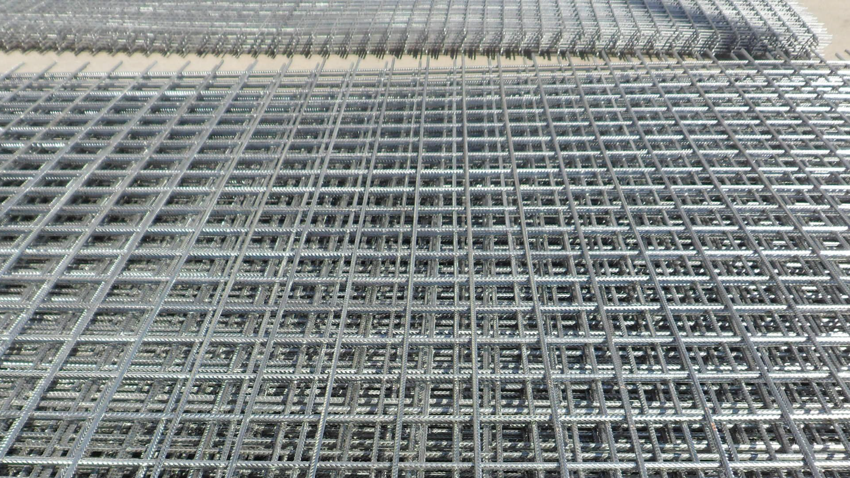
Easy
Rebar
Wire Fabric
Hooks & Shapes
Custom Shapes
Angle-driven Shapes
Areas
Paths

Slide 21
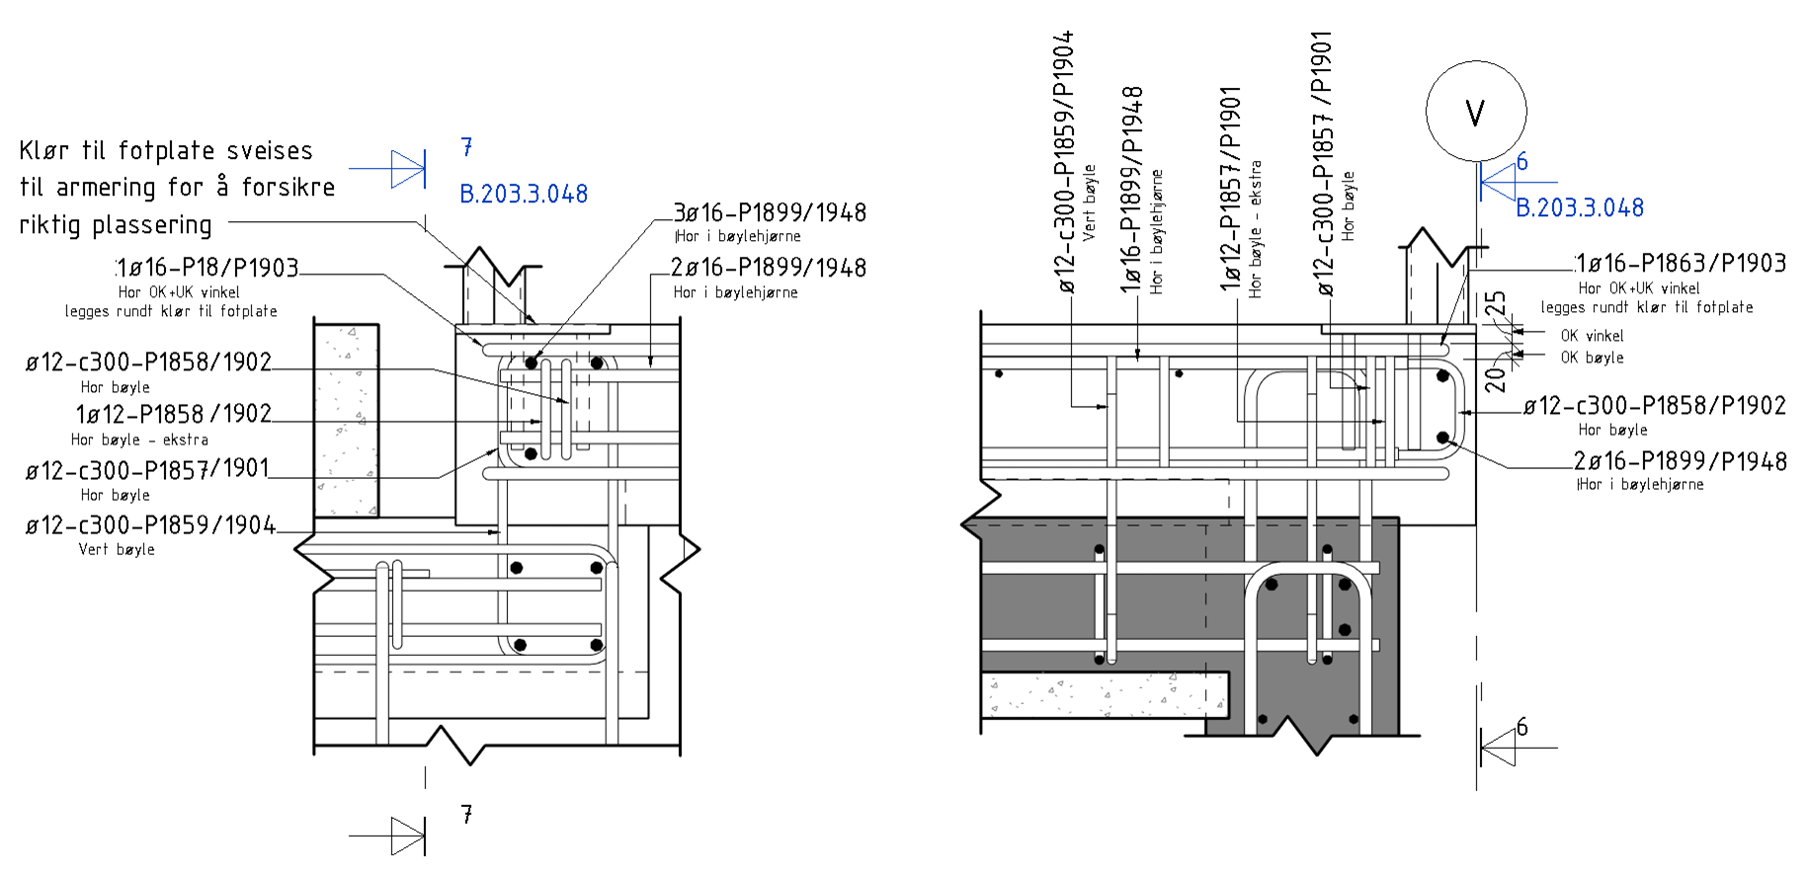
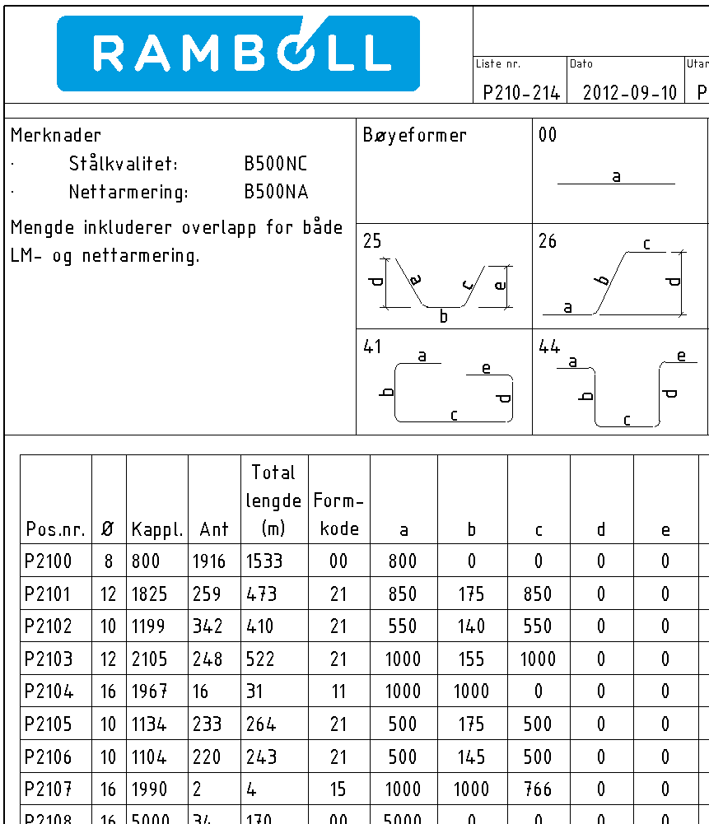
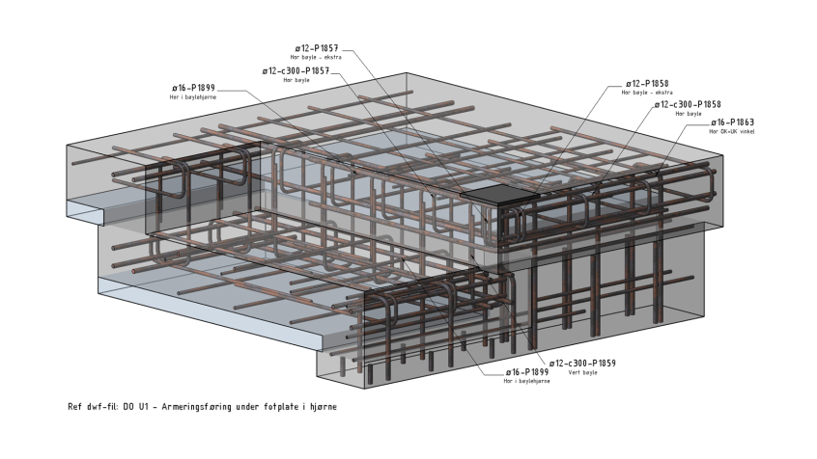
Easy
Rebar
Wire Fabric
Hooks & Shapes
Sections
Custom Shapes
Schedules
Angle-driven Shapes
3D
Areas
Paths

Slide 22
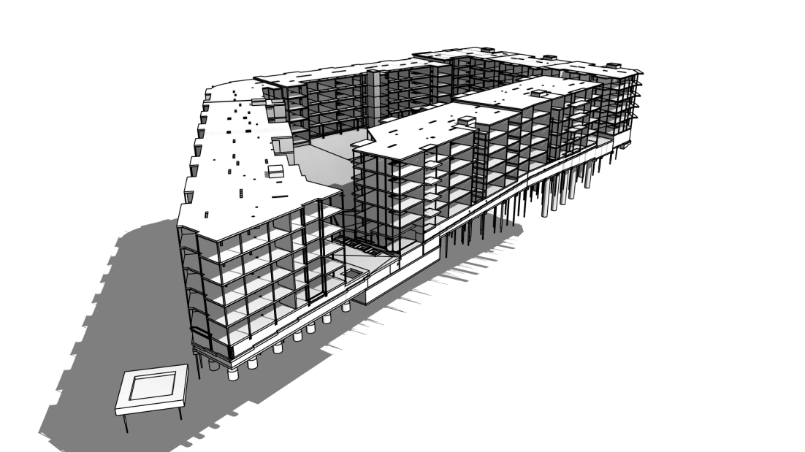
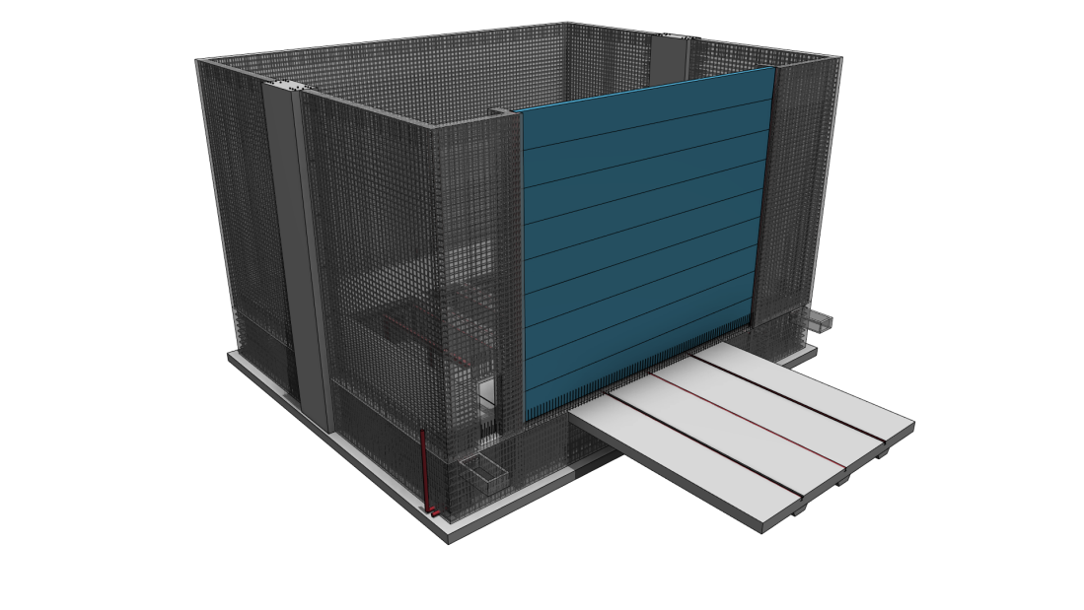
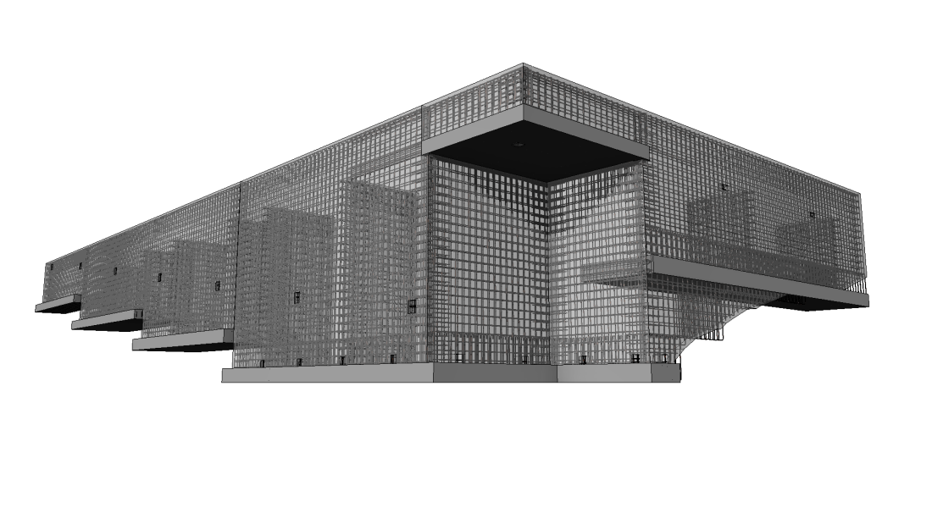

Slide 23


Slide 24


Slide 25
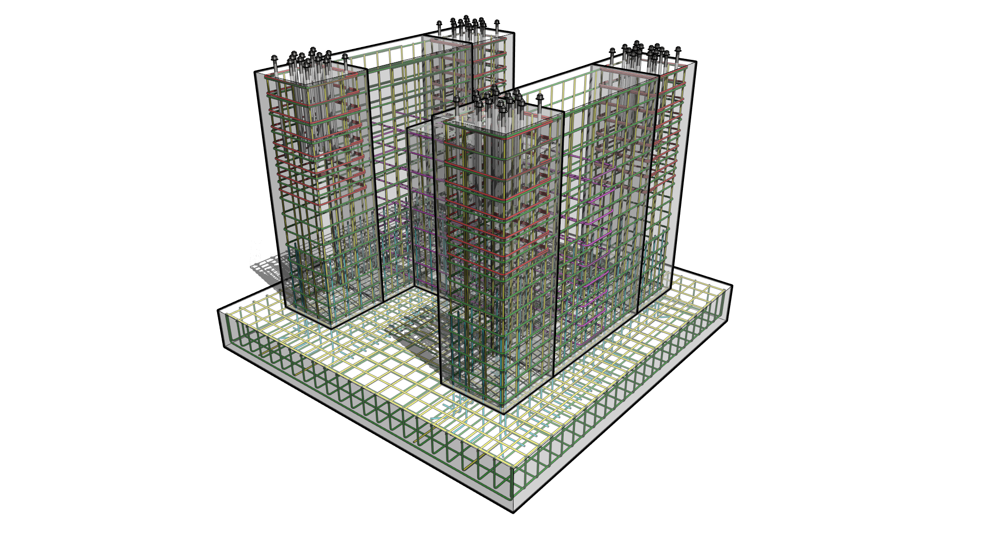

Slide 26
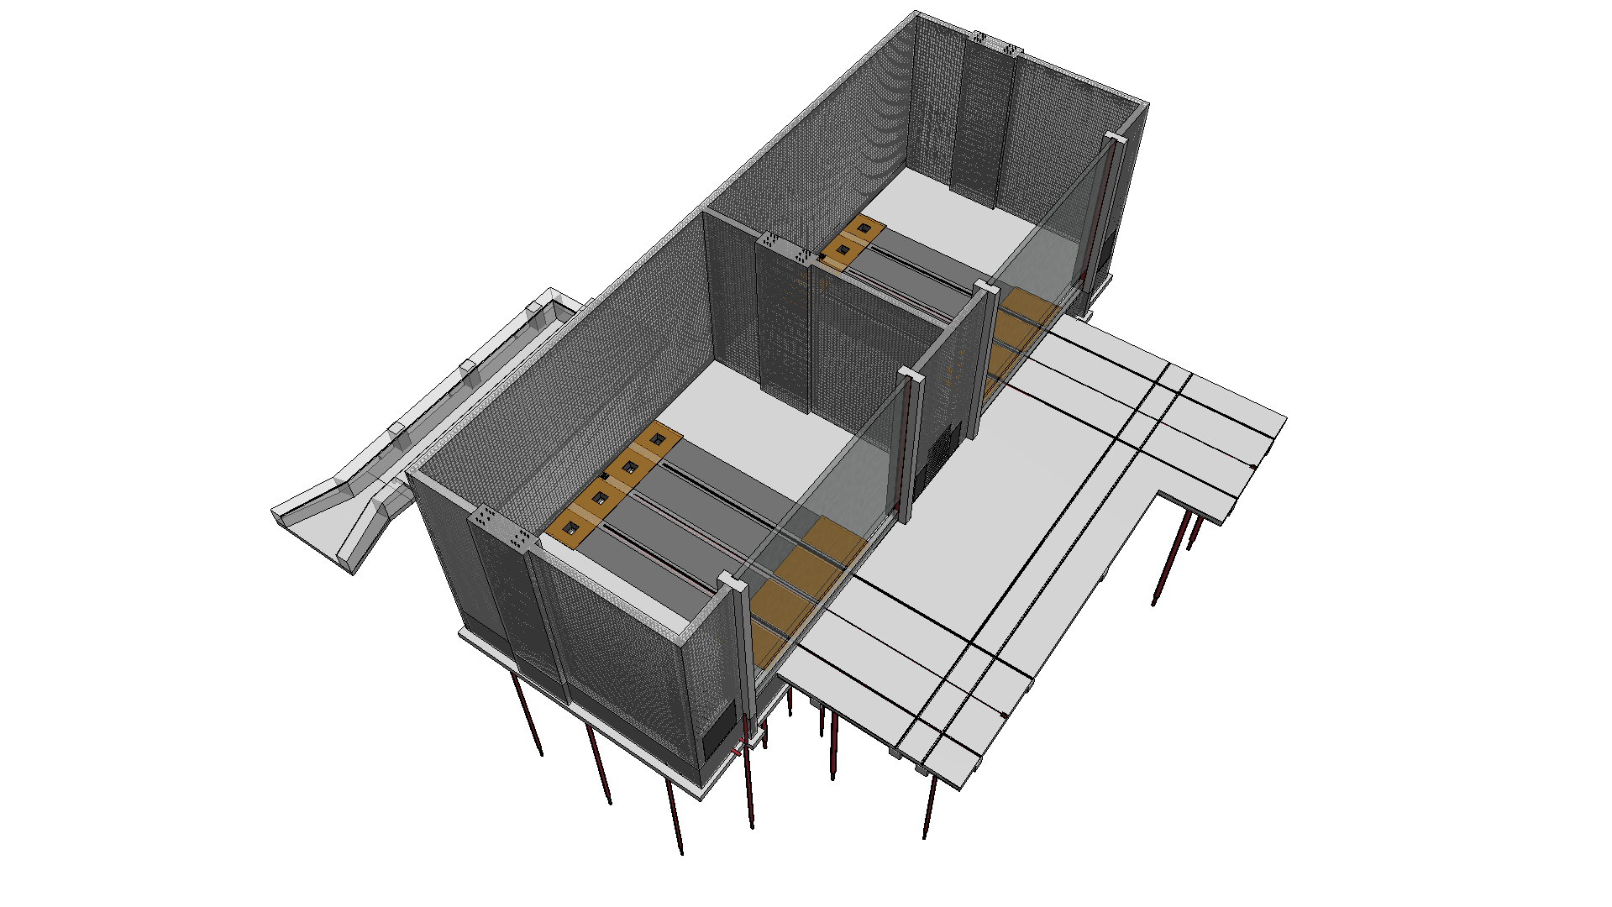

Slide 27


Slide 28
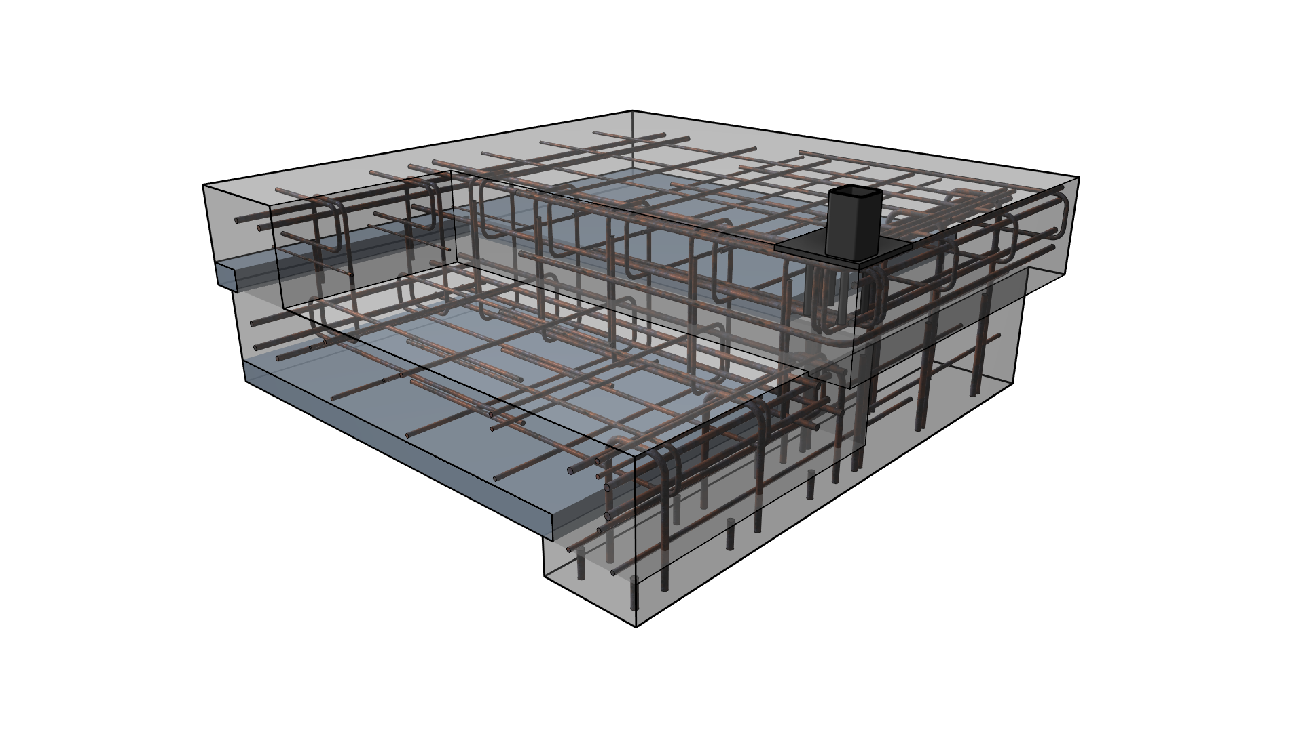

Slide 29
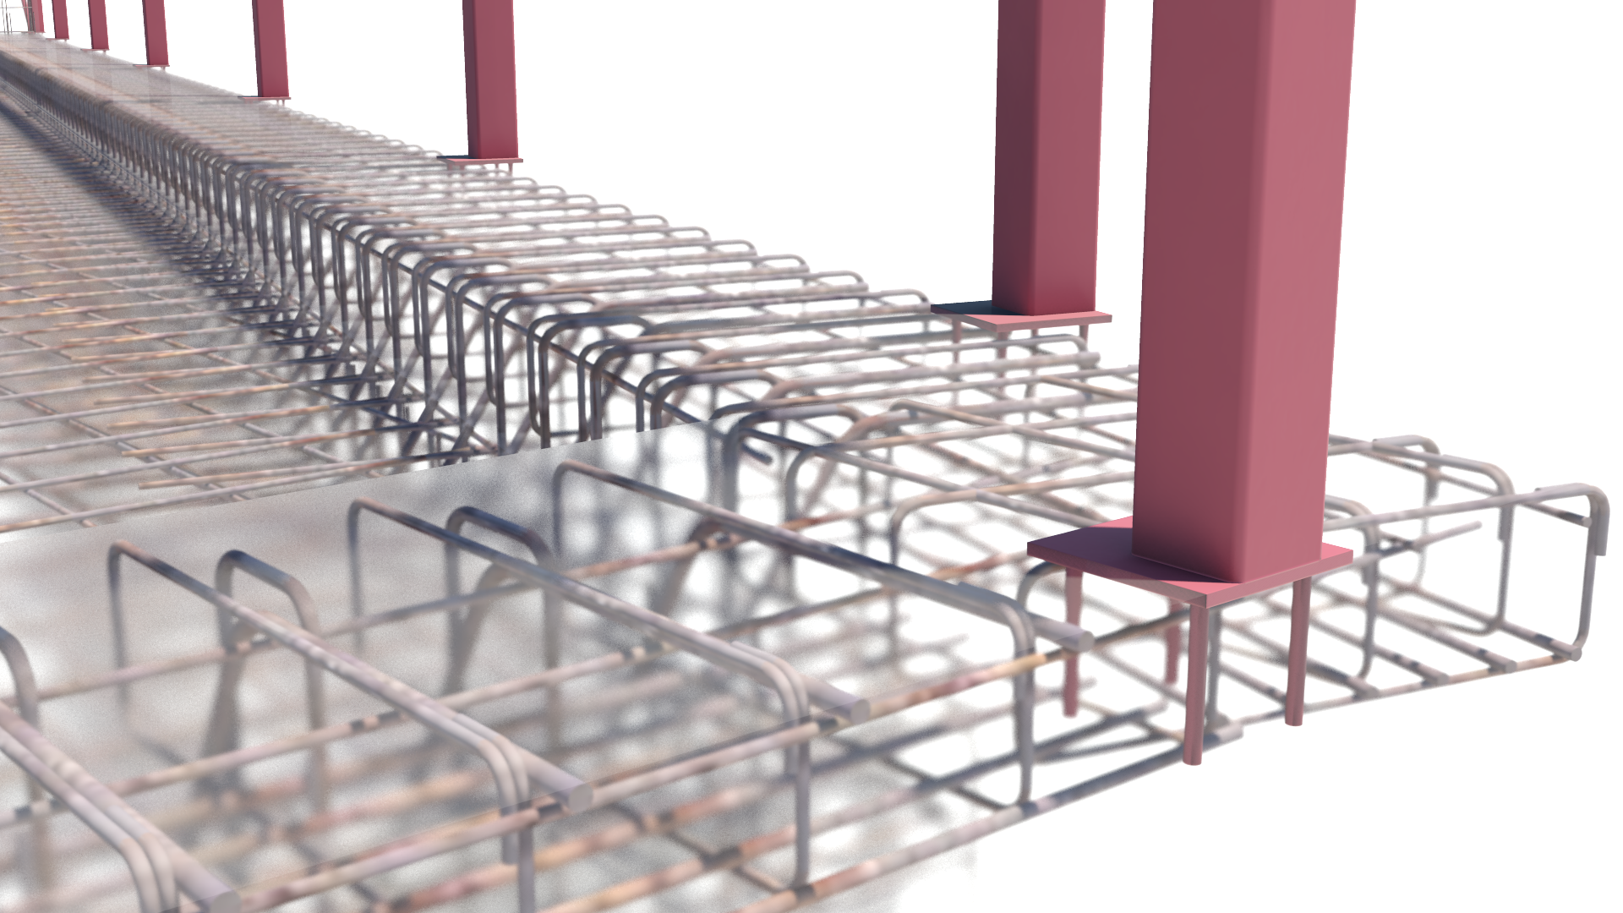

Slide 30
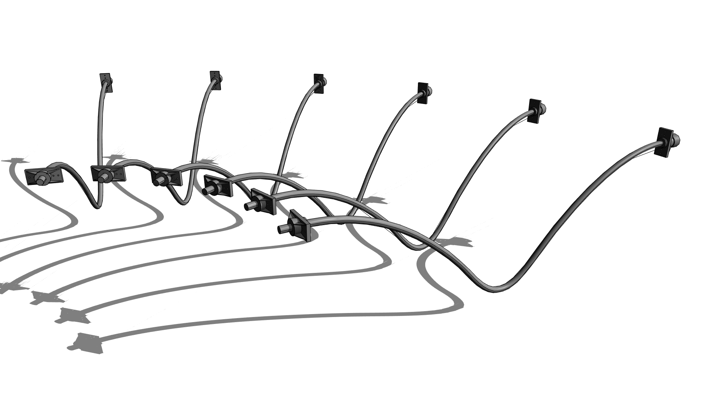

Slide 31
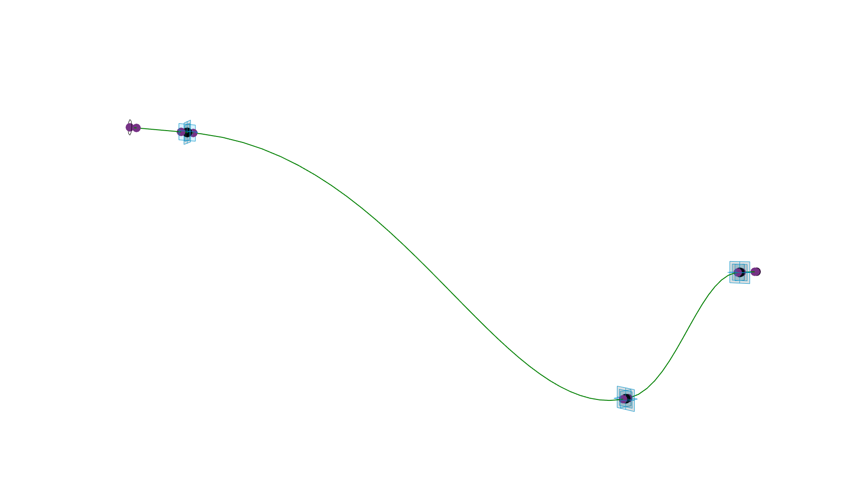

Slide 32
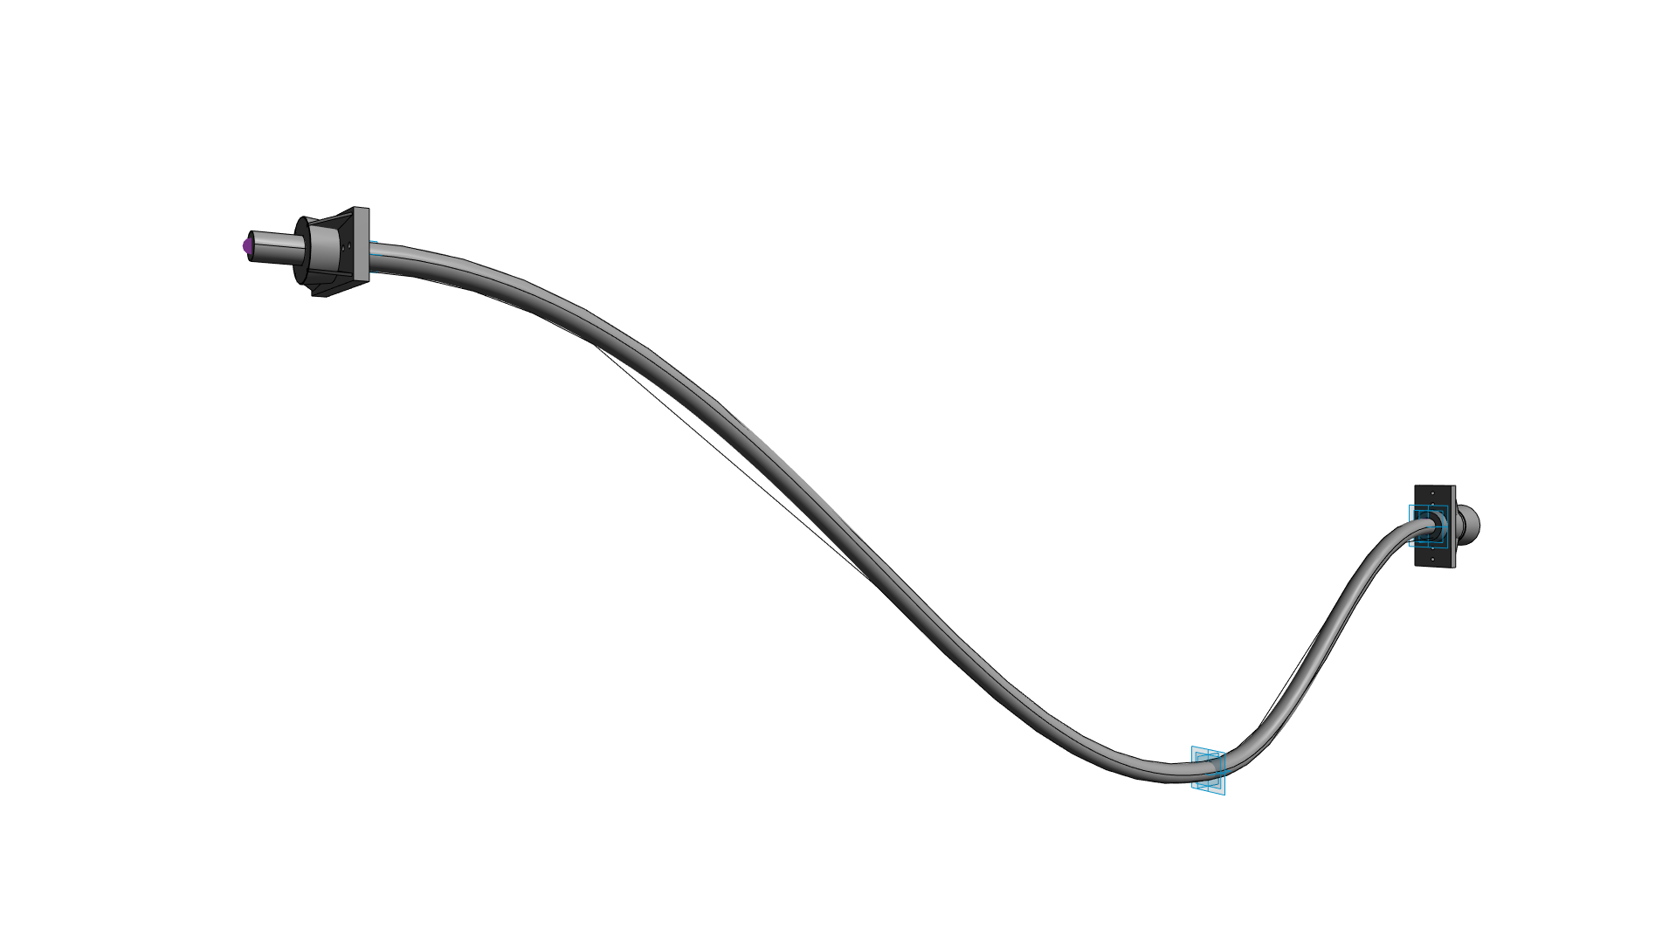

Slide 33
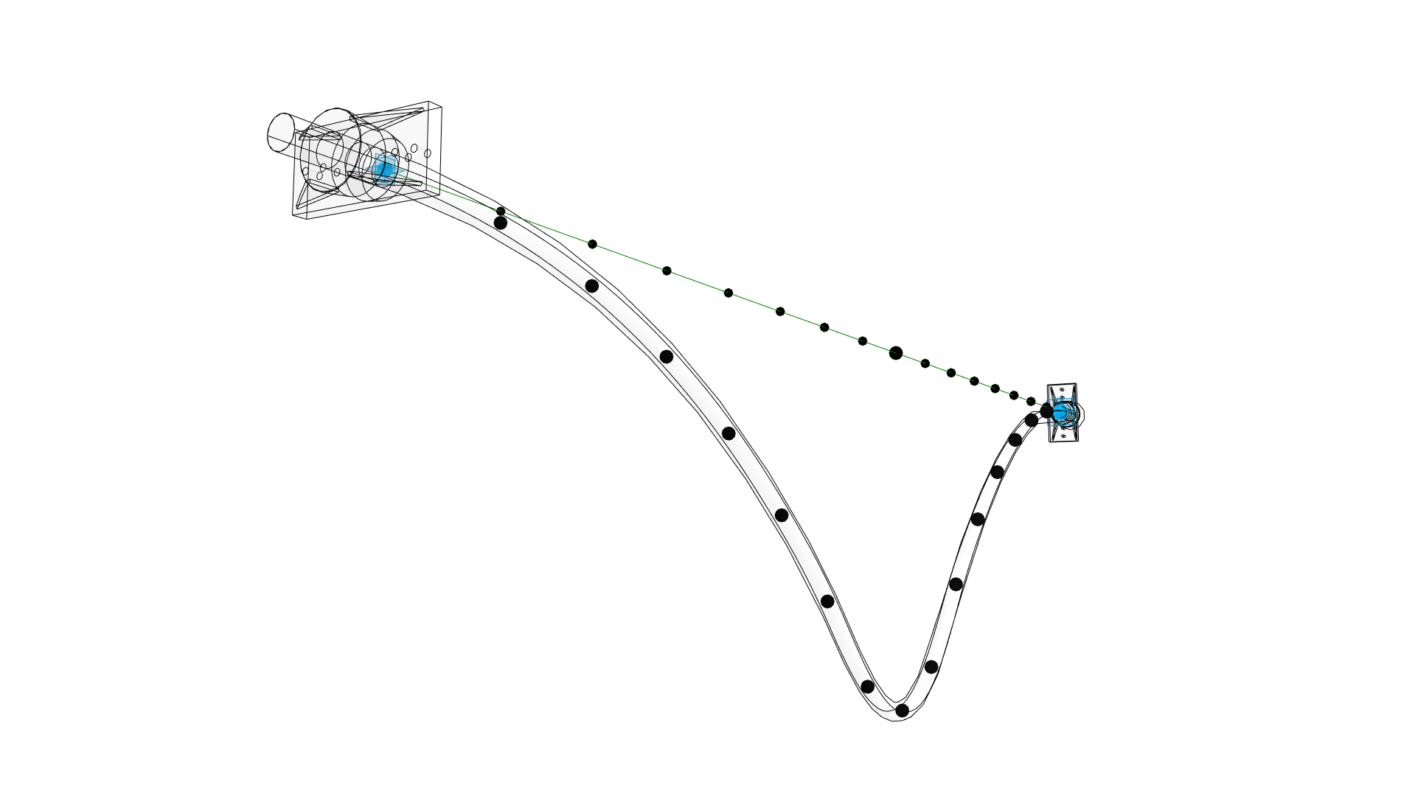

Slide 34
