Slide 1
TSMC, Trump, and the TWD
March 2025
paul@eastasiaecon.com

Slide 2
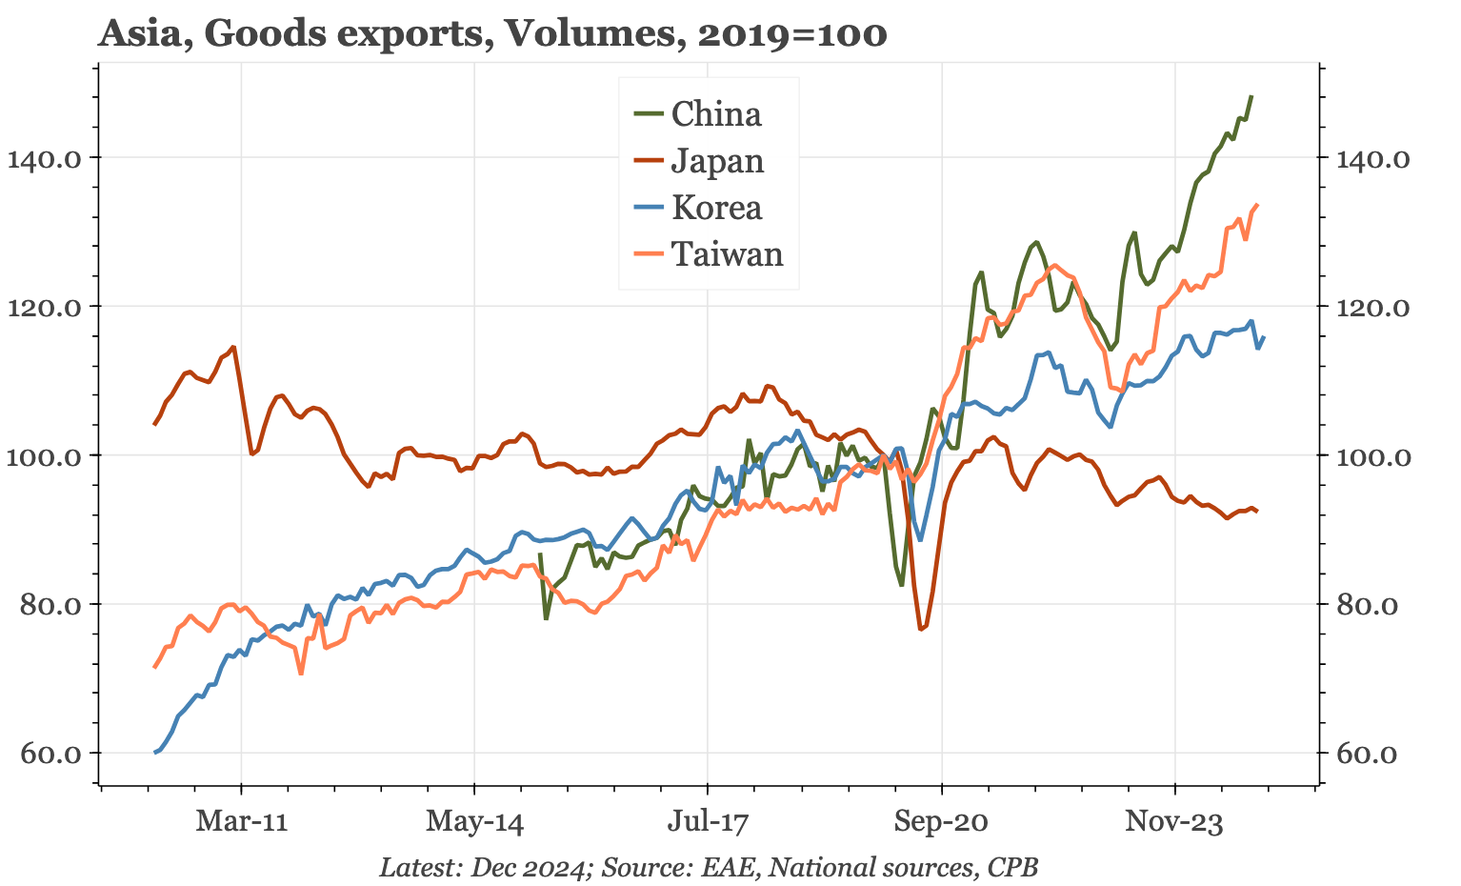
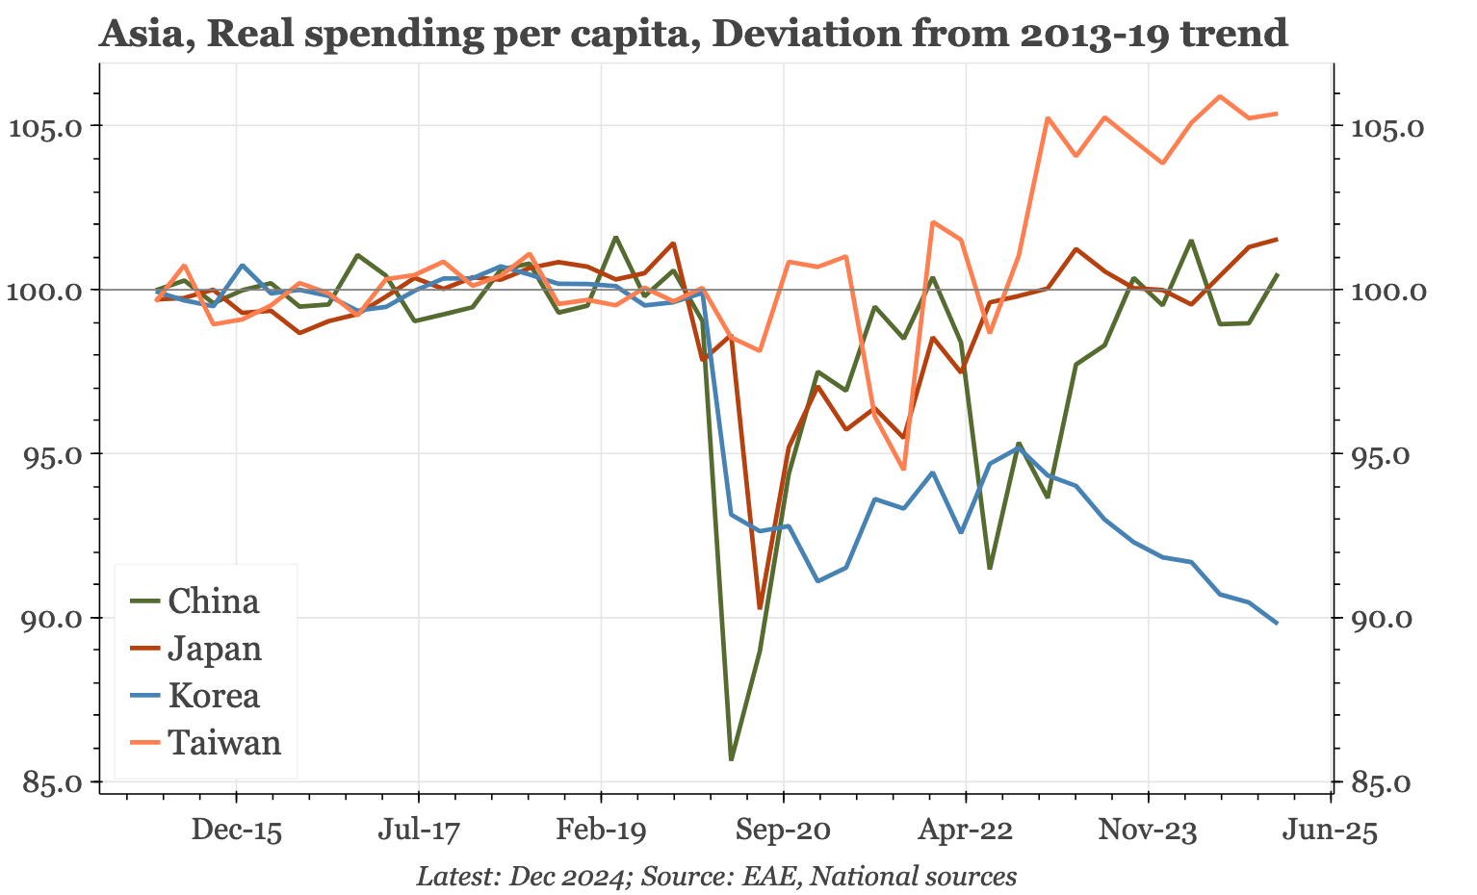
Domestic inflation A different economy trajectory since 2020

Slide 3
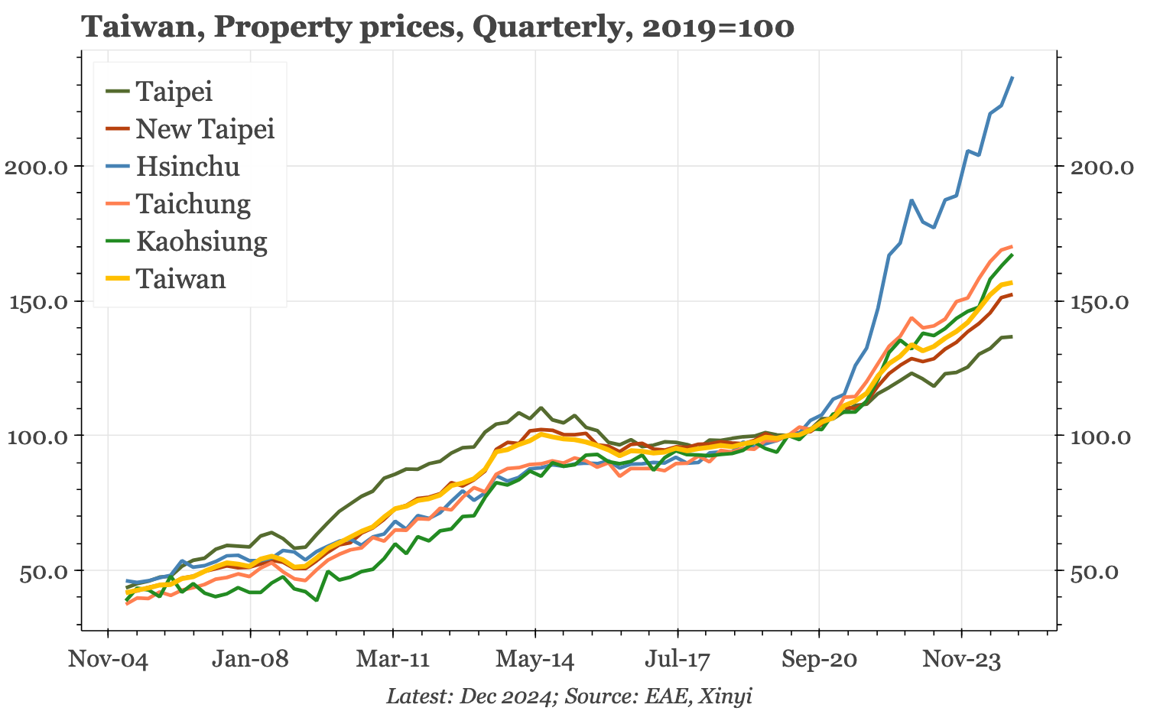
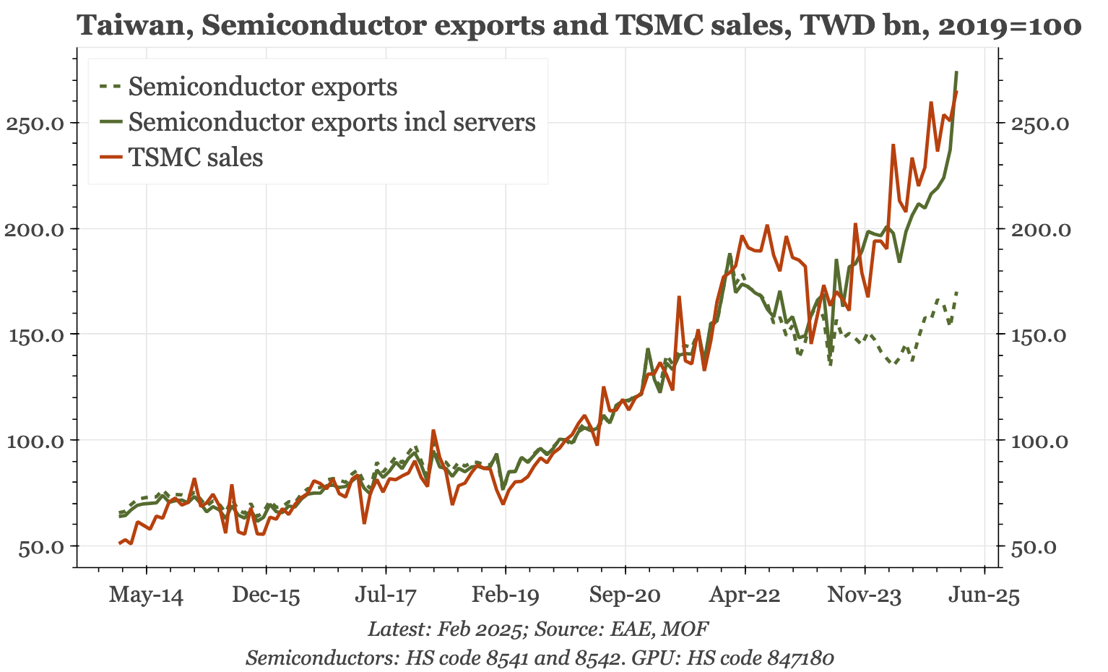
Domestic inflation TSMC lifts the economy…and prices

Slide 4
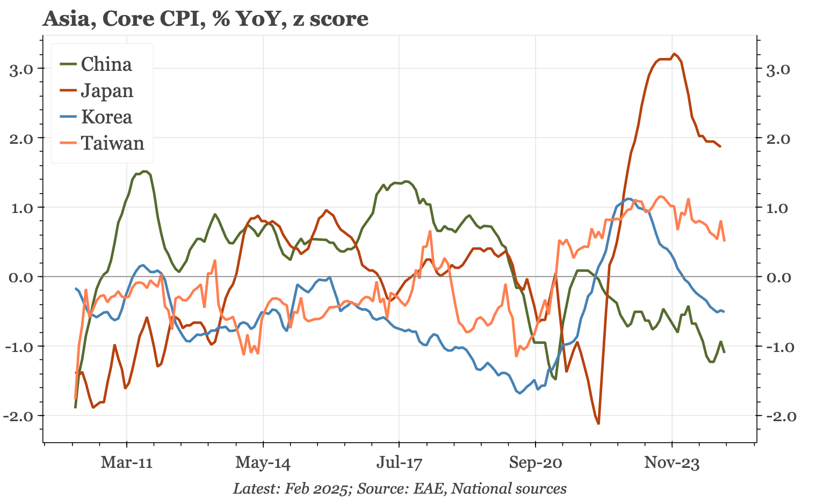
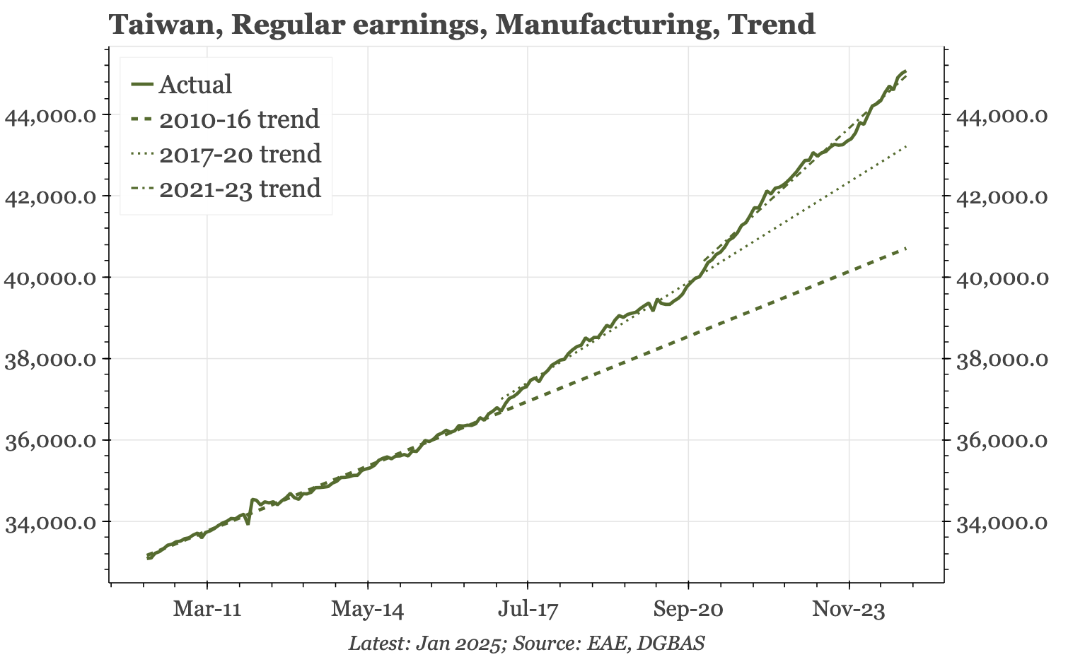
Domestic inflation Like Japan, out of deflation

Slide 5
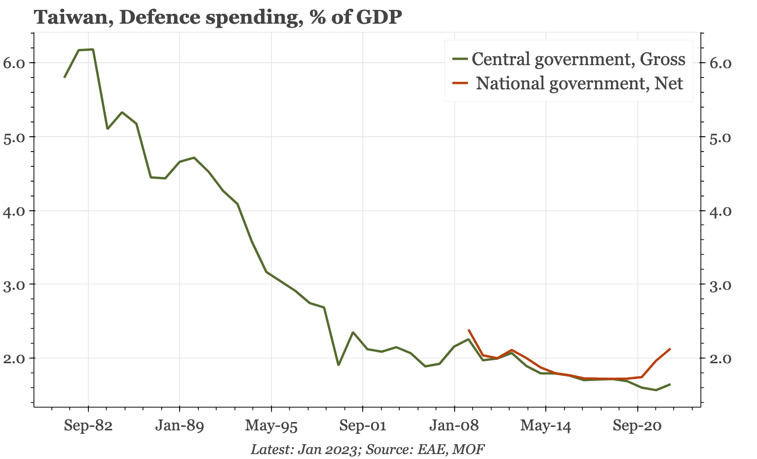
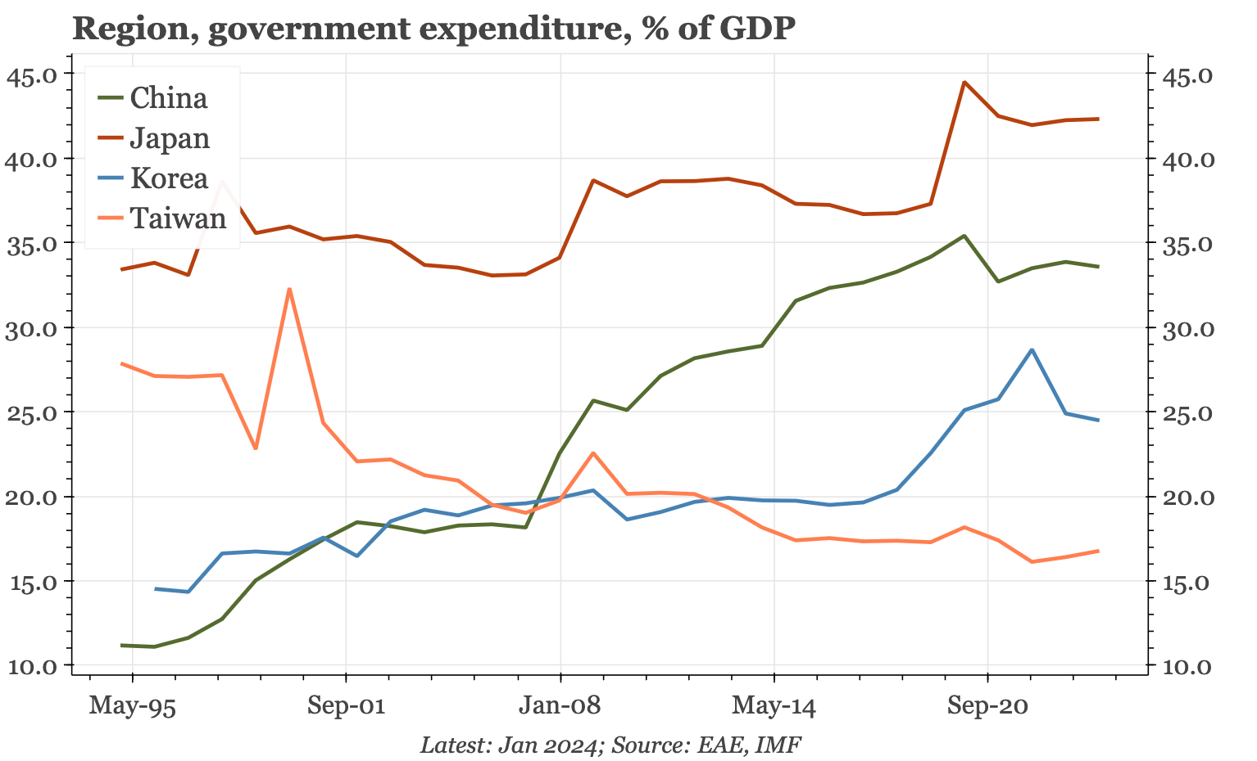
Trump’s agenda Under-sized defence spending

Slide 6
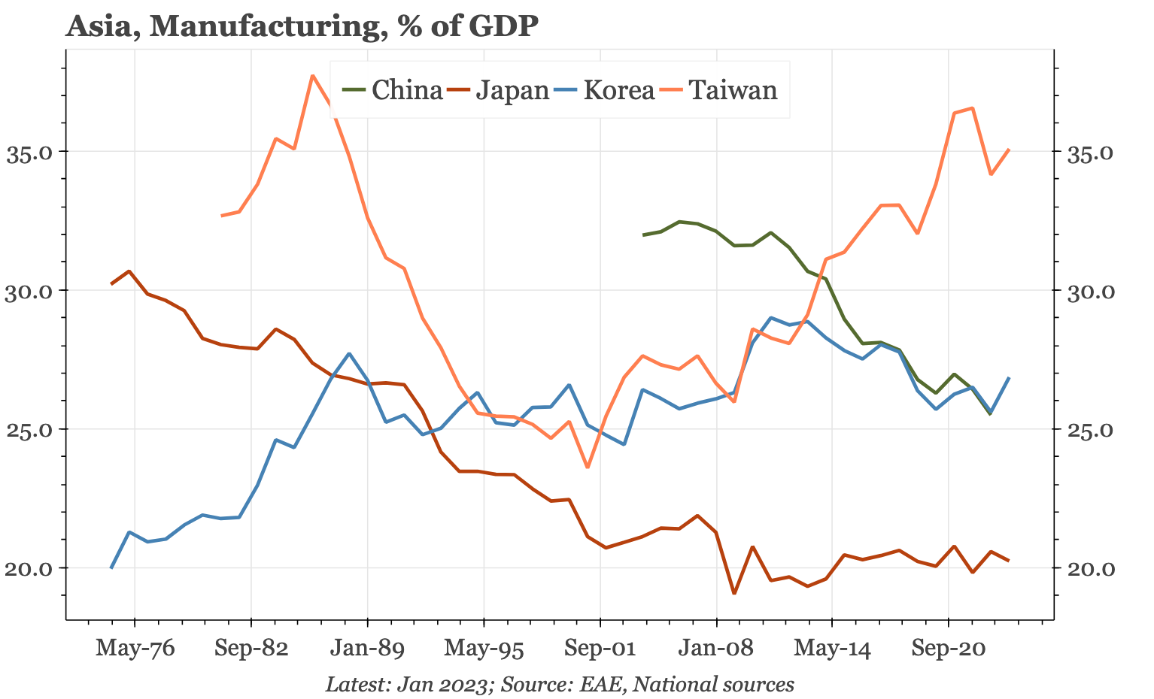
Trump’s agenda Over-sized manufacturing base

Slide 7
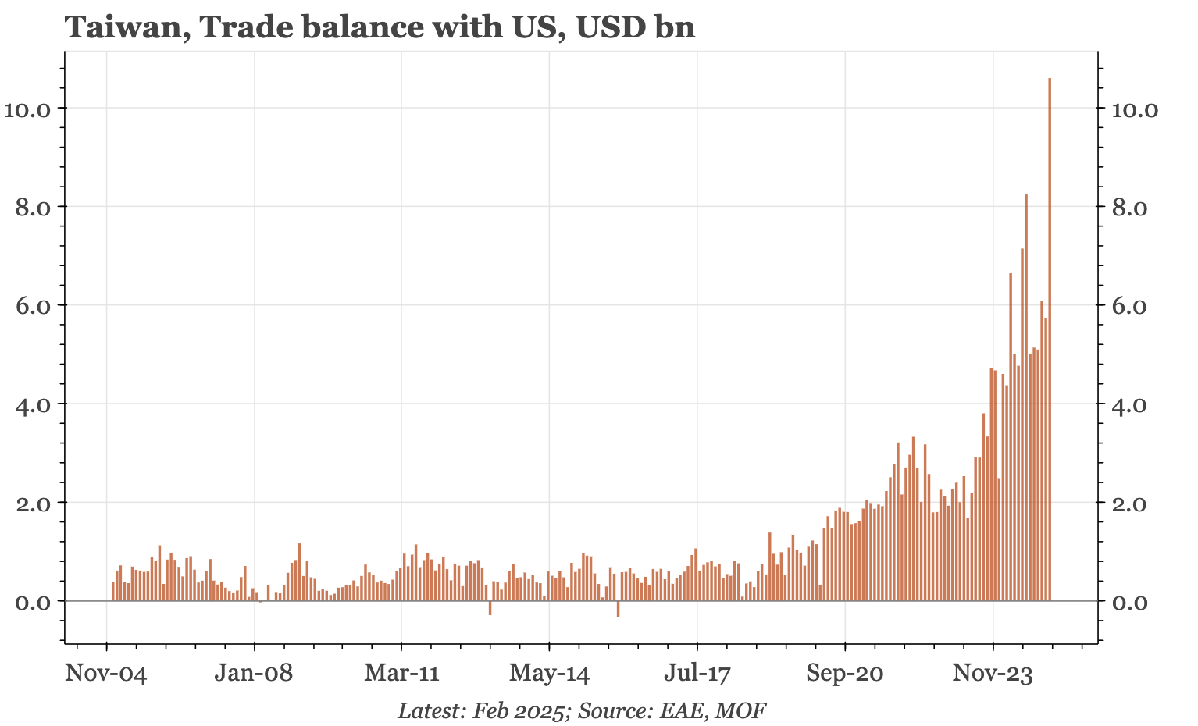
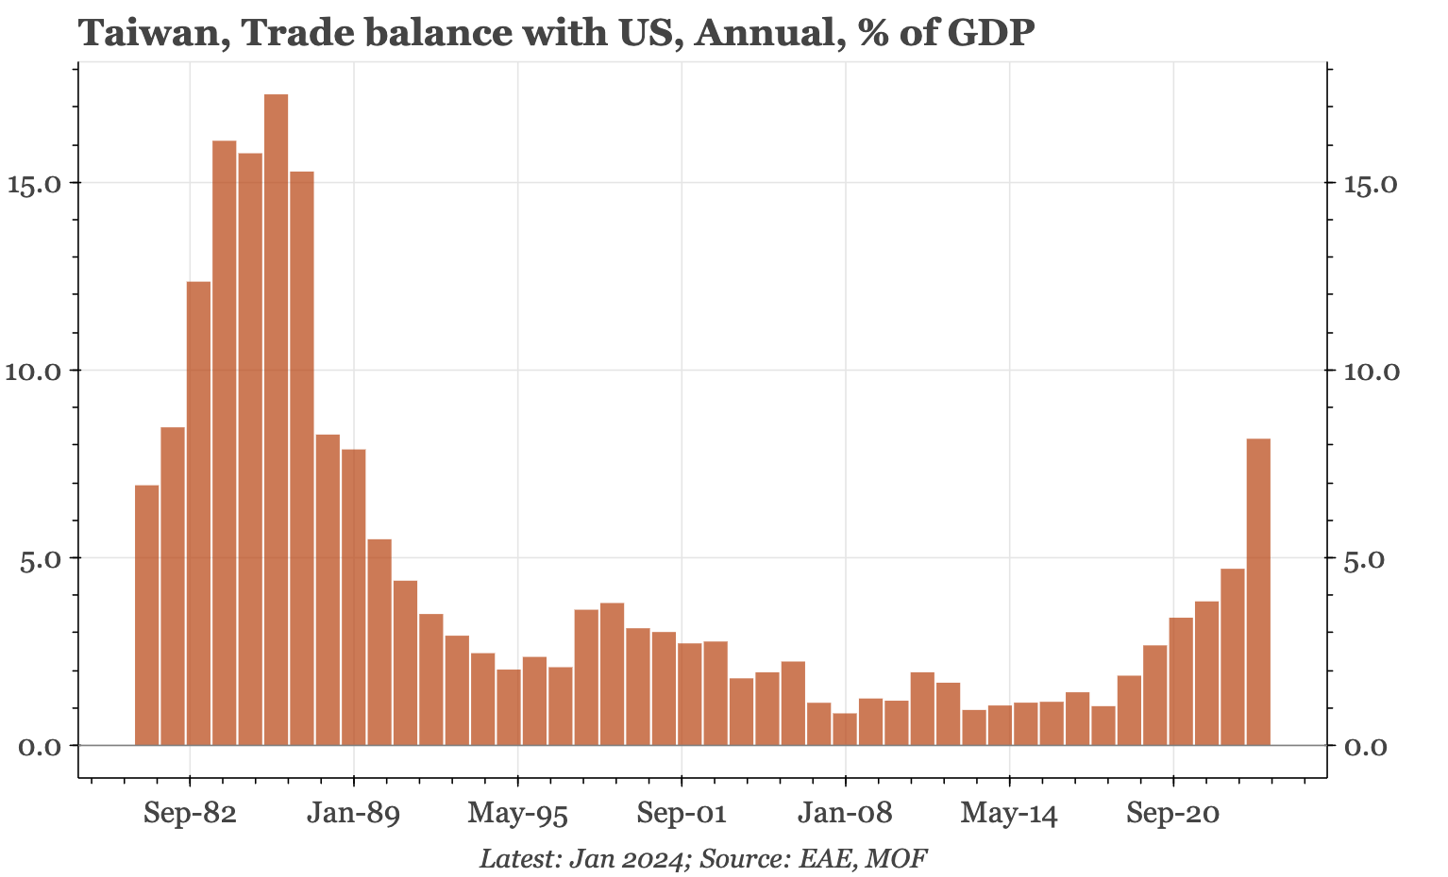
Trump’s agenda Over-sized bilateral surplus

Slide 8
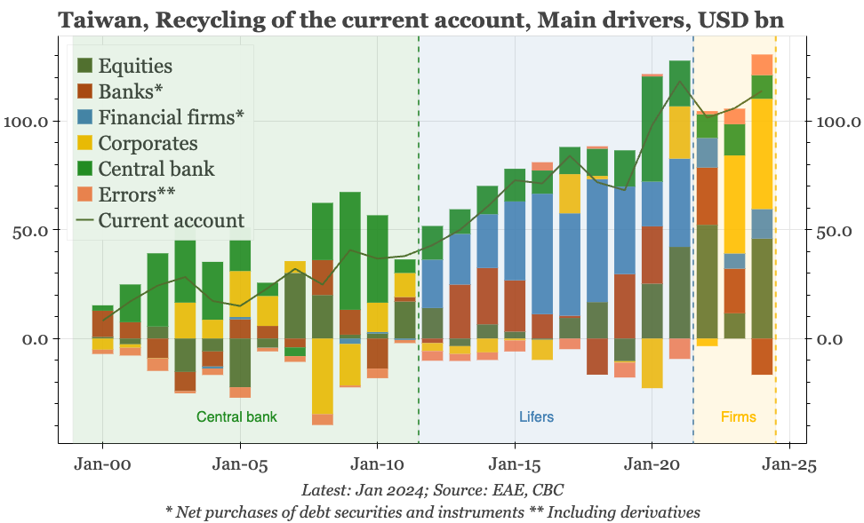
External surplus Who’s the next buyer?

Slide 9
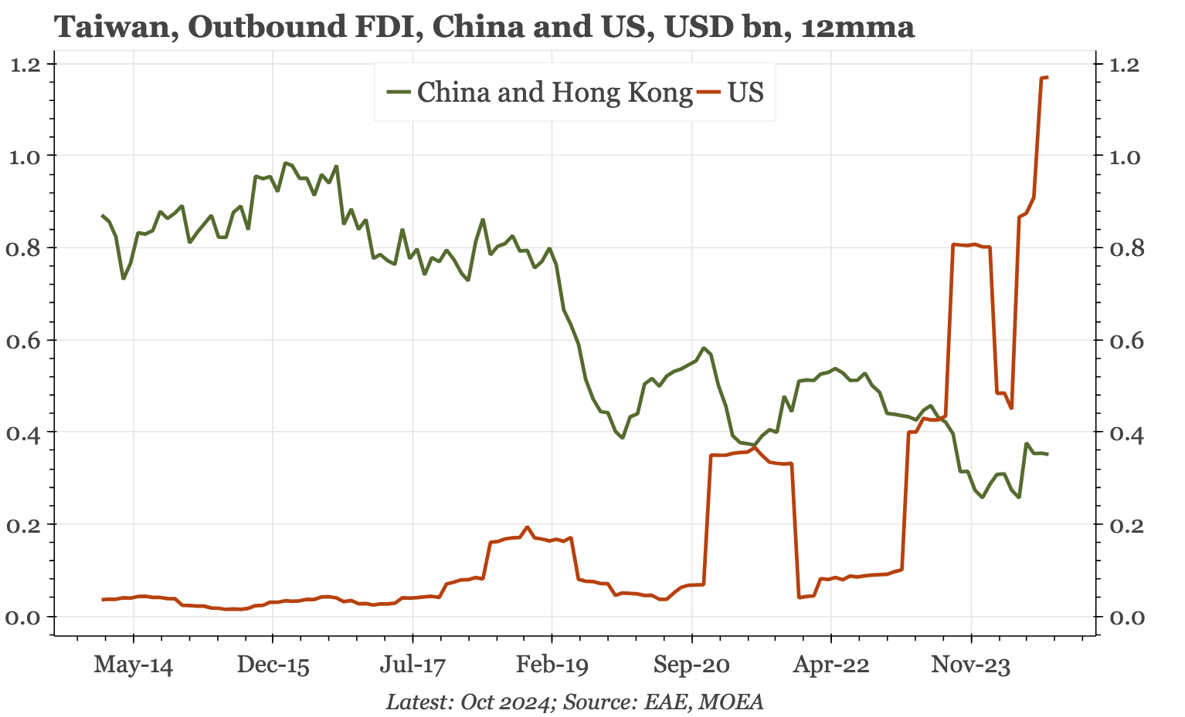
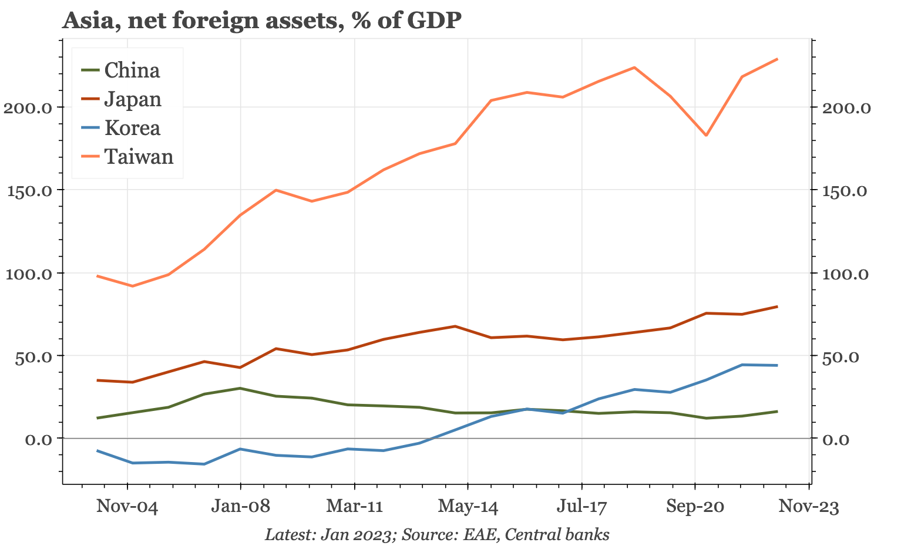
External surplus FDI up…but foreign assets already huge

Slide 10
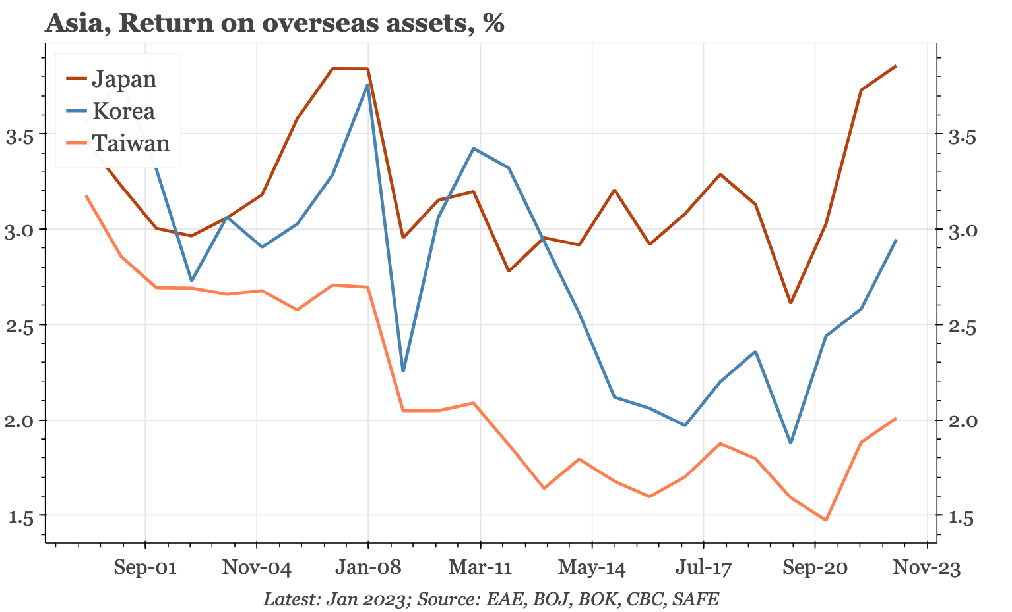
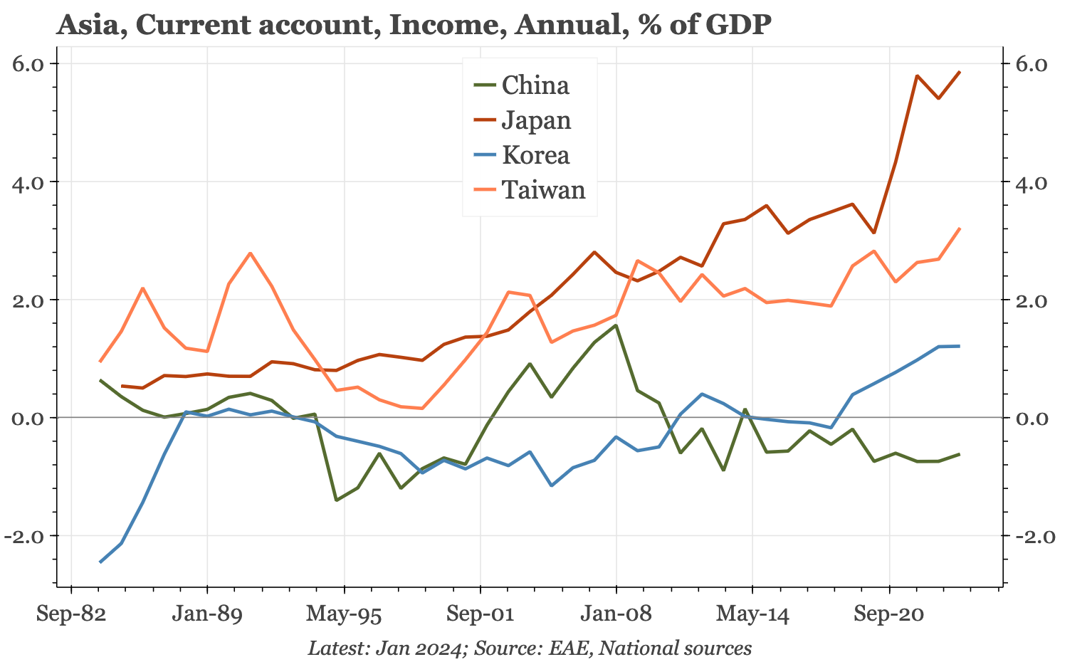
External surplus Shouldn’t the surplus be bigger still?

Slide 11
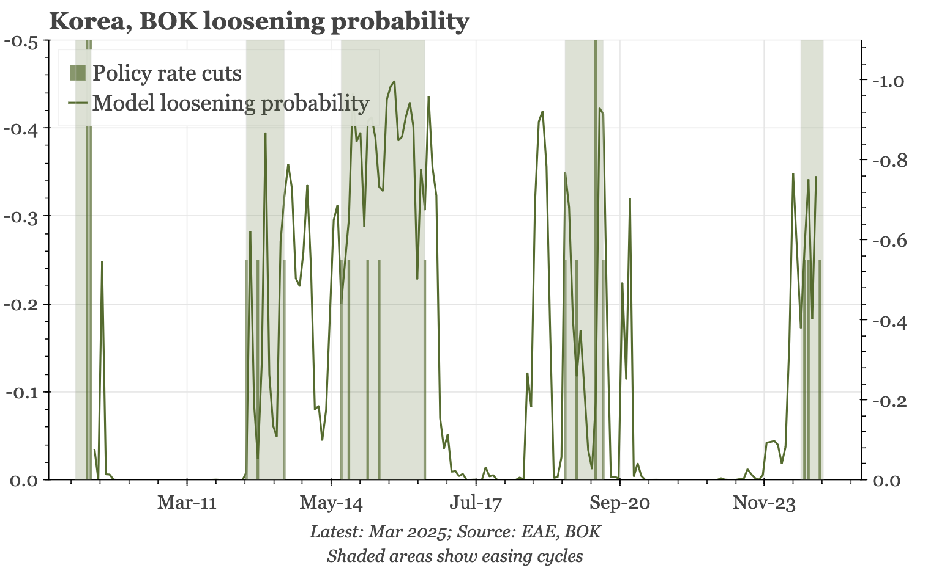
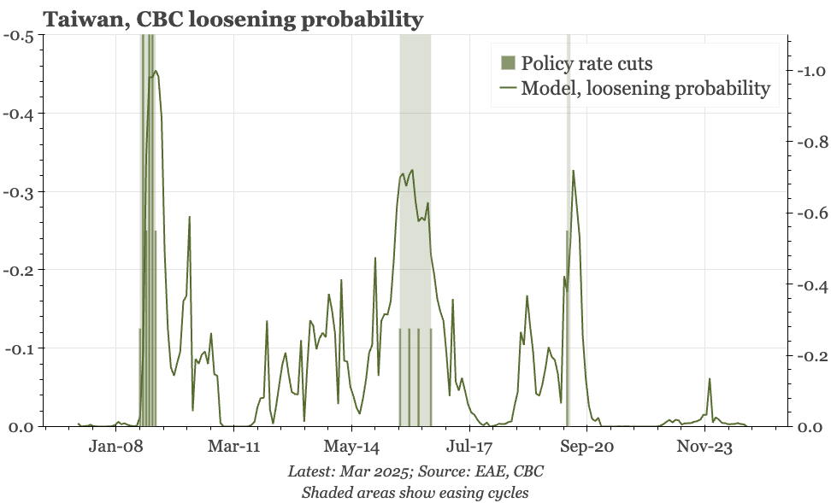
Policy and markets No pressure to ease…yet

Slide 12
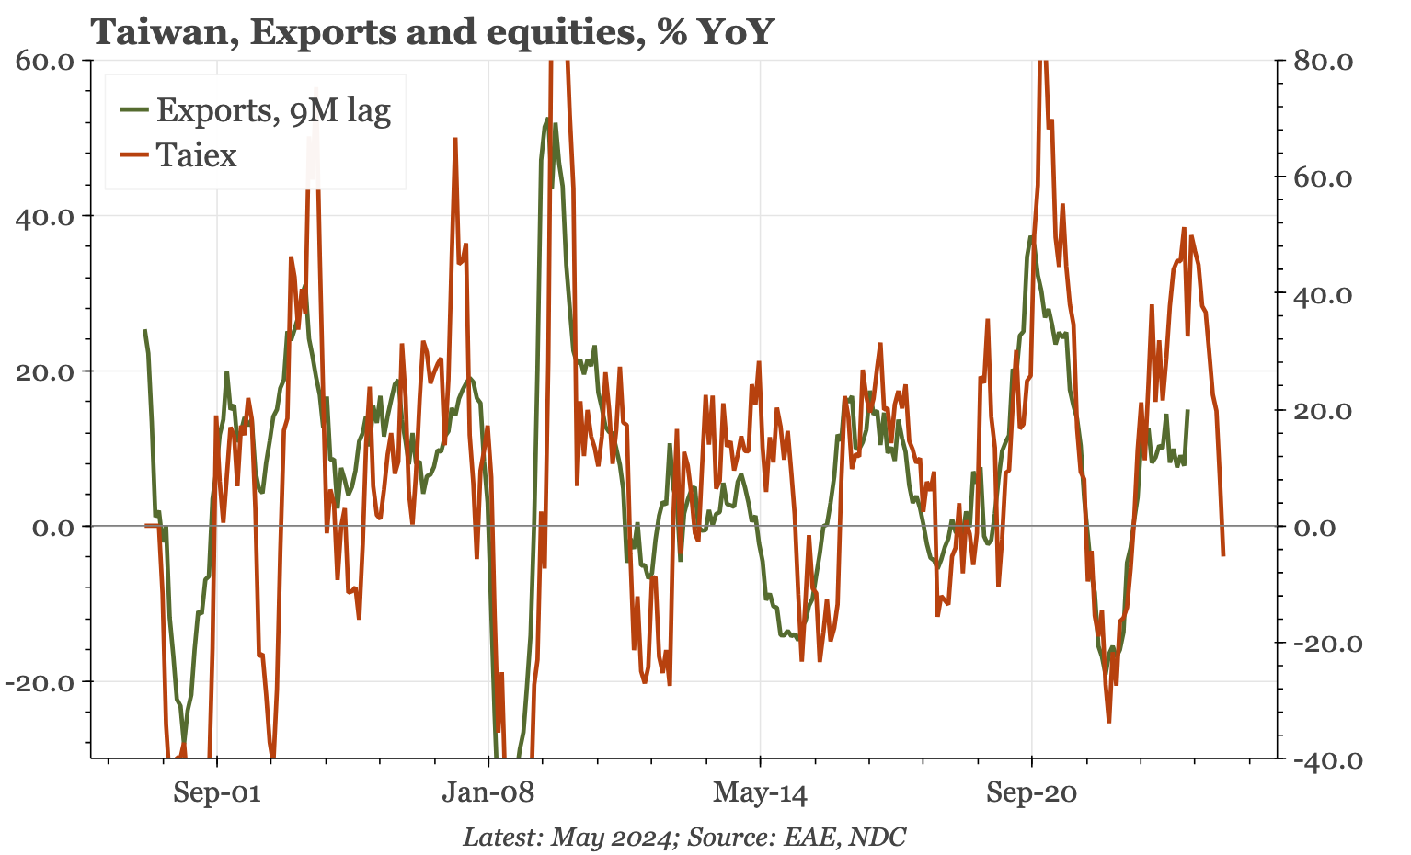
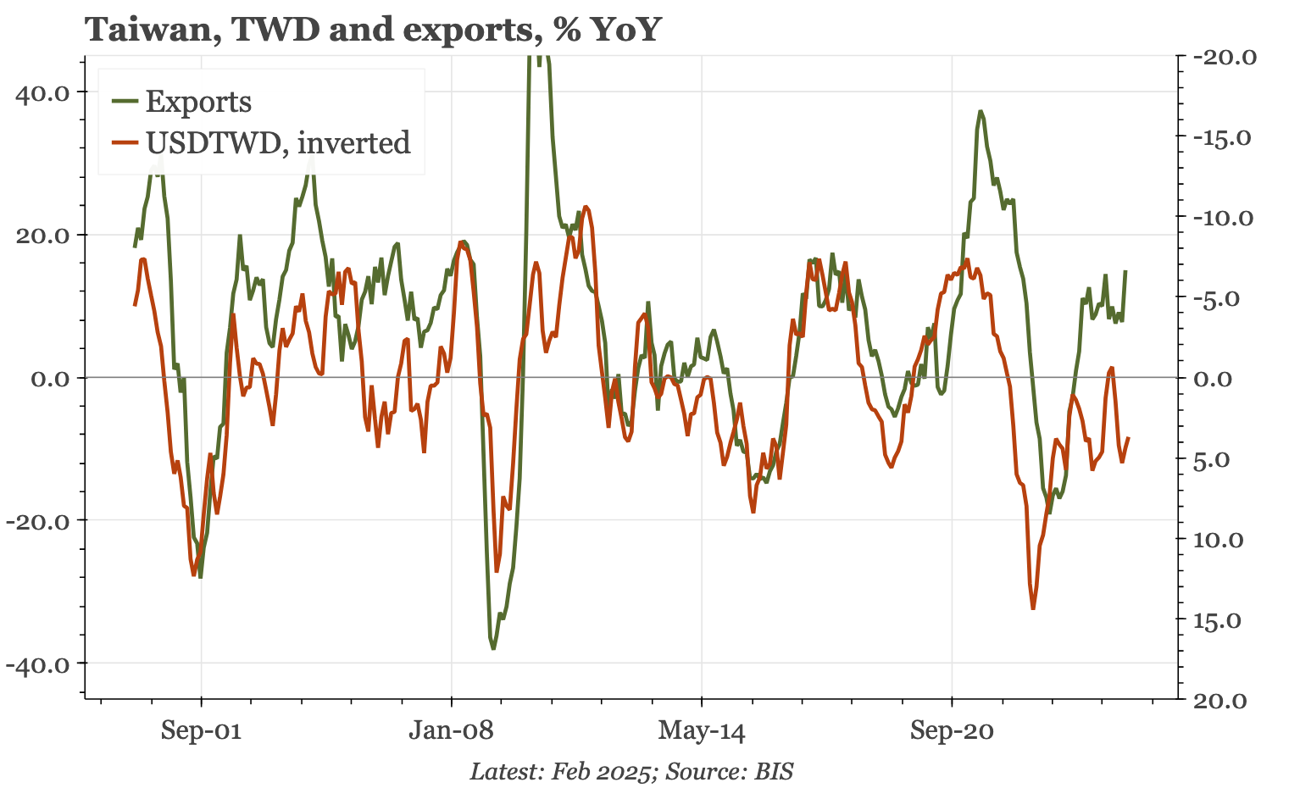
Policy and markets Cycle slowing, but TWD already weak

Slide 13
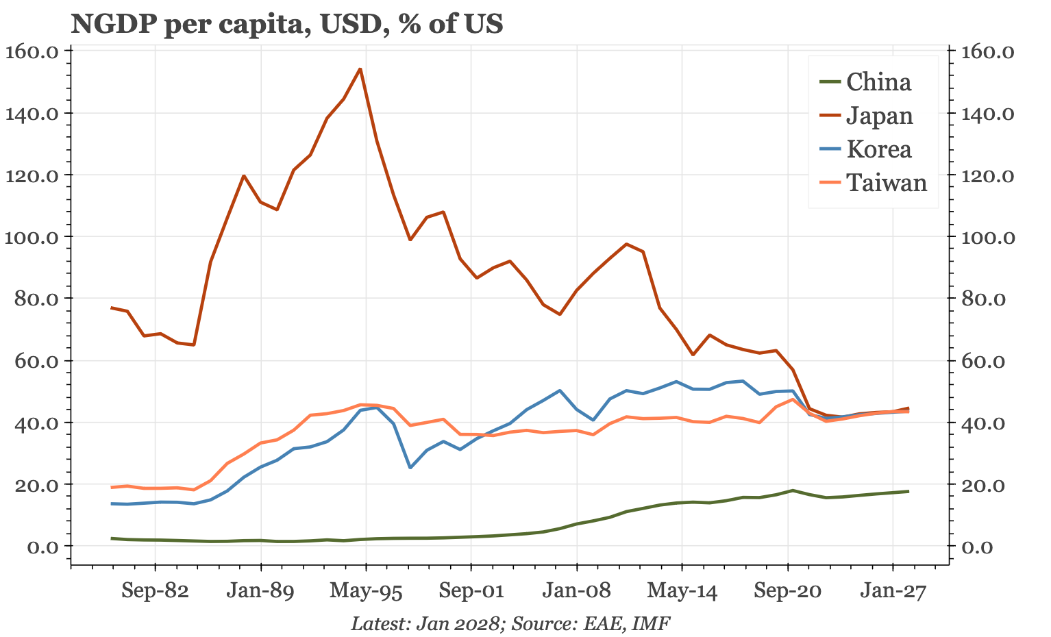
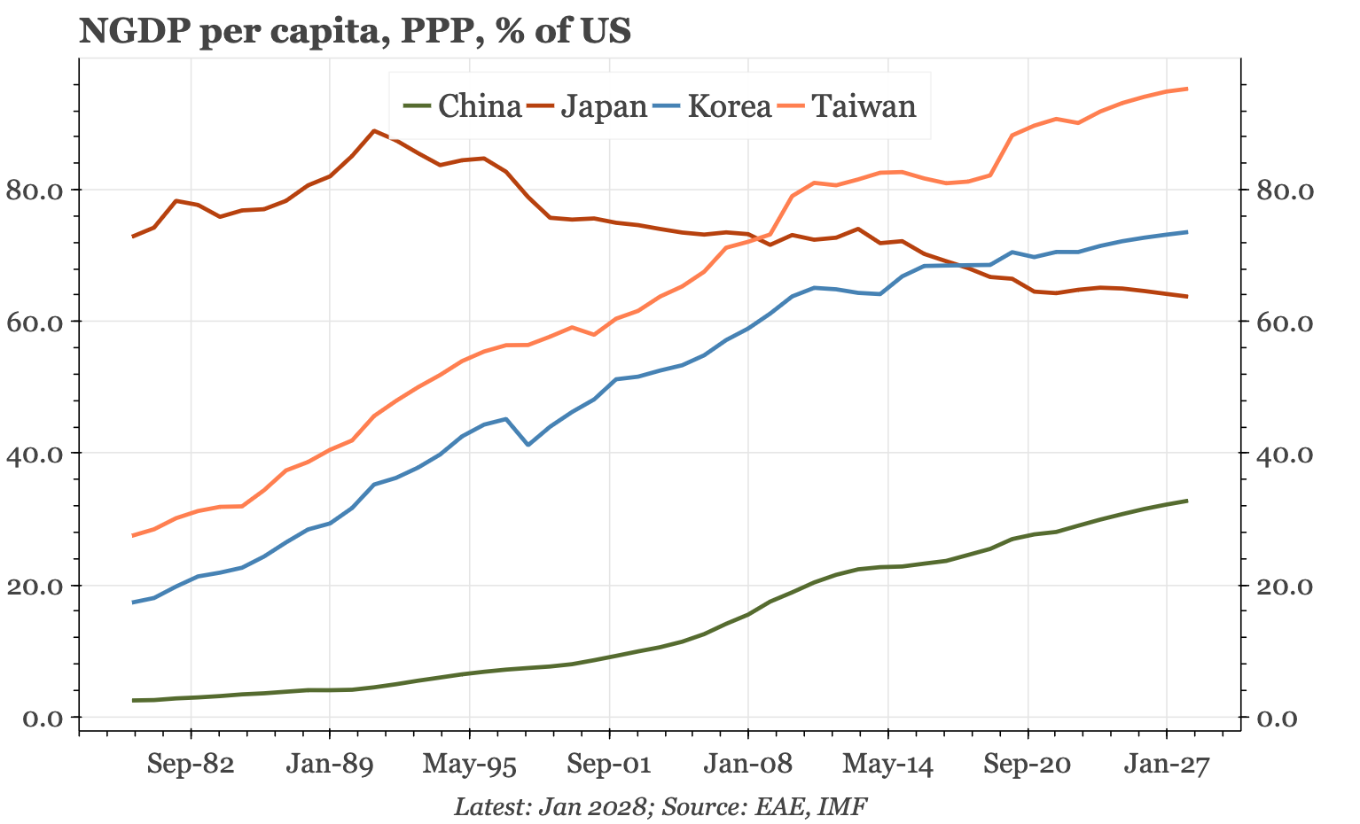
Policy and markets An opportunity for politicians

Slide 14
www.eastasiaecon.com/tw/

