Slide 1

Strategic Framework: Vision, Mission & Values
Building clarity and cohesion at the core of strategy
Our Vision
Our Mission
Our Values
To be the leading innovator in our industry, creating solutions that transform how people work and live.
We deliver exceptional products and services that exceed customer expectations while fostering sustainable growth and positive impact in our communities.
Innovation
Integrity
Excellence
Collaboration
Customer Focus
www.strategypunk.com

Slide 2
Strategic Framework: Vision, Mission & Values
Aligning purpose, direction, and principles for lasting impact
Our Vision
Our Mission
Our Values
To establish market leadership through transformative innovation that redefines industry standards and creates sustainable competitive advantage.
We drive organizational excellence by delivering data-driven solutions that optimize performance, accelerate growth, and generate measurable value for stakeholders across the enterprise.
Strategic Excellence
Client-Centricity
Analytical Rigor
Collaborative Leadership
Continuous Innovation
www.strategypunk.com

Slide 3






Strategic Framework: Vision, Mission & Values
Defining why we exist, what we do, and how we lead
Our Vision
Our Mission
Our Values
To establish market leadership through transformative innovation that redefines industry standards and creates sustainable competitive advantage.
We drive organizational excellence by delivering data-driven solutions that optimize performance, accelerate growth, and generate measurable value for stakeholders across the enterprise.
Strategic Excellence
Client-Centricity
Analytical Rigor
Collaborative Leadership
Continuous Innovation
www.strategypunk.com

Slide 4

Strategic Framework: Vision, Mission & Values
Building clarity and cohesion at the core of strategy
Our Vision
Our Mission
Our Values
To be the leading innovator in our industry, creating solutions that transform how people work and live.
We deliver exceptional products and services that exceed customer expectations while fostering sustainable growth and positive impact in our communities.
Innovation
Integrity
Excellence
Collaboration
Customer Focus
www.strategypunk.com

Slide 5



Strategic Framework: Vision, Mission & Values
Building clarity and cohesion at the core of strategy
Our Vision
Our Mission
Our Values
To be the leading innovator in our industry, creating solutions that transform how people work and live.
We deliver exceptional products and services that exceed customer expectations while fostering sustainable growth and positive impact in our communities.
Innovation
Integrity
Excellence
Collaboration
Customer Focus
www.strategypunk.com

Slide 6
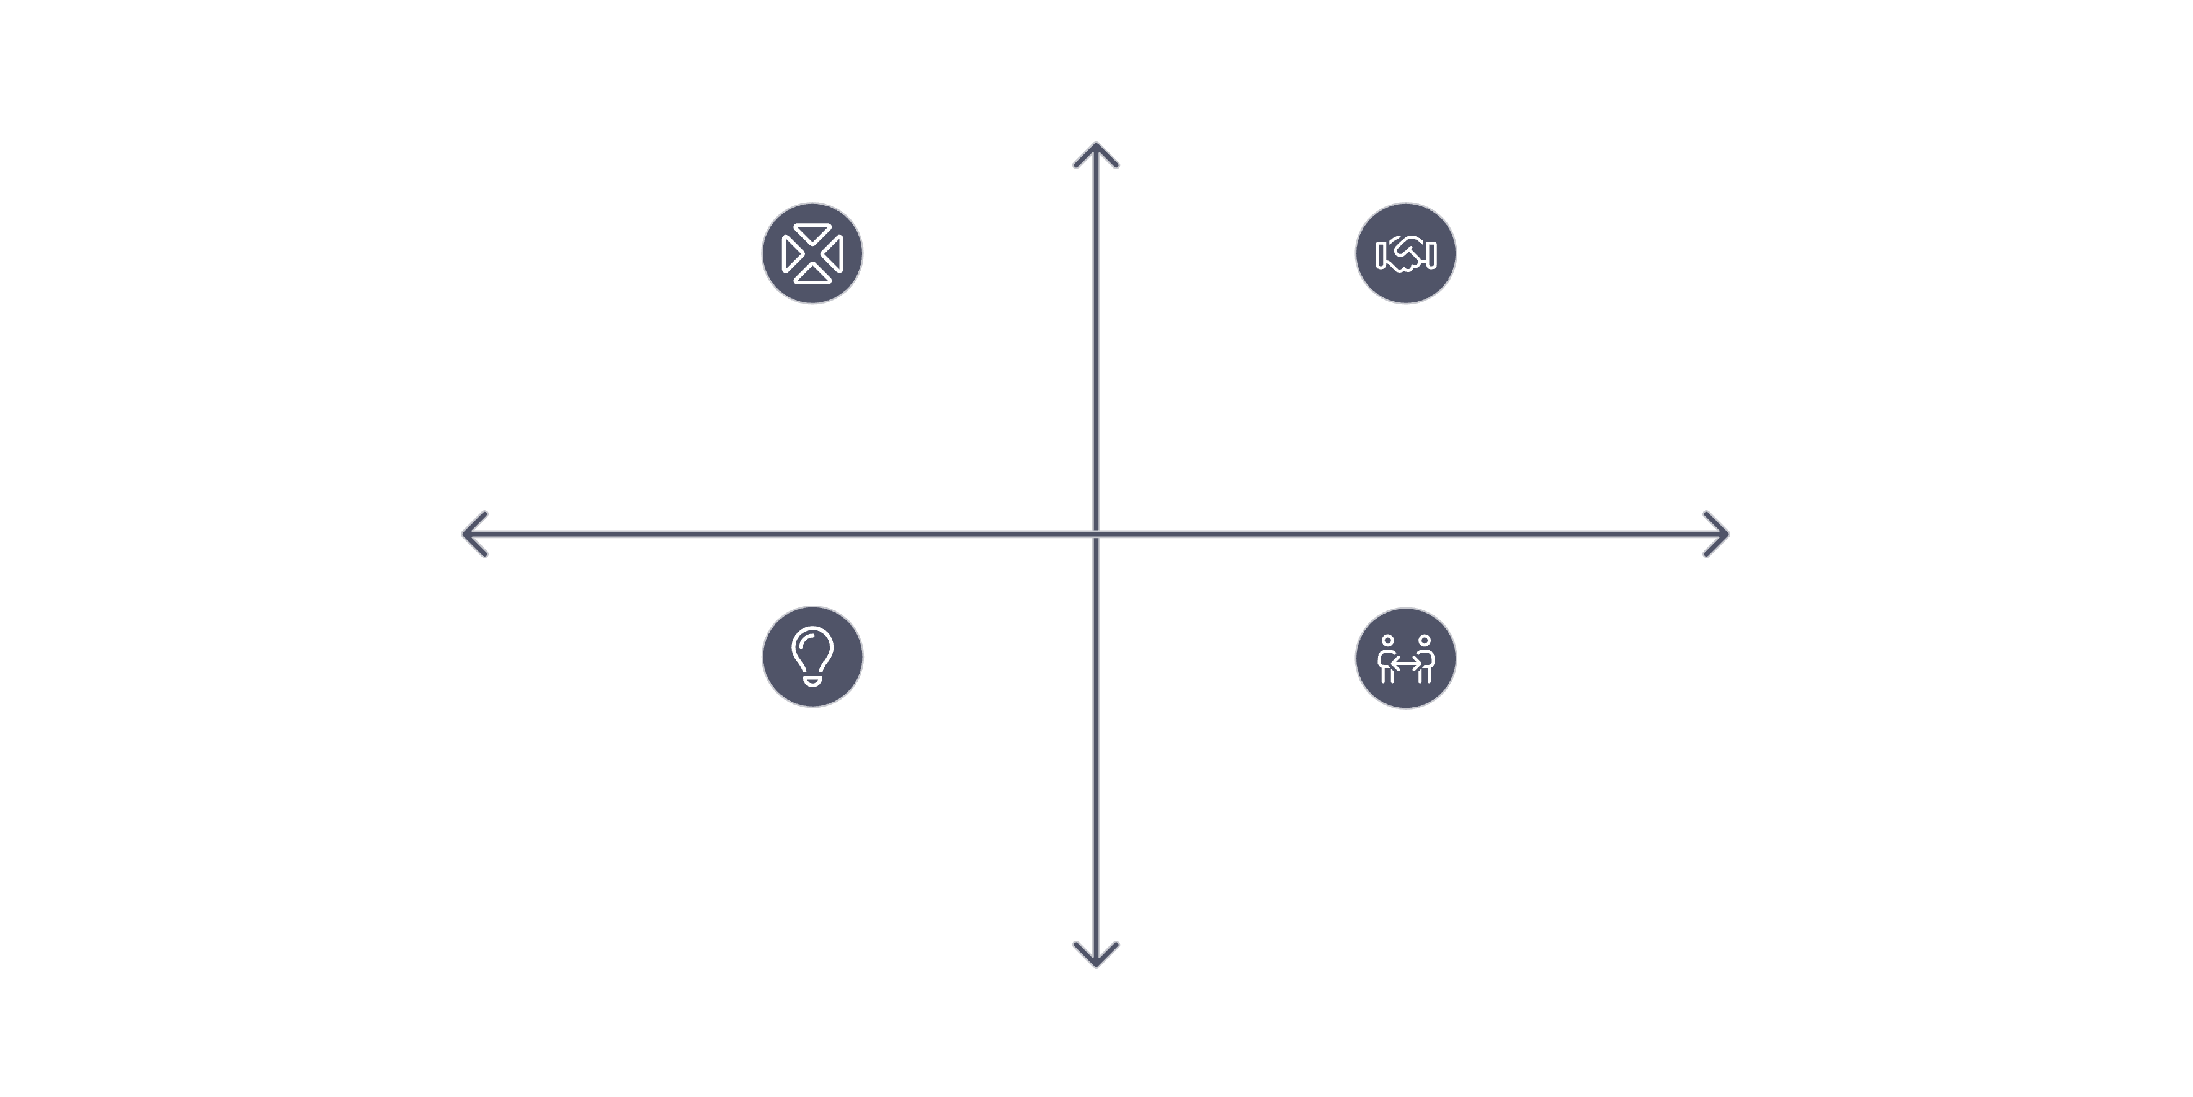




Strategic Framework: Vision, Mission & Values
Defining why we exist, what we do, and how we lead
Vision
Strategic Excellence
Client-Centricity
Culture
Mission
Continuous Innovation
Collaborative Leadership
Values
www.strategypunk.com

