Slide 1
Read the Talking Points Articles at your Tables
What can you learn about using and integrating quotes?
What can you learn about the value of multiple perspectives and how to balance them?
What can you learn about transitions?
What pattern(s) do you notice about this type of news feature?
Bellwork
Notes:
Day 1 – I begin the week by placing copies of The Week magazine on their tables, pre-opened to the recurring feature “Talking Points.” Each talking points article is 3 paragraphs and explores various perspectives on a current event. It is a great model for how to embed quotes, put sources in conversation, and explore multiple perspectives on an issue. I discovered “Talking Points” through my own subscription, however, my media specialist was delighted to use money set aside for periodicals and get the school a subscription. There are also some free ones on The Week website.

Slide 2
This week, you are going to write your own ’Talking Points’ Style Article
How should I grade it? What are the markers of a successful ’Talking Points’?
What would an ’A’ paper look like? Would what it do?

Slide 3
Your Talking Points Article
Due ___<End of Day 3> _____ by Midnight
  Typed, formatted to look like the ones in The Week
  Creative titles and pictures are fun EXTRAS
  Submit on Canvas
Requirements
3-5 sources reflecting multiple perspectives
You, as author, are invisible (write in an unbiased 3rd person)
Bold sources and identify relevant authorship
A-level work
Balances quotes with paraphrasing
3 Paragraphs (roughly 300 words)
Demonstrates selective, short and deliberate use of quotes
Explains relationship between perspectives while remaining neutral and invisible
Quotes are integrated, not dumped
Creative hook
Sources reflect multiple lenses
Notes:
Here’s how I grade this assignment: If students meet the requirements above, they can get any where between a 70 and an 89. 70s are papers that just barely did what they were supposed to do. If they did not meet the minimum requirements, I return it to them ungraded. Try again. If students succeed at the required tasks and attempt to do some of the A-level work, they can get anything from a 90-100. I emphasis that they must do EVERYTHING in the required box, but only one thing in the A-level work.

Slide 4
Putting it all Together
3 paragraphs: 50 pts
  Paragraph 1: describes the controversy and one point of view on it
  Paragraph 2: gives an alternate point of view and quotes multiple sources that support that
  Paragraph 3: shows a 3rd perspective on the issue
Format: 20 pts
  Highlight the sources
  Use both direct quotes and paraphrasing
Grammar Grade: 30 pts
  Proofread your work
  Embed quotes as we will discuss
Prompt: write a “Talking Points” style article on the issue of your choice
  This will be a 100-point writing grade
Focus on transitioning between sources and putting them in conversation
Remain unbiased! This is expository writing that is not about your opinion
Notes:
Alternative version of the prior slide based on grading preference. I used this when I did Talking Points in sophomore English.

Slide 5
What voices are missing still? What perspectives would you like to add a quote to?
Thinking about, the research you gather on Friday...

Slide 6
Add to your notes on searching the Gale database: “Direct Searching Media Outlets”
To find current events and news media source either
  In a search engine type “<your topic> <news outlet>”
    Example: Iowa Debates NPR
    Example: Strip Mining Washington Post
  Or better yet go directly to a news website and type your topic into their search function

Slide 7

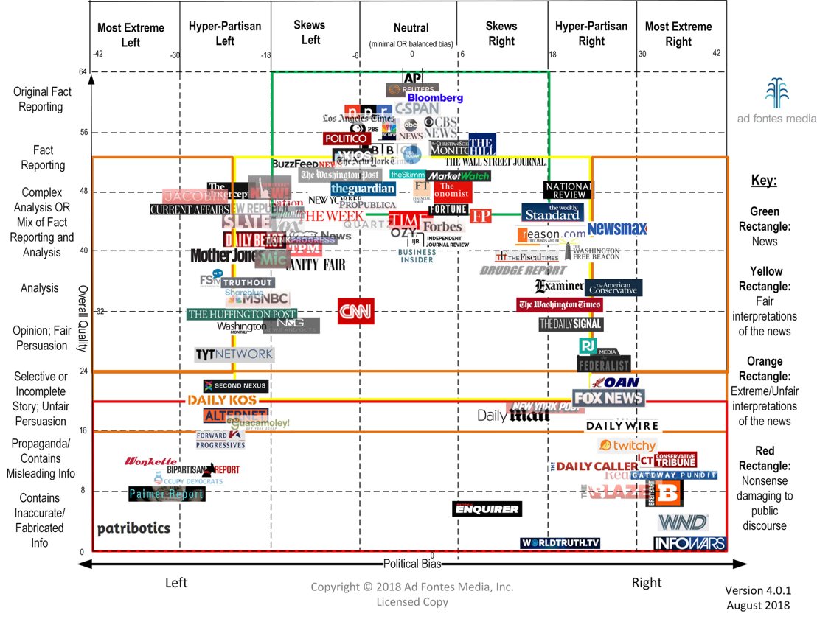

Slide 8
Bellwork
Looking back again at the Talking Points articles, come up with three rules/guidelines/tips at your table for how to make quotes flow smoothly with your own words.
Notes:
Day 2

Slide 9
Three Tips (and 1 Rule) for Embedding Quotes
The Only Rule: Never leave quotes alone in their own sentence. Ever. Seriously, ever.
Use one of these:
1
According to _______, “…”
As ____ said in her essay _____, “…”
In the words of ______, “…”
The author goes on to explain that “…”
Put quotes in the middle of your sentences to combine evidence and commentary
2
Keep your quotes as short as possible (like 10 words or less)
3
Notes:
I have them copy this into their notes section.

Slide 10
Begin your Talking Points article
And start embedding quotes!

Slide 11

Today is a Work Day
Participation Points awarded for using class time wisely
  And deducted for not…
Bring necessary materials (devices, printed articles, etc.)
Take advantage of the classroom
  Help each other!
  Ask me questions!
Find the quotes you want to use from the articles you found yesterday
Begin Writing Your Talking Points Article
Papers Due Tonight

Slide 12
Dear Teacher
The next few slides are to demonstrate what I did the last few years. I will update again this year with a current news story, often one that I hear on the way to work that day.
  The requirements are simple:
    should be less than five minutes to listen to
    The host interviews a REPORTER who gives a break down of the news
  Then I find it on NPR’s website and copy/paste their picture into the slides below.
Why two slides?
  We listen to it twice.
  The first slide has discussion questions about CONTENT
  The second slide has discussion questions about vocal variety

Slide 13
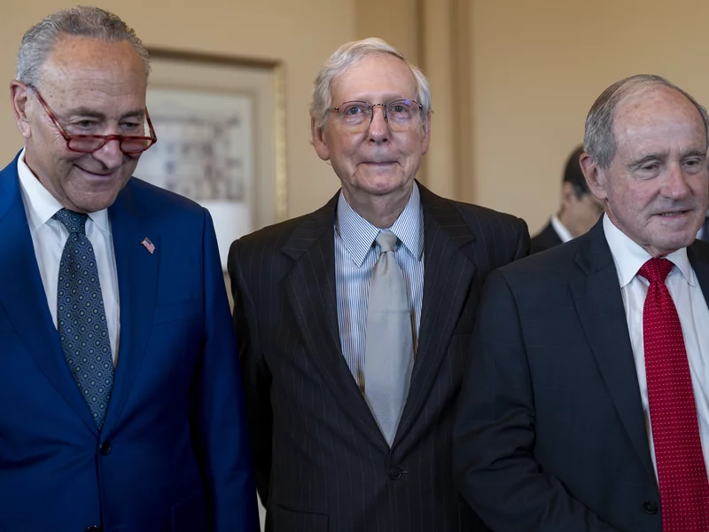
Listen to the NPR News Brief
What lenses did you hear?
What perspectives were covered?
What types of sources did the reporter call on?
How did the reporter present the information in an interesting way?
Notes:
Mitch McConnell appears to freeze again while talking to reporters in Kentucky : NPR

Slide 14
Listen Again, but this time listen to their voices
How does the reporter avoid being monotone?
How does the interaction between the host(s) and the reporter create interest?
What do they do with their voices to make them interesting to listen to?
How does the reporter purposefully use multi-media sources?

Slide 15

Listen to the NPR News Brief
What lenses did you hear?
What perspectives were covered?
What types of sources did the reporter call on?
How did the reporter present the information in an interesting way?
Notes:
Rebuilding Lahaina to be more resilient after deadly wildfire : NPR

Slide 16
Listen Again, but this time listen to their voices
How does the reporter avoid being monotone?
How does the interaction between the host(s) and the reporter create interest?
What do they do with their voices to make them interesting to listen to?
How does the reporter purposefully use multi-media sources?

Slide 17
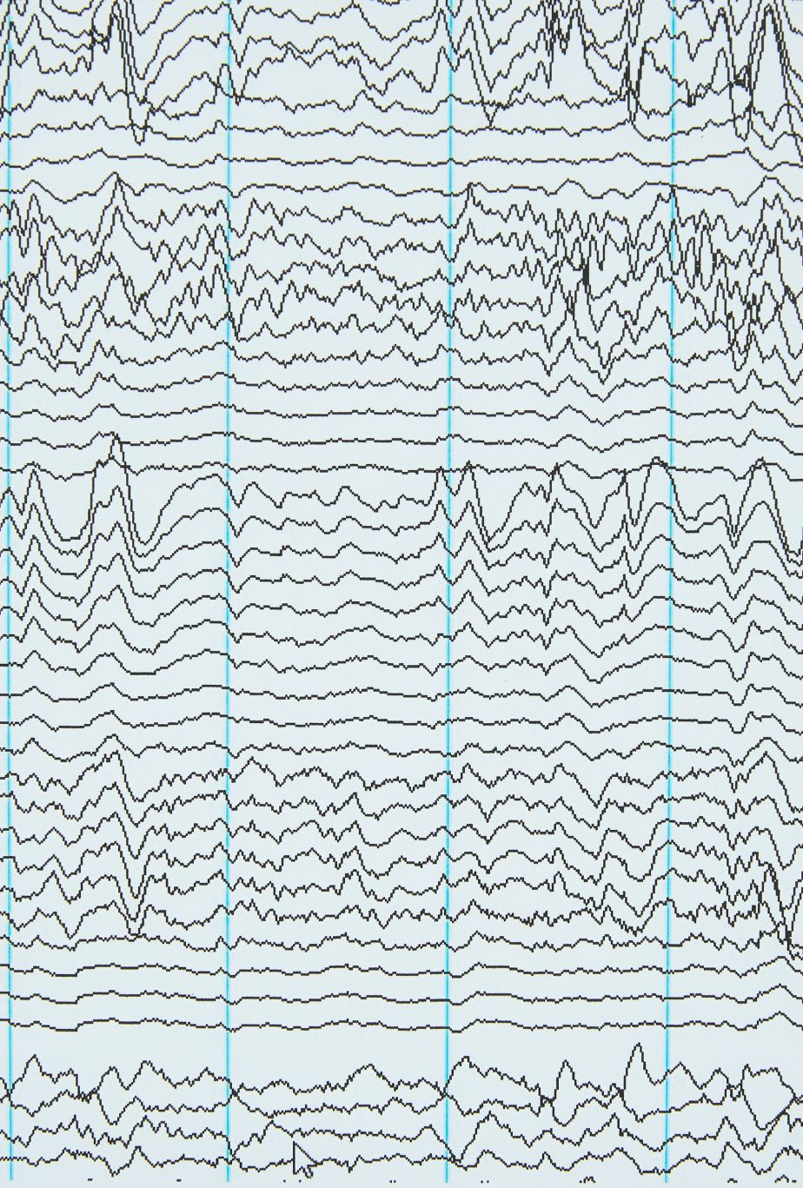
Vocal Variety
Volume (quiet and loud)
Intonation (rise and fall of pitch)
Pace (rate/speed)
Pause (sound and silence)
Resonance (strength and breath)
Notes:
Students add these notes to the notes section of their notebook

Slide 18
Controversial Topic Briefing
You will prepare a set of questions which you will be ready to respond to with minimal text aides.
The purpose of this activity is to…
Develop extemporaneous speaking skills
Ease students into public speaking
Improve vocal variety in public speaking
Notes:
Spend some time discussing the meaning of the word extemporaneous. Sometimes, I even have them add that word and its definition to their notes.
Another way of explaining this assignment: look back at the talking points article you wrote. Imagine that you are going to verbally report on what each paragraph says—not read it out loud but speak extemporaneously about it! The host of the program (your partner) is going to ask a question before each paragraph and then you as the reporter will answer with the information from the paragraph.

Slide 19
Controversial News Brief
Due __<I usually do two days from showing this slide>__
  3 notecards, one question each, written large (the first questions should include a 1-2 sentence introduction)
  3 notecards with quotes/facts/info
  You will be graded on your own speaking as well as the way you read the three questions introduction and three questions from your random partner.
Requirements*
You speak on the topic of your talking points article
Clearly demonstrate 4 of the 5 elements of vocal variety
A-level work
(do at least one of the following)
Student employs an audio recording as one of their quotes
Should be about 2 minutes in length
Only refers/reads off notecards for specific information
Clearly demonstrates all 5 of the elements of vocal variety
Expresses genuine emotional reactions as part of their presentation
Write a cute outro for you & your host
*Please keep in mind that not fulfilling the requirements means you will redo it in order to earn the grade.
Notes:
This is the slide I use when I plan to do the presentations live in class. I call students up two at a time randomly and they just trade notecards and I check off as I hear each element of vocal variety.

Slide 20
Controversial News Brief
Due __<I usually do two days from showing this slide>__
  Option 1: find a partner and record two short podcasts, trading jobs as host and reporter
  Option 2: with a group of 3-5, record a news podcast where one person serves as the host and cycles through the other members as reporters.
Requirements*
You speak on the topic of your talking points article
Clearly demonstrate 4 of the 5 elements of vocal variety
A-level work
(do at least one of the following)
Edit the audio with intro/outro music and make it sound like a real newscast!
Should be about 2 minutes in length
Only refers/reads off notecards for specific information
Clearly demonstrates all 5 of the elements of vocal variety
Expresses genuine emotional reactions as part of their presentation
Write a cute outro for you & your host
*Please keep in mind that not fulfilling the requirements means you will redo it in order to earn the grade.
Notes:
This is the slide I use when I have students record them as podcasts.

Slide 21
Take turns reading the sentences at your table. Each time you read the sentence, emphasize a different word by altering the tone and pitch of your voice to affect different meaning.
Bellwork
Notes:
Day 5 – Prep by writing the following sentences on sentence strips before class. (these sentences aren’t magical, you can make your own, or have kids make their own!)
Do you really want to fight with hammers?
My bathroom is on fire.
I’m telling you soup is cereal.
Mom, get the guerrilla out of the garage.
Does this keyboard smell like feet?
I’m sorry. I ate all the plums.
It’s possible that he didn’t mean to cheat.
Would you invest your retirement in bitcoin?

Slide 22
“Oh” – “Wow” – “No”
I’m thinking of asking out Kyle.
Did you know hippos run 20 miles per hour?
My dog died.
Mr. Sizemore is an alien.
There’s a spider on you.
My mom has recovered from her tragic fabric accident.
I think I got the job…
  Of my dreams.
  At the dollar store.
You’ve just been served.
I really like your outfit today.
I’ve really been meaning to tell you that you saved my life.
Notes:
Get three volunteers to stand in front of the room. One of them is “Oh,” one of them is “wow,” and one of them is “no.” They can each only respond to the following prompts with their word. This is fun activity about putting emotion into speech.

Slide 23
The Big Speech
Working in your groups, coach a volunteer through delivering a famous dramatic movie monologue
Text-mark/make notes on the paper telling them how to read
Focus on using all 5 elements of Vocal Variety
Practice before the speech is performed for the class
Notes:
Prep: find and print out the text of a famous movie monologue. Here are some examples that I use: Alex Baldwin’s God Complex, Bill Pullman Independence Day for the whole world, “I’m mad as hell” from Network, ”We are the Mutants” from Stripes, Denzels’ Gettysburg speech from “Remember the Titans” …and I just realized that these are all men. I apologize and promise that I’m woke. Here: 13 Powerful Film Monologues Women Can Perform

