Slide 1
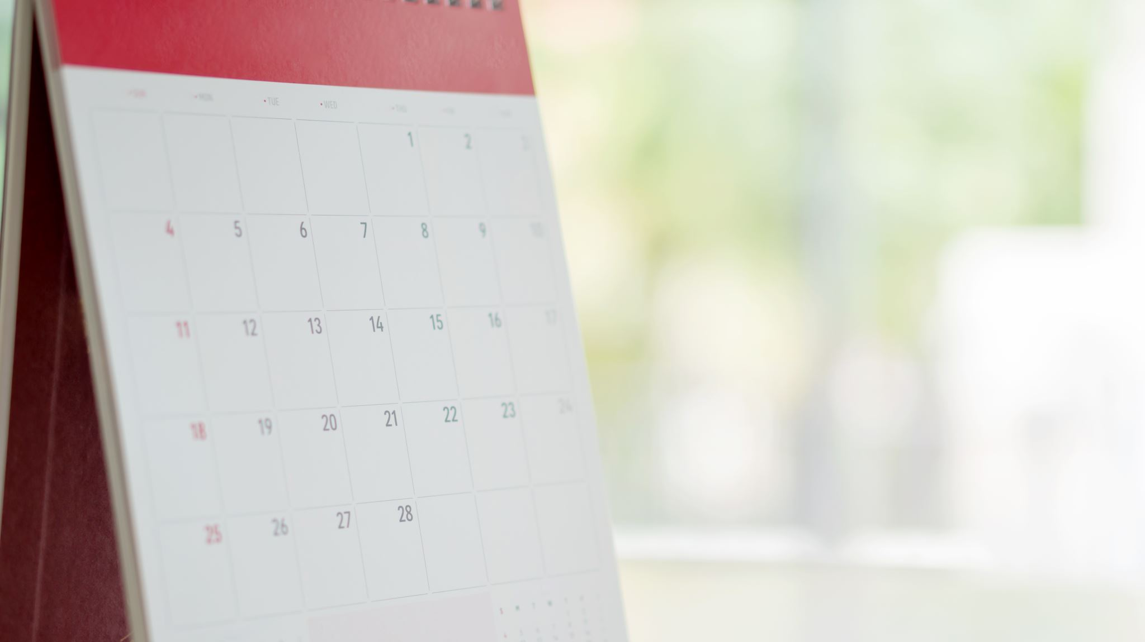
AP Seminar | 2nd Semester
Let the Madness begin
Notes:
Tuesday – Jan 6th

Slide 2
Your AP Exam Starts Now
Group Project
Individual Project
January and February
1200 Word Individual Paper (Graded by College Board)
8-10 Minute Group Presentation (Graded by Your Teacher)
I cannot help you, but other teachers can…
March and April
Based on Stimulus Material
2000 Word Paper (Graded by College Board)
6-8 Minute Presentation (Graded by Your Teacher)
I cannot help you, but other teachers can…
All Rubrics are Posted to Canvas

Slide 3
Modified Grading Scale
20% Participation
Participate in activities
Use work time wisely (“I’ll do it at home” = pts off)
30% Deadline Grades: Paper and Presentation
Completion and MEETING THE DEADLINE
50% Classwork Grades
Notebook Checks
Rough Drafts and High Quality Peer Feedback
Stimulus Materials
Other Assignments as I see fit

Slide 4

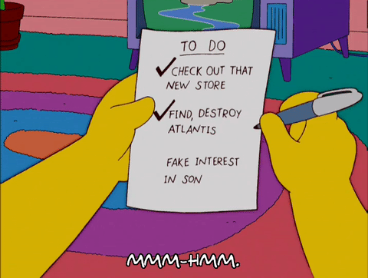
Get Out Your Calendars…

Slide 5
3rd Quarter
1/7-1/9 Topic Brainstorm and Group Formation
1/12 Research Questions Due
1/13- 2/2 Teacher-led Mini-Lessons and Student-led Work Days, Notebook Checks
2/5 IRR Rough Draft Due
2/9 Peer Feedback Due
2/17-2/20 Group Presentations
2/23 Final IRR Paper Due
4th Quarter
2/23 Receive Stimulus Material
3/2 Socratic Discussion
3/5 Initial/Research Question Due
3/11 Research Question Faire
3/24 – 4/2 Research, Notebook Checks
4/9 IWA Rough Draft Due
4/13 Peer Feedback Due
4/20-4/24 Individual Presentations
4/27 Final IWA Papers Due
Notes:
Note that the first couple weeks of quarter 4 are technically in quarter 3. These grades will apply to quarter 4

Slide 6
4/27-4/30 Last Looks and Final Portfolio Submissions
Everything must be submitted by midnight on 4/30
Notes:
It’s at this point that I will tell students that in the last three years, I’ve had 4 students not pass the exam. That’s 4 out of 150+. 3 of those 4 were the only students who did not submit both of there papers. I don’t’ want to undermine the message about how much writing a quality paper matters, but I’ve literally had one student in three years submit both papers and fail. None of the kids who passed failed to submit papers.

Slide 7
5/11 Your AP Exam
3 short answer questions (30 minutes)
1 essay (90 minutes)
Notes:
In the week between their portfolio submission and their exam date, we will go over the exam format and do some practice responses.

Slide 8
Questions???
Review:
What are the qualities of a good question?
What makes one topic stronger than another?
Notes:
This is a “if we have time” slide

Slide 9

Controversial issues!
Bellwork
And where to find them
CHeck out these:
The Week
The Atlantic
Harper’s
National Geographic
New Scientist
Smithsonian Magazine
Popular Science
Popular Mechanics
As a student, you have a library card. Download the libby App and log in
Your job today is to look through current news publications in search of compelling controversies. Make a new section in your notebook and call it Pt1 (for now). Keep track of your ideas and where you got them on a new page in that section
Notes:
Wednesday – Jan 7th

Slide 10
Bellwork
Read
Easy Topics/Issue Finder
Pull up Opposing Viewpoints in the Gale Database
Explore
There are 435 Topics in the Database. Start clicking on them and reading the overviews
Record
In your notebook create a list of topics and issues that you are interested in exploring further.
Take a look at the available sources. Skim through some of the different opinion articles
Notes:
Thursday – This bellwork is a backup for students who maybe struggled to find something the day prior

Slide 11
SUBJECT
TOPIC
ISSUE
Notes:
Revenge of this slide
Example: Subject: Technology. Topic: AI Issue: Pollution caused by AI data centers
They want an ISSUE

Slide 12
On Your Poster Due By THE END OF CLASS
This is NOT a brainstorming activity. This is a quietly reading and writing activity.
Layout your poster in w/e way you choose but include the following information:
Topic
Debate/Controversy
Subtopics
Potential Questions (not research questions necessarily)
Specific Perspectives (at least 3) (look in viewpoints/featured viewpoints)
Where Your Peers Can Read/Learn More (other articles/videos of interest)

Slide 13
3 Ways to Evaluate Potential Topics
Topic 1 ***
Topic 2 *
Topic 3 *****
Key:
* = Relevant/Current
* = Researchable
* = Multiple Perspectives
* = Actual Debate
* = Unique & Specific
Open
Your Method Here!!!
Broad
Specific
Closed

Slide 14
Gallery Walk
Write your name on 5 post-it notes.
Absolute Silence
Do not place any post-it notes until we say so. Be sure to view all posters.
You must place all 5 post-it notes.
Notes:
Friday Jan 9th – After the gallery walk, eliminate all posters with 2 or fewer post-it notes but check for eliminating kids. Then start the messy process of building the groups. I always do this right in front of them with the posters still spread around the room. I tell them to be quiet and watch and to let me cook. They can raise their hand if they have a suggestion, but I might not call on them. I think aloud while I build the groups. If their name is on a poster, it’s fair game. I will eliminate posters that are too broad or are setting a group up for failure in some other way, but I don’t say that part out loud and I do this sparingly. It’s a little bit of a cheat, but not really. I’m just assisting in group formation. It’s messy, but by the end of the period people are sitting in their new groups.

Slide 15
Once Groups are Formed…
Creating Group norms
To Do List:
How will you communicate?
What platform will you use to collaborate?
What’s your group name?
What are you going to do to have some fun with this?
Formulate and agree on a research question
Divide the work into subtopics/sub-questions/lenses
HOMEWORK: Start researching. Everyone bring in 5 sources for Tuesday.
At least one academic source
At least one news source (preferably semi-current)
At least three different perspectives
No overlap between members
Notes:
If the first part takes too long, kick this to Monday.

