Slide 1
What is product marketing?
The PMA take

Slide 2
“Product marketing can be summed up as the driving force behind getting products to market - and keeping them there. Product marketers are the overarching voices of the customer, masterminds of messaging, enablers of sales, and accelerators of adoption. All at the same time.”
- PMA

Slide 3
Customers
Product marketers sit at the intersection of several functions.
As well as the core departments outlined here, they’re a regular point of contact and guidance for other internal teams, like:
Sales enablement
Finance
Engineering
IT
Senior leadership
...and more.
Product
Product Marketing
Marketing
Customer Success
Sales
Customers

Slide 4
When product marketers are set-up for success, they:
Represent the voice of the customer - before, during and after launch
Unlock new opportunities and tee marketing and sales teams up for success
Ensure what companies deliver is what people actually want - and are willing to pay for
Clearly articulate a product’s value in a way that resonates with the market
Drive customer adoption and advocacy - and therefore the business’ bottomline
Ensure company-wide alignment
When product marketers are set-up for success, they:

Slide 5
Roles & responsibilities
The role of product marketing is varied and day-to-day, you’ll find them doing any number of these core activities:
Mastering product positioning & messaging
Crafting your product’s story
Managing product launches
Driving alignment across the organization
Creating and delivering sales collateral
Conducting customer and market research
Analyzing and optimizing campaigns and products
Reporting on product marketing metrics
Working on the product roadmap
Onboarding customers and ensuring they’re set-up for success with your product
Content marketing initiatives - such as blog posts, landing pages, email copy, etc.
Managing the website

Slide 6
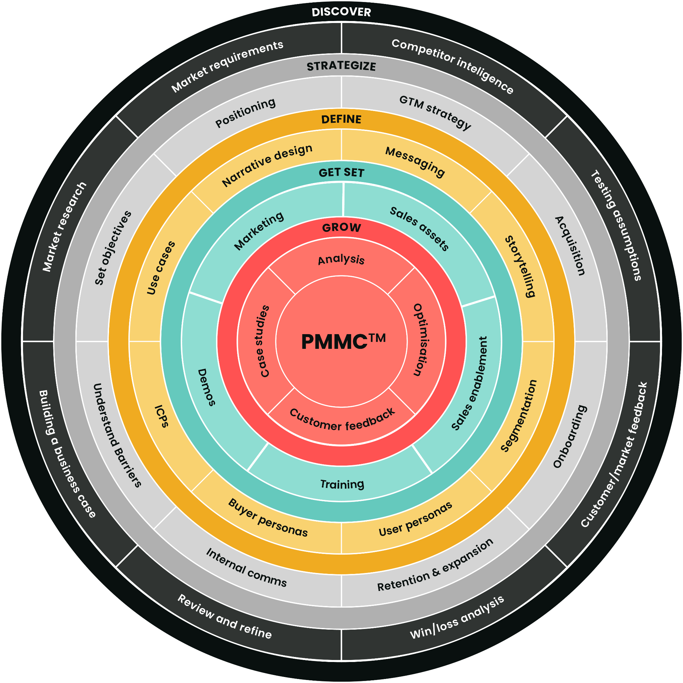
The depth of the role doesn’t stop there though, and there’s a lot of work involved in successfully launching a product - and making sure it continues to be successful overtime. Here’s a visual representation of the steps product marketers take when growing a product.

Slide 7

While a product marketer’s skill set should be utilized during every stage of the cycle, the tasks they undertake will vary slightly depending on which phase the product’s in - let’s take a top line look at each of those phases in isolation.
Maturity
Growth
4
3
Decline
5
Introduction
2
Development
1

Slide 8
The development phase
Along with other internal teams, product marketing will go heavy on research in this phase - and that includes competitor, prospect, customer and market research
The core focus here is speaking to the market, understanding what they want, and defining those must-have requirements
PMMs will spend a lot of time immersing themselves in the product during this phase to ensure they understand it inside and out and, as well as the Product team, are subject matter experts in it

Slide 9
The introduction phase
Testing is key in the introduction phase - as well as testing new products and features themselves, PMMs will beta test upcoming releases and gather invaluable feedback that feeds into future, improved iterations
As well as testing the product itself, PMMs will test things like the product’s positioning, messaging, onboarding, and so on
The result of this is a more polished off product so that when marketing starts to go hard on their activity, they’re set-up for success
Key questions PMMs find answers to in this stage include: how are people reacting to our product? What do they like and dislike? How do they feel about us against our competitors? Do they have any reservations about our product? Are there any needs our market has that we’re not addressing?

Slide 10
The growth stage
Continually tweak, refine and improve what’s already being done in terms of both promotions and the actual product
During this phase the market, competition and perceptions will change, and PMMs keep a constant pulse on that and make changes/recommendations accordingly
Key questions the product marketing function answers in this stage include:
  Does our messaging still work?
  Are we differentiating ourselves enough from the competition?
  Are our customer using the product?
  Are our customers crying out for new features?
  Are we looking for customers in the right places?

Slide 11
The maturity phase
The focus shifts to maintaining industry authority and market share
By this point, the market will have probably flooded with competitors which can make differentiation even harder and because of this, the maturity phase is often a time for PMMs to look for ways to reinvent the business model and do something others aren’t
PMM:customer conversations are critical during this phase because customers’ wants will have changed since the introductory phase - and these insights should feed into future plans
This stage is all about seizing opportunities and taking calculated risks to do something that’ll make the product really stand out from the crowd

Slide 12
The decline phase
A product marketer’s job is to prevent this phase being reached in the first place but if that isn’t humanly possible, they will:
  Find another use for the product - which relies on a positioning and messaging overhaul, plus a whole new set of customer and market research
  Introduce a new product, or suite of products, to replace the declined one

Slide 13
Next, let’s take a look at product marketing benefits by department
Sales | Product | Customer success | Marketing
*While their benefits span far further than these four, for now, we’ve decided to focus our attention on the main business areas product marketing interacts with.

Slide 14
Product marketers help scales teams close more deals by:
Equipping reps with sales collateral (like battlecards, product sheets and sales scripts) so they’re able to deliver stronger pitches with shorter sales cycles
Ensuring reps aren’t over or under-selling your products
Delivering product training - including the product’s specifications, positioning, pricing, benefits, etc.
Providing key learnings and feedback to help make all sales reps top performers
Optimizing the buying funnel and providing more, high quality leads
Helping them personalize their pitches to various personas, segments and markets, so every sales conversation is relevant

Slide 15
Product marketers help product teams deliver better products by:
Fuelling them with real prospect and customer insights so they know what people do and don’t like, what there’s demand for, how users are using the product, and more
Ensuring all releases are tied to organizational goals
Fine-tuning existing products based on customer feedback to ensure ongoing usage and revenue
Helping to build out product roadmaps and bringing fresh ideas to the table
Ensuring other internal business areas are positioning products correctly

Slide 16
Product marketers help customer success deliver better experiences by:
Providing in-depth data on things like a customer’s goals, pain-points, drivers, traits, and so on, so they can provide tailored conversations
Ensuring their Customer Success colleagues are armed with everything they need to successfully handle complaints and objections
Reducing the number of complaints received by a) ensuring sales aren’t overselling the product, and b) taking feedback on board and making changes based on customer requests/demand
Equipping customer success with the collateral and training need to up or cross-sell products
Providing customer-driven feedback on how their processes can be improved

Slide 17
Product marketers help marketing bring in more leads by:
Arming them with key market, persona and segmentation data so they can deliver highly targeted campaigns that convert
Providing mission-critical positioning, messaging and storytelling information to improve the impact of campaigns - email, PPC, social, PR, or otherwise
Supplying customer case studies for use across the board to add credibility to any campaign
Providing customer-driven feedback on how their marketing activity can be improved

Slide 18
Let’s take a look at $$$$
How product marketing contributes to the business’ bottom line.
Being the voice of the customer, PMMs ensure every output is in-line what customers want - happy customers stay longer and buy more, and that increases their CLTV
Driving adoption leads to loyalty, loyalty leads to referrals, and referrals lead to sales
More confident sales reps, shorter sales cycles and better, sales-qualified leads means reps can a) increase their win-rate, and b) spend more time selling, and less time convincing
Data-driven product and feature decisions means money isn’t wasted on unsuccessful releases
Better optimized marketing campaigns = more deals closed
When prospects understand the true value of your product, they’re willing to pay more for it - and that’s a direct result of product marketing’s positioning work and will lead to an uplift in deal sizes

Slide 19
Product marketers don’t work in a vacuum…
And to be successful, they need to be:
Brought into into the product roadmap and key business decisions from the very beginning
Given a voice across the company - PMMs listen to customers, you need to listen to PMMs
Be trusted to do their job - product marketing is strategic and tactical, and being agile is essential
Able to access knowledge and data from around the organization - especially from other customer-facing teams, like Sales and Customer Success
Co-operated with - product marketing is a highly cross-functional role and to execute their objectives, they will almost always need support from other, internal teams
Buy-in from senior leadership and alignment across the company
Communicated to clearly and involved in discussions that a) impact them, and b) they can add value to
Valued and understood by everyone in the organization

Slide 20
Quashing a common confusion…
What’s the difference between product marketing and product management?
In a nutshell, product managers are the people who create and define products and features. They work closely with developers, designers and engineers to build and refine a product based on what’s most valuable to their market. Just some of their core responsibilities include defining customer needs, translating customer requirements into tangible products or features, prioritising requests, and conducting research into competitors’ products.
This is where the confusion can come in, because, like product managers, product marketers are also responsible for things like understanding customers’ needs and the competitive landscape, however, although they too need to know the product inside and out and be a subject matter expertise on it, they don’t always have the same level of technical insight as product managers. And, as we touched on earlier, product marketers are also responsible for things like go-to-market strategies, positioning, messaging, sales enablement, and so on, and these are all activities product management doesn’t touch - except for perhaps fact-checking the technical accuracy of what’s been written in internal and external-facing documents.

Slide 21
The key to success
Product managers and product marketers are most valuable when they work like this:
Not this
Product Management
Product Marketing
Product Management
Product Marketing

Slide 22
“Good product marketing is invaluable. At many of the early-stage start-ups I have personally worked with, this has been a hole and the pain is felt throughout the company. Good product marketing is mission-critical, and good product marketing people are extremely valuable.”
- Anonymous C-suiter

Slide 23
Got a question?
youremailgoeshere@you.com
We’re all ears. Just drop me a line or come drop by my desk and I’d love to chat about all things product marketing in more detail.

