Slide 1
Voice of the customer report
Analysis of customer feedback & strategies impacting revenue

Slide 2
How to use this template
With so much changing daily, it's critical to review all the feedback coming into your business so you can react, reassure and redirect focus as needed.
Use this template to report on customer and market feedback impacting new revenue and retention, as well as the strategies you are putting in place to adapt.
Use this spreadsheet to populate the charts.

Slide 3
Voice of the customer report
Analysis of customer feedback & strategies impacting revenue
Meeting purpose:
Review customer and market feedback to identify opportunities and threats to new revenue and retention.
Use learnings to monitor, support, and adjust strategy; communicate back to frontline teams, customers, and prospects.
Meeting attendees: Cross-functional leadership (decision makers) – Customer Success, Sales, Marketing, Support, Product.
Cadence: Every week, 1-hour meetings with report-outs
Agenda:
(1) Executive summary
(2) customer feedback insights
(3) action plan

Slide 4
Voice of the customer process overview
Leaders | Channels | Insights | Impact
Sales | Sales calls | Why are/aren’t prospects buying? Who are we losing deals to and why? | New revenue
Marketing | Online reviews Win/loss calls | What do customers like/dislike about us? What is working/not working with the offer and positioning? | New revenue Retention
Customer Success | NPS & CSAT surveys | Why are customers leaving? Where are there opportunities to deliver more value to them? | Retention
Customer Support | Support tickets | What common questions and requests do customers have? What common issues need support? | Retention
Product Management | In-app surveys | Where do customers struggle in product? What are they asking for? | New revenue Retention
Actions
New offers and positioning
Roadmap prioritization
New support and service models
Frontline enablement
Messaging and campaign strategy
Communications and content

Slide 5
Executive summary

Slide 6
Revenue scorecard
May 2025
KPI |  | Goal | Forecast | % | Feedback Insights | Actions
New Revenue | New customers | 25 | 24 | 96% | Prospects have been increasingly negative about missing features specifically around notes functionality. | [Product]: Improvements to notes - multiple users complained of notes disappearing in March
 | New revenue | $45,000 | $39,000 | 87%
Churn | Churned customers | 20 | 30 | 150% | Customers are complaining more frequently about support and platform reliability. | [Product]: Improvements to notes - multiple users complained of notes disappearing in March
 | Churned revenue | $9,000 | $12,000 | 133%
Net Customers | Net customers | 1000 | 989 | 99% | Customers and Prospects have been giving increasingly positive feedback about Ease of Use. | [Marketing]: Elevate ease of use in value prop and positioning on website - more important than ever for doctors to have easy & user-friendly tools.
 | Net revenue | $450,000 | $441,000 | 98%

Slide 7
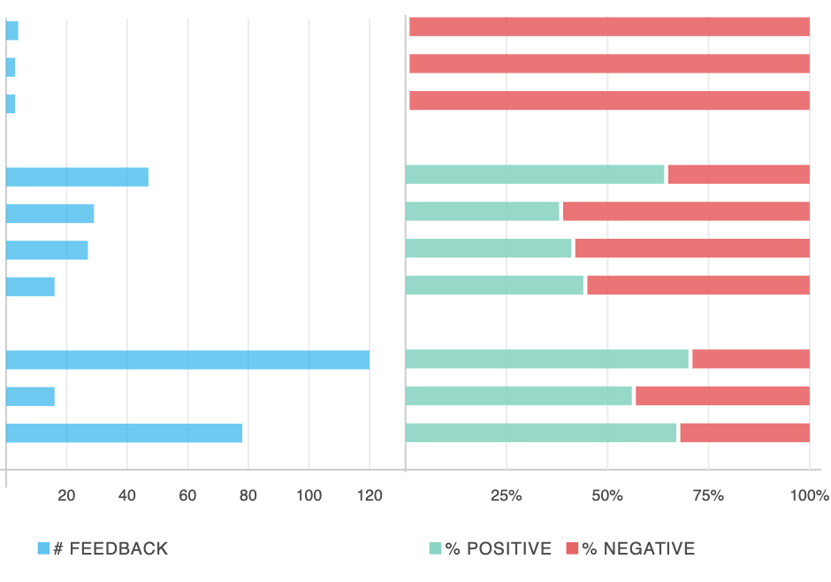
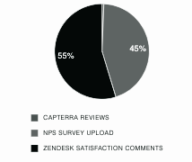
Customer feedback summary
May 2025
Feedback volume
Positive sentiment
Topics mentioned in feedback
Service responsiveness continues to drive positive feedback.
Customers are complaining more about support and platform reliability.
Customers and prospects have been giving more positive feedback about Ease of Use due to product roadmap work around UX improvements.
Prospects have been increasingly negative about missing features specifically around notes functionality.
Recommendations: update value prop to focus on ease of use, explore alternate support channels to prevent churn while product team focuses on stability improvements
180
65%
Price point
Packaging
Price metric
Ease of use
Features
Platform
Analytics
Service
Onboarding
Support
vs 300 last month
vs 50% last month
Feedback by channel

Slide 8

Key takeaways
May 2025
Topic | Sentiment | Trend | Impact | New actions needed
Ease of Use |  |  | Retention & New Revenue | [Marketing]: Elevate ease of use in value prop and positioning on website - more important than ever for doctors to have easy & user-friendly tools.
Service |  |  | Retention | [Marketing]: Elevate responsiveness in value prop and positioning.
Support |  |  | Retention | [Support]: Explore options to provide support in real time to prevent churn.
Features |  |  | New Revenue | [Product]: Improvements to notes - multiple users complained of notes disappearing in March
Platform |  |  | Retention | [Product]: Analyze reliability improvements

Slide 9
Customer feedback
insights

Slide 10
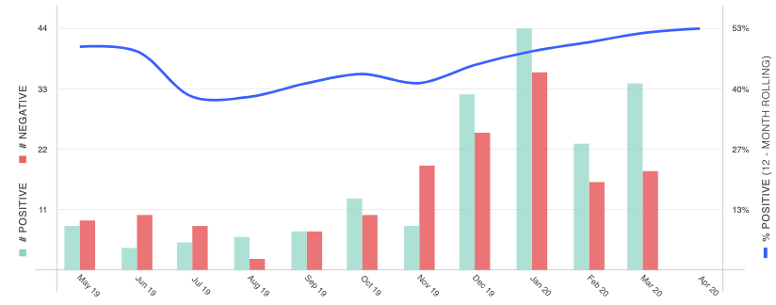
Ease of use
May 2025
On the front-end it was super easy to integrate with our existing website. On the back-end it is so easy to use that our 70+ year old financial secretary has no problem using it to track our financial giving.
Easy to navigate through the website. The interface is clean.
Super user-friendly, open source, robust functionality and even some ML capabilities.
Easy to use because of schema-less feature. Data retrieving is very fast. Powerful Aggregate functions.

Slide 11
Ease of use (cont.)
Insights
Impact
Action
Customers have been
giving increasingly positive feedback about Ease of Use (especially from mid-market customers). Positive impact from February product roadmap work around UX improvements.
Retention & new revenue - mid-market customers
[Marketing]: Elevate ease of use in value prop and positioning on website.

Slide 12
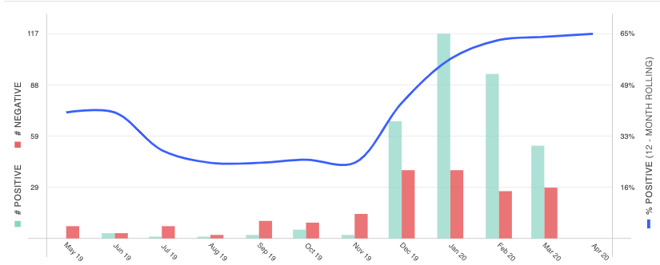
Support
May 2025
No customer support. Can’t ever talk to a person.
I do not like the fact that you can not talk to a rep for problems or questions in real time. EDI is difficult and the help is minimal.
Posting receipts takes too long. Reporting is very limited.
Lots of features I don’t know how to use. Lot of quirks that drchrono doesn’t fix like non threading of messages to and from patients, and I can’t call and get tech support while the problem is occuring. I need to fill out a ticket with a lot redundant drop down options.
The colors and art features are limited. Tech support is not consistent. Sometimes we get an almost immediate response and other times it may take an hour or two to resolve questions.

Slide 13
Support (cont.)
Insights
Impact
Action
Customers have become increasingly negative about Support, which is a primary driver of positive sentiment.
Customers are seeking faster support and answers to their problems.
Retention
[Support]: Explore options to provide support in real time to prevent churn.

Slide 14
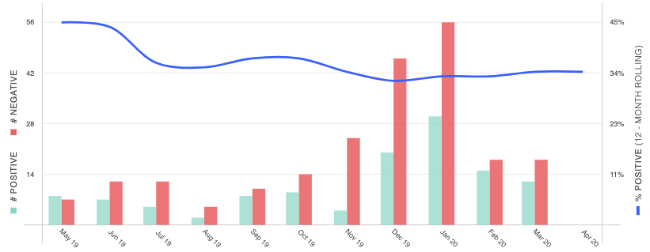
Platform
May 2025
System goes down more than ever before. Response time for bigger issues taking much longer than they ever have before. It has become unreliable.
Feedback over time: Platform
At this point it is unreliable on the web version. Over the last 6 months we have had significant down time related to billing and billing issues and are currently having trouble with ERA regeneration for the 4th time. The EHR app is slow. I cannot with any confidence recommend this to a professional.
I tried to reset my password asked for a temp email 3 times with no resolution.

Slide 15
Platform (cont.)
Insights
Impact
Action
Customers have continued to complain about platform reliability.
Most negative feedback comes from NPS surveys.
Retention
[Product]: Analyze reliability improvements

Slide 16
Reporting
May 2025
I want more reporting and data export capabilities.
More Custom reporting.
Feedback over time: Reporting
Having trouble pulling off details on giving for our financial secretary.
I can’t seem to find a report that works for me. Not sure I’m looking in the right place.
As Treasurer, I’d like more flexibility to format summary giving reports ina way that works best for me.
Reporting, difference in dates - deposit from giving, search criteria, fees should be structures by deposits in the month - not taken
each time.

Slide 17
Reporting (cont.)
Insights
Impact
Action
Customers have continued to complain about the lack of custom reporting, especially customers spending over $5K MRR.Most negative feedback about reporting comes from NPS surveys.
Retention
[Product]: Build custom reporting

Slide 18
Action plan

Slide 19
Action plan
May 2025
Topic | Action | Owner | Start Date | Days Active | Impact
Ease of Use | [Marketing]: Elevate ease of use in value prop and positioning on website - more important than ever for doctors to have easy & user-friendly tools. |  |  |  | Retention
Service | [Marketing]: Elevate responsiveness in value prop and positioning. |  |  |  | New sales
Support | [Support]: Explore options to provide support in real time to prevent churn. |  |  |  | Retention
Features | [Product]: Improvements to notes - multiple users complained of notes disappearing in March | Lauren | 3/1/2020 | 35 | New sales
Platform | [Product]: Analyze reliability improvements | Barry | 2/28/2020 | 36 | Retention

Slide 20
Action plan progress
August 2025
Action | Owner | Start | End | Impact | KPI | Baseline | Goal | Milestone 1 | Milestone 2
[Marketing]: Elevate ease of use in value prop and positioning on website - more important than ever for doctors to have easy & user-friendly tools. | Lauren | 3/1/2020 | 5/1/2020 | Retention | positive customer sentiment about Ease of Use. | 70% | 70% | 70% | 70%
[Marketing]: Elevate responsiveness in value prop and positioning. | Barry | 2/28/2020 | 5/28/2020 | New Sales | positive prospect sentiment about Service | 80% | 80% | 80% | 80%
[Support]: Explore options to provide support in real time to prevent churn. | Madeline | 3/15/2020 | 6/15/2020 | Retention | positive customer sentiment about Support | 75% | 80% | 77% | 79%
[Product]: Improvements to notes - multiple users complained of notes disappearing in March | Lauren | 3/30/2020 | 7/30/2020 | New Sales | positive prospect sentiment about Features | 50% | 70%
[Product]: Analyze reliability improvements | Barry | 4/1/2020 | 7/1/2020 | Retention | positive customer sentiment about Platform | 30% | 50%

