Slide 1
Messaging cheat sheet
Name of course here
Your shortcut to messaging that lands

Slide 2
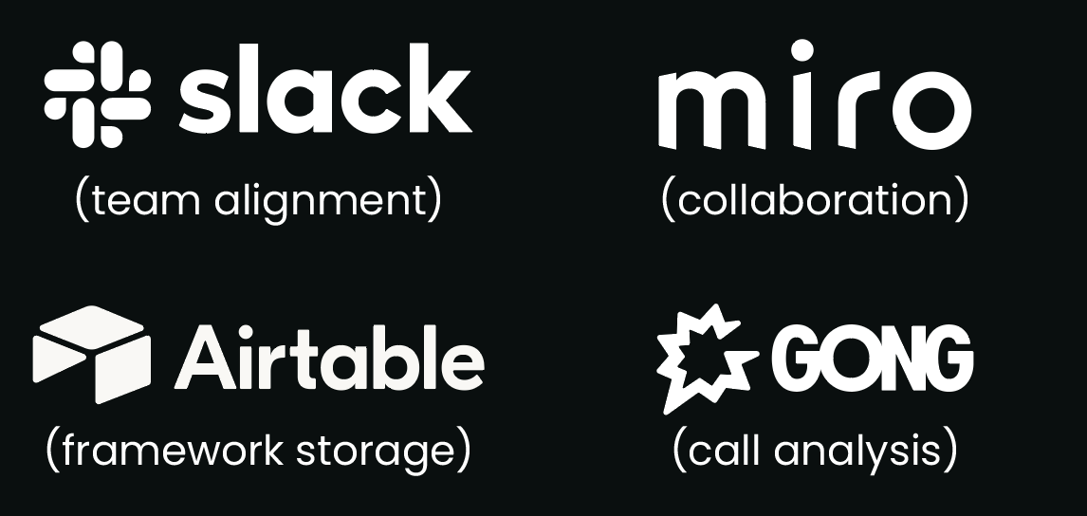
Messaging cheat sheet
8 strategic questions
Who exactly is your audience? (roles, challenges, drivers) What current belief do you need to change? What problem are you actually solving? Why is your solution uniquely qualified? Where does your solution fit in their world? When do they need your solution most? What’s stopping them from buying? How does messaging evolve over the customer journey?
Testing checklist
Customer verbatim validation Sales team feedback A/B testing key phrases Competitor differentiation check Field testing with prospects Message consistency audit Channel effectiveness tracking
Essential tools
12 essential messaging blocks | Writing rules (SHARP)
One-liner (Tweet-length value prop) Target persona definition Pain points (ranked by priority) Market category Unique value proposition Proof points/evidence Competitive differentiators Key benefits (emotional & rational) Feature-to-value mapping Common objections & answers Voice & tone guidelines Core narratives/customer stories | Simple: One idea per sentence Human: Write like you talk Active: Use active voice Real: Avoid jargon Proof: Back claims with evidence
4 key metrics
Adoption: | % of team using framework
Impact: | Win rate with new messaging
Resonance: | Customer feedback score
Conversion rate: | E.g. demo requests, downloads

