Slide 1

ARFID, making sense of food and
Sense-SATIONAL Food project
BOOKLET
Presented by – Beth Kitchen, QTS ADMP A.I.S.T.D
ASC and SPD Educational Consultant
In association with Sarah Yates, CEO of SEN- ED kitchen

Slide 2
Thomas, J.J. and Eddy, K.T. (2019). Cognitive-Behavioral Therapy for Avoidant/Restrictive Food Intake Disorder: Children, Adolescents, & Adults. Cambridge: Cambridge University Press.
Deficiency | Sign and symptoms | Possible treatments | Food rich in this nutrient
Calcium | Weak or broken bones (even when blood levels may be normal) | Pills, chews, wafers | Milk, cheese, yogurt, canned sardines, fortified fruit juices or cereals, milk substitutes (e.g., soy milk, almond milk), tofu, collard greens, kale, ice cream, blackstrap molasses
Folate | Weakness, fatigue, difficulty concentrating, irritability, headache, heart palpitations and shortness of breath, soreness and ulcers in the tongue and mouth, increased risk of birth defects | Pills | Beef liver, boiled spinach, black eyed peas, asparagus, Brussels sprouts, romaine lettuce, avocado, cooked broccoli, mustard greens, green peas, kidney beans, peanuts, wheat germ, fortified breads, cereals, orange juice, flour, pasta, rice and other grains
Iron | Difficulty thinking clearly, weakened immune system, low energy, decreased endurance, feeling too hot or too cold | Pills, liquid drops (possibly intravenous but this is rare) Tip: Calcium supplements may interfere with iron absorption. Take pills or eat calcium and iron dense foods at different times. | Animal Sources: Clams, oysters, liver (beef), sardines, beef, and chicken Non-animal sources: Breakfast cereals fortified with 100% of daily value for iron, black strap molasses, lentils, dark chocolate (45-69% cacao solids), cooked spinach, tofu (firm), kidney beans, chickpeas, cashews Tip: More iron is needed for vegetarians or vegans as non-animal sources of iron are not as well absorbed as animal sources. Vegetarians and vegans need almost twice the amount of iron of those who consume meat.

Slide 3
Deficiency | Sign and symptoms | Possible treatments | Food rich in this nutrient
Protein | Loss of lean body mass, decreased energy | Oral supplements (e.g., high energy nutrition drinks), protein powder | Beef, chicken, turkey, pork, fish, eggs, beans/legumes (e.g., lentils), nuts, nut butter (e.g., peanut butter, almond butter), seeds, milk, yogurt, cheese, tofu, quinoa, oats, peas, meat substitutes with ≥ 14 g of protein in your chosen serving size
Vitamin A | Night blindness or inability to see when it is dim or dark; decreased immunity; having more severe illnesses or infections | Pills | Sweet potato, beef liver, fish oil, spinach, raw carrots, pumpkin pie or canned pumpkin, cantaloupe, red peppers (raw), mango, dried apricots, broccoli, milk fortified with Vitamin A
Vitamin B12 | Fatigue, weakness, constipation, loss of appetite, weight loss, numbness, tingling, depression, confusion, poor memory, soreness of mouth/tongue | Pills, sublingual tablet injection | Liver (all types), fish, meat, poultry, eggs, milk, yogurt, cheese, nutritional yeast Tip: Vitamin B12 is found in animal products and not plant based foods
Vitamin C | Severe deficiency (scurvy) can cause tiredness and weakness with severe medical complications | Pills, chews, lozenges, powder packets | Bell peppers, orange juice, oranges, grapefruit juice, kiwi, broccoli, strawberries, Brussels sprouts, grapefruit
Vitamin D | Bone pain, muscle weakness, skeletal deformities (in growing children and adolescents), low mood | Pills, sunshine | Very few foods have Vitamin D naturally, aside fish liver oil and the flesh of fatty fish (tuna, salmon and mackerel), fortified milk, breakfast cereals, yogurt, and soy beverages
Vitamin K | Bruising, bleeding in your mouth/gums, blood in stool, poor bone health | Pills | Leafy green vegetables, broccoli, roasted or fermented soybeans, soy or canola oil, pomegranate juice, grapes, cashews, olive oil
Zinc | Poor growth, loss of appetite, low immune function, taste changes, depression, hair loss, diarrhea, eye and skin lesions | Pills, lozenges | Oysters, crab, beef, lobster, pork, baked beans, chicken, yogurt, cashews, chickpeas, cheese, oatmeal, milk, fortified cereals Tip: Zinc is easier to absorb in animal sources

Slide 4
Recognising hunger cues
A person who is eating normally will experience normal hunger cues
1
Extreme
hunger
4
Neutral
Not hungry
Not full
7
Extreme
fullness
Track how hungry you feel before eating and after eating
To begin shifting your hunger cues, you need to start eating when scoring 3 or 4 (not hungry and not full), rather than waiting for 1 (extreme hunger)
Keep eating until 6 or 7 (extreme fullness) rather than stopping at 4 or 5 (not hungry and not full)
A person who is chronically food restricted has learnt to ignore hunger cues. Where someone would normally feel hungry, someone with ARFID will feel neutral
The best way to shift hunger cues back to normal is-
Eat by the clock
Increase awareness through self monitoring
1
Extreme
hunger
4
Neutral
Not hungry
Not full
7
Extreme
fullness
Diagram from “The picky eaters recovery book”
Jennifer J Thomas, Kandra R. Becker and Kamryn T Eddy

Slide 5
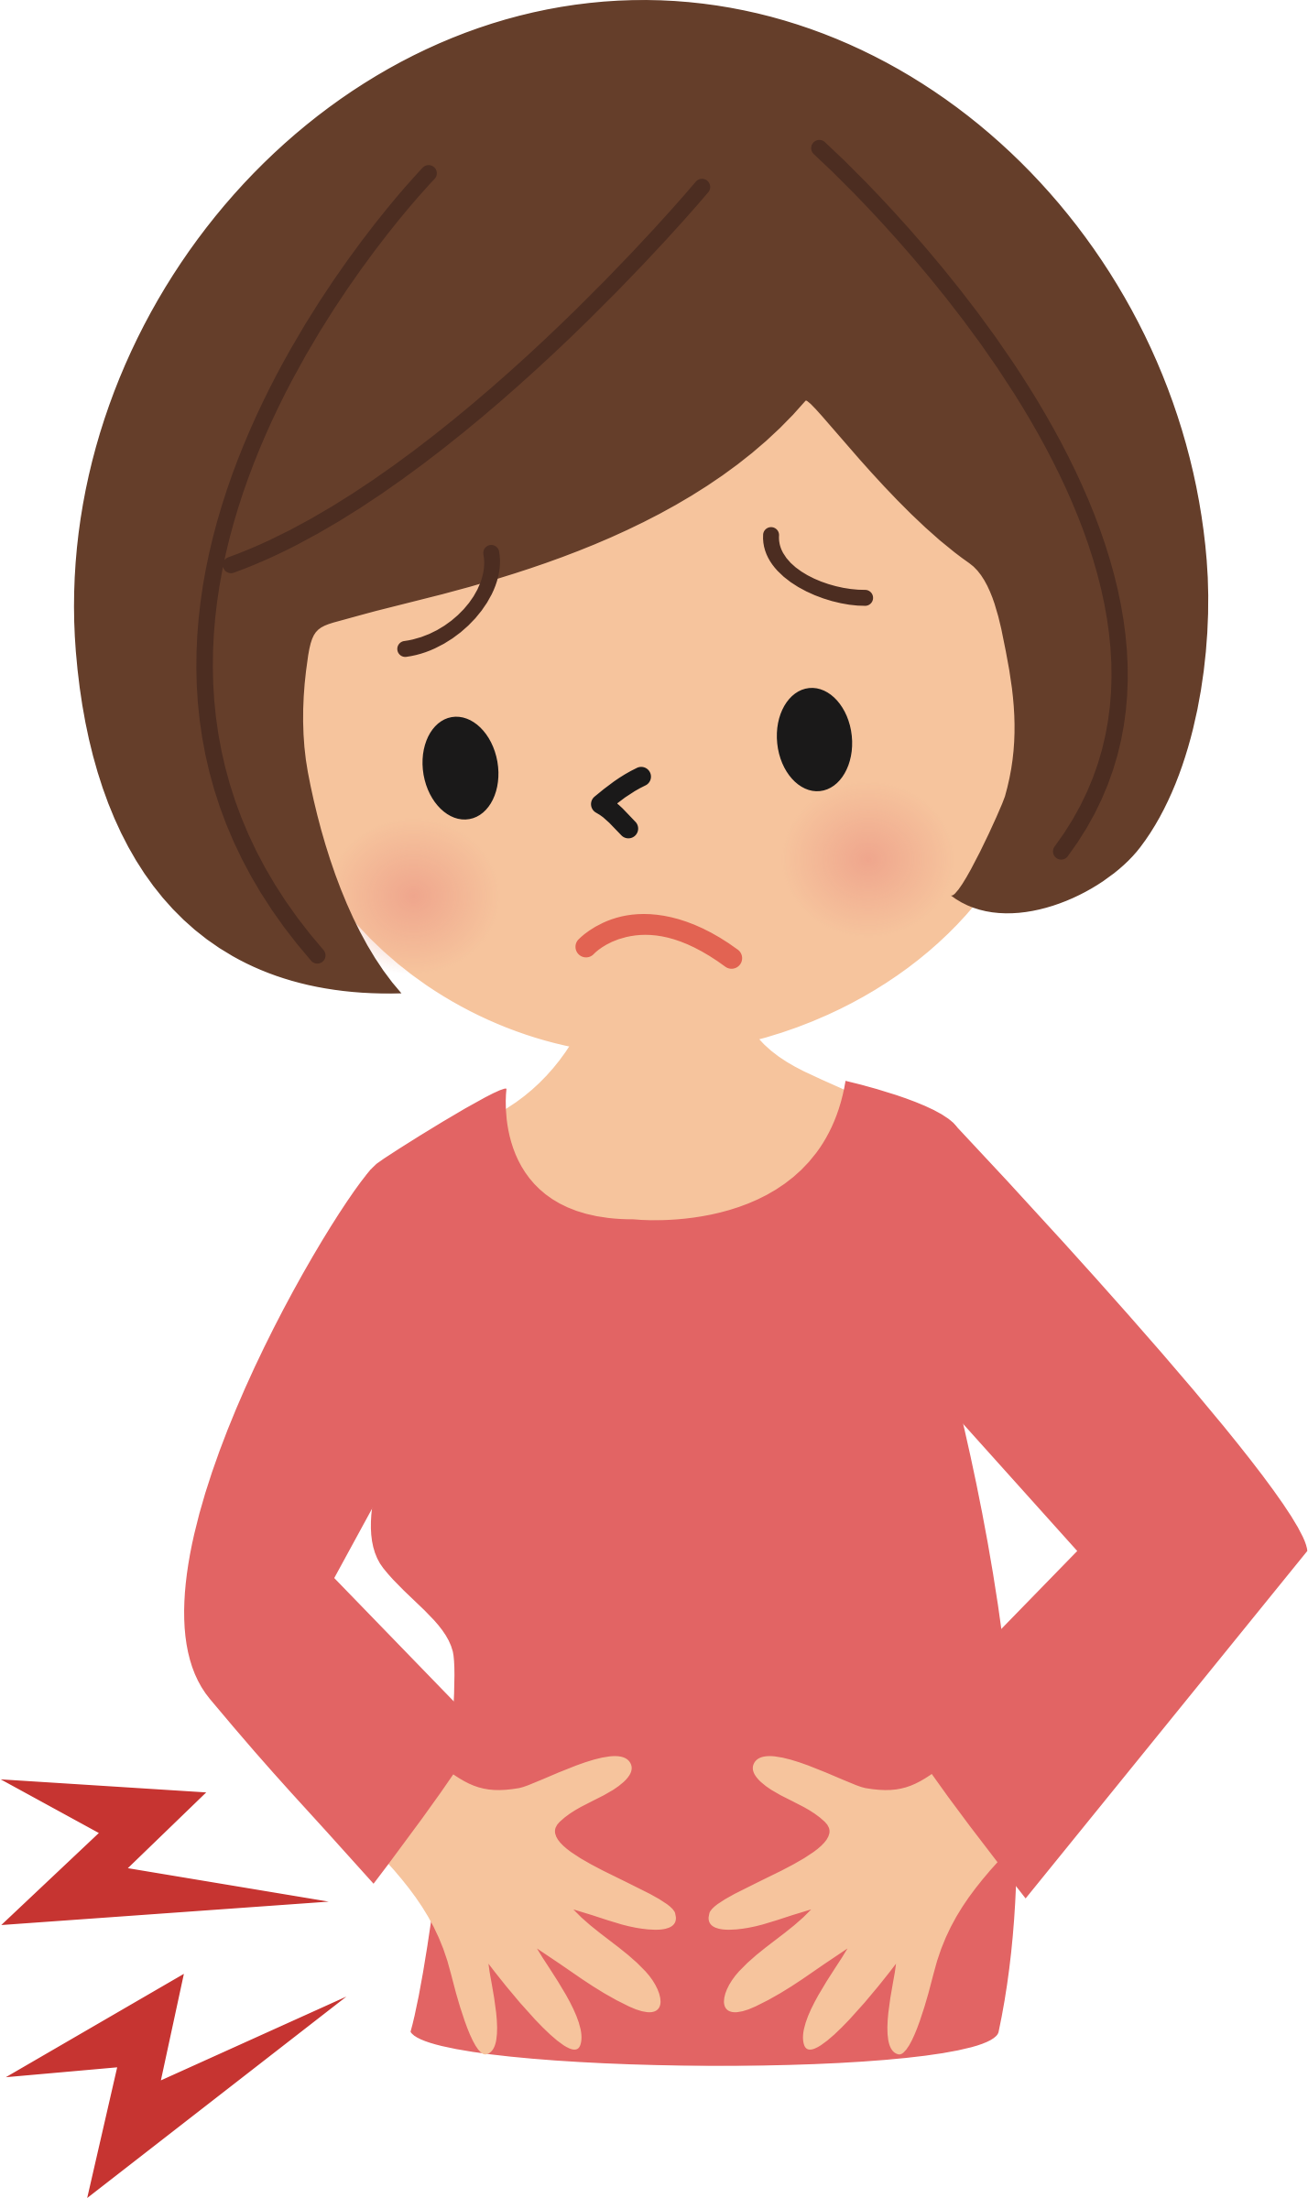




My Tummy Talk Sheet
I feel…
1. Really hungry
2. Quite hungry
3. A bit hungry
4. Not hungry and not full
5. A little full
6. Almost full
7. Really full
Time- ……………………………
It is-
Breakfast time
Morning snack
Lunch
Afternoon snack
Teatime
Snack
Supper
POP!

Slide 6





Five of my favourite foods are: | 1. 2. 3. 4. 5.
Today I am tasting-
What does it- | Two words that describe the food:
Look like? | 1. | 2.
Feel like? | 1. | 2.
Smell like? | 1. | 2.
Taste like? | 1. | 2.
Texture like? | 1. | 2.
What do I like about:
The way the food looks
The feel
The smell
The taste
The texture
When will I add this food to my diet this week?
………………………………………………………….

Slide 7
Score 100 being highest anxiety 0 being no anxiety | Food or eating situation
100
90
80
70
60
50
40
30
20
10
0

Slide 8
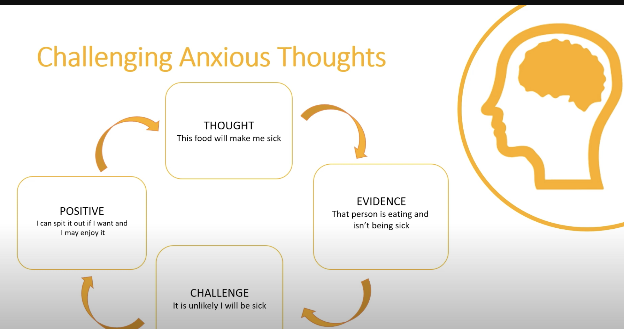

Slide 9
“It just going out for a coffee”….
What can I smell? | What can I see? | What can I feel? | What can I hear? | What is my body telling me?

Slide 10
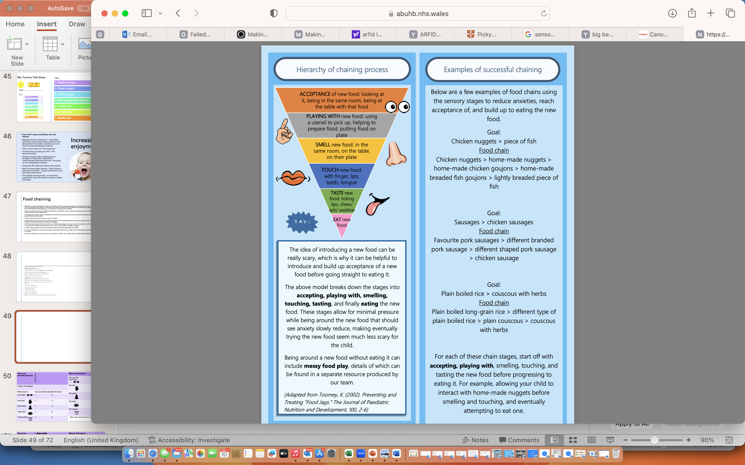
ABB Paediatric Psychology Wales
Parents information unit

Slide 11
Examples of food chains using the sensory stages to reduce anxieties, reach acceptance of, and build up to eating the new food.
Goal:
Chicken nuggets > piece of fish
Food chain
Chicken nuggets > home-made nuggets > home-made chicken goujons > home-made breaded fish goujons > lightly breaded piece of fish
Goal:
Sausages > chicken sausages
Food chain
Favourite pork sausages > different branded pork sausage > different shaped pork sausage > chicken sausage
Goal:
Plain boiled rice > couscous with herbs
Food chain
Plain boiled long-grain rice > different type of plain boiled rice > plain couscous > couscous with herbs
For each of these chain stages, start off with accepting, playing with, smelling, touching, and tasting the new food before progressing to eating it. For example, allowing your child to interact with home-made nuggets before smelling and touching, and eventually attempting to eat one.

Slide 12
Ways that my eating has improved since the start of treatment:
Possible future triggers for relapse:
Red flags that I might be starting to relapse:
CBT-AR techniques to continue or try on my own after treatment is completed:
Ways I’d like to continue to change my eating post-treatment:

Slide 13
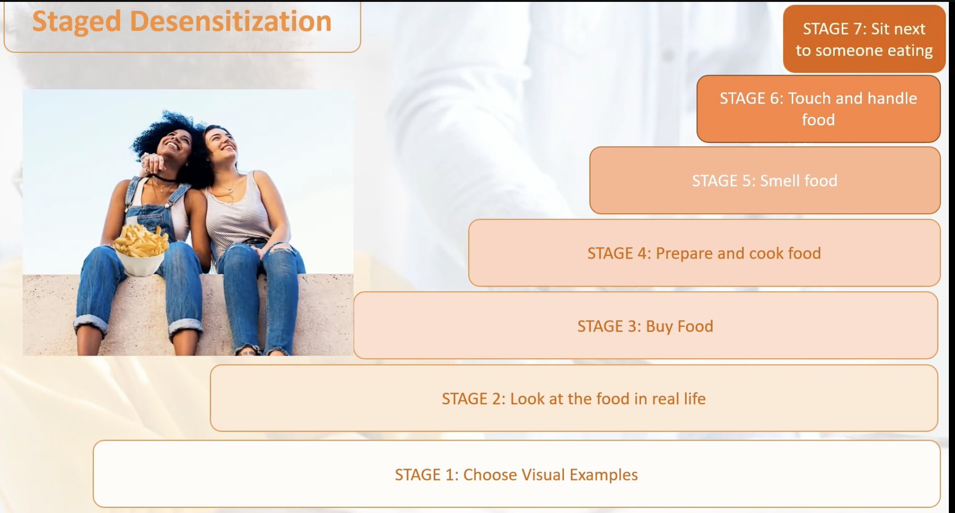
De-sensitisation

Slide 14
Reasonable adjustments and ARFID
Environment | Equipment | Food choice | Before/ After
Eat in a light environment | Eat with my fingers | Eat small chunks | Play with my friends
Longer to eat than others | Eat with a spoon | Eat one food item at a time | Have to option of a relaxing activity
Eating at different times to others | Eat with metal cutlery | Eat little and often | Complete some exercise
Eat in a darker environment | Eat with plastic cutlery | A small bowl with new foods in for me to look/smell at | Have a visual aid to help me know is going to be eaten
Eat in the dark | Eat with cutlery with adapted handles | A small bowl with one new food item in | Have a sleep
Eat in a noisy environment | Eat out of a bowl | A small bowl with the option of the school meal | Meditation
Eat in a quiet environment | Eat off a plastic plate | ”Safe” meal always an option | A games I like to play
Eat sat down | Eat off a plate | “Safe” snacks throughout the day | Photographs of food
Eat not sat down | Have a visual aid to help me know how to eat | Food to be processed down to swallowing capability | Revising individual food plan
Eat with one other person | Eat of a tray plate | Certain amount | Check the labels of food
Eat alone | Eat off a divided plate | Certain brand | Alone time
Eat with other people | Eat on a specific chair/seating adaption | Pudding before main | Clean and wash myself

Slide 15
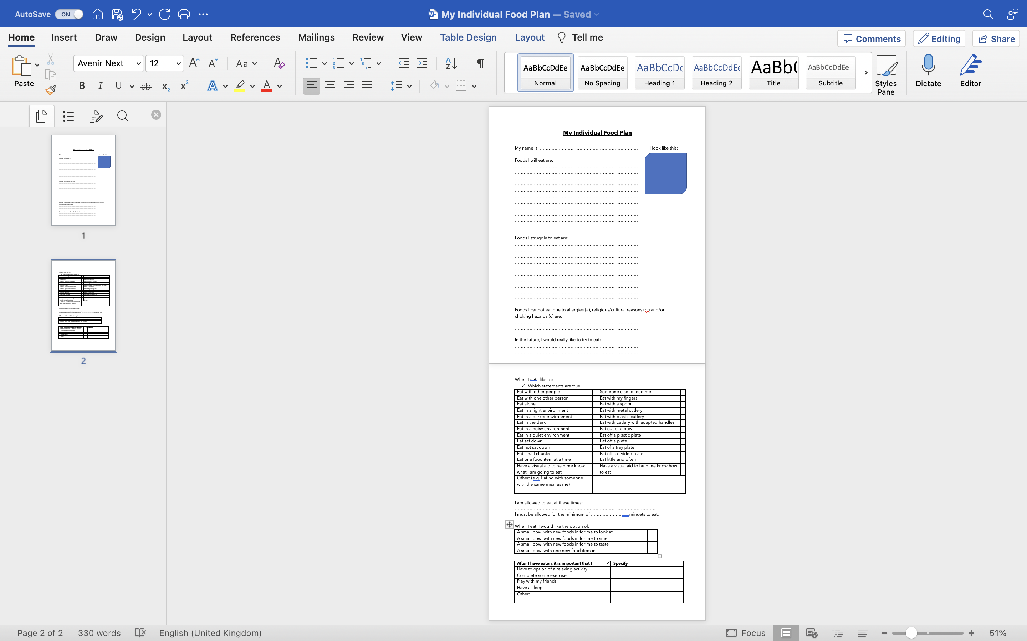

Slide 16

KEY QUESTIONS TO ASK INPATIENT SETTING
Does the student have a meal plan?
How best to support the pupil during mealtimes?
How much sport/exercise can the student undertake?
What academic progress has the pupil made (if any)?
What should the school do if they suspect the pupil is relapsing?
Can the school retain contact with the unit for advice/updates?
Who is the key person responsible for the pupil’s care after discharge can they be put in touch with the school?
Will the student be attending appointments if so could the school be made aware of the dates to make sure they can support the pupil during this absence?
Is there any other information the school need to be aware of?
What information is appropriate to be shared amongst staff and pupils?
Parents?
From Knightsmith (2015) ‘Self-Harm and Eating Disorders in Schools

Slide 17


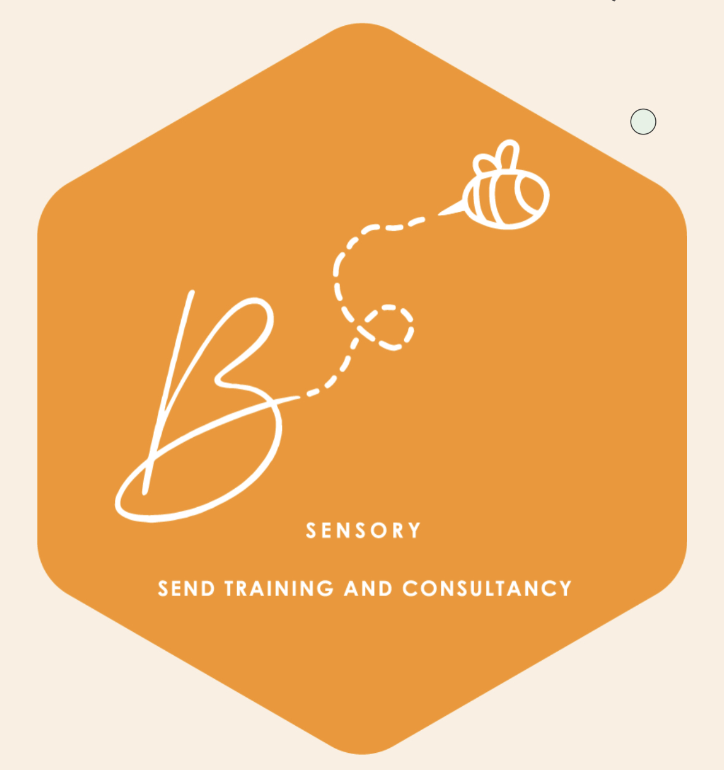
Contact- Beth
For support and more information please contact contact@bsensory.org
Enjoyed the training? Why not look at other courses-
Accredited Sensory Needs Practitioner course
PDA advocate course
We also offer school support packages including Professional Neurodiversity Advocate training packages
Visit www.bsensory.org
Don’t forget to follow our social media too
Notes:
Support us we are local!

Slide 18

Contact- Sarah
Web: https://www.senedkitchen.co.uk
email:sarah@senedkitchen.co.uk
Tel: 07857 635053
FB/insta: @senedkitchen,
Notes:
Support us we are local!

Slide 19
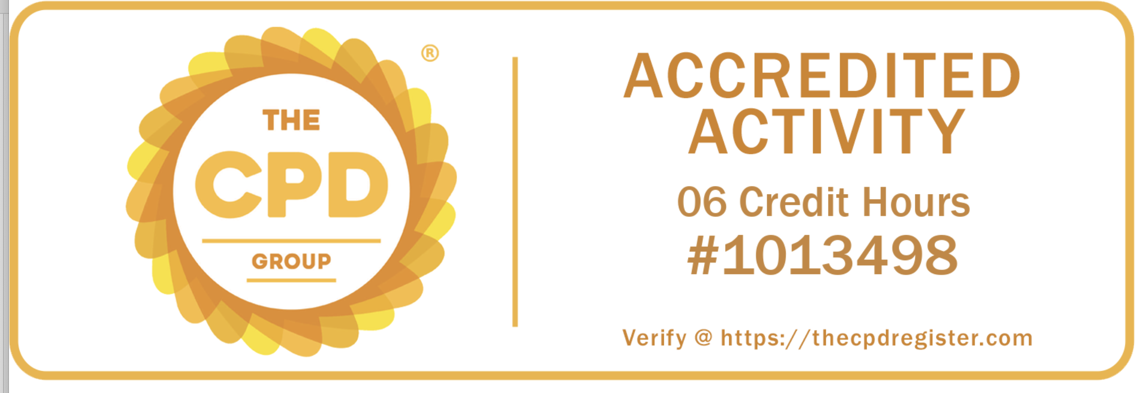
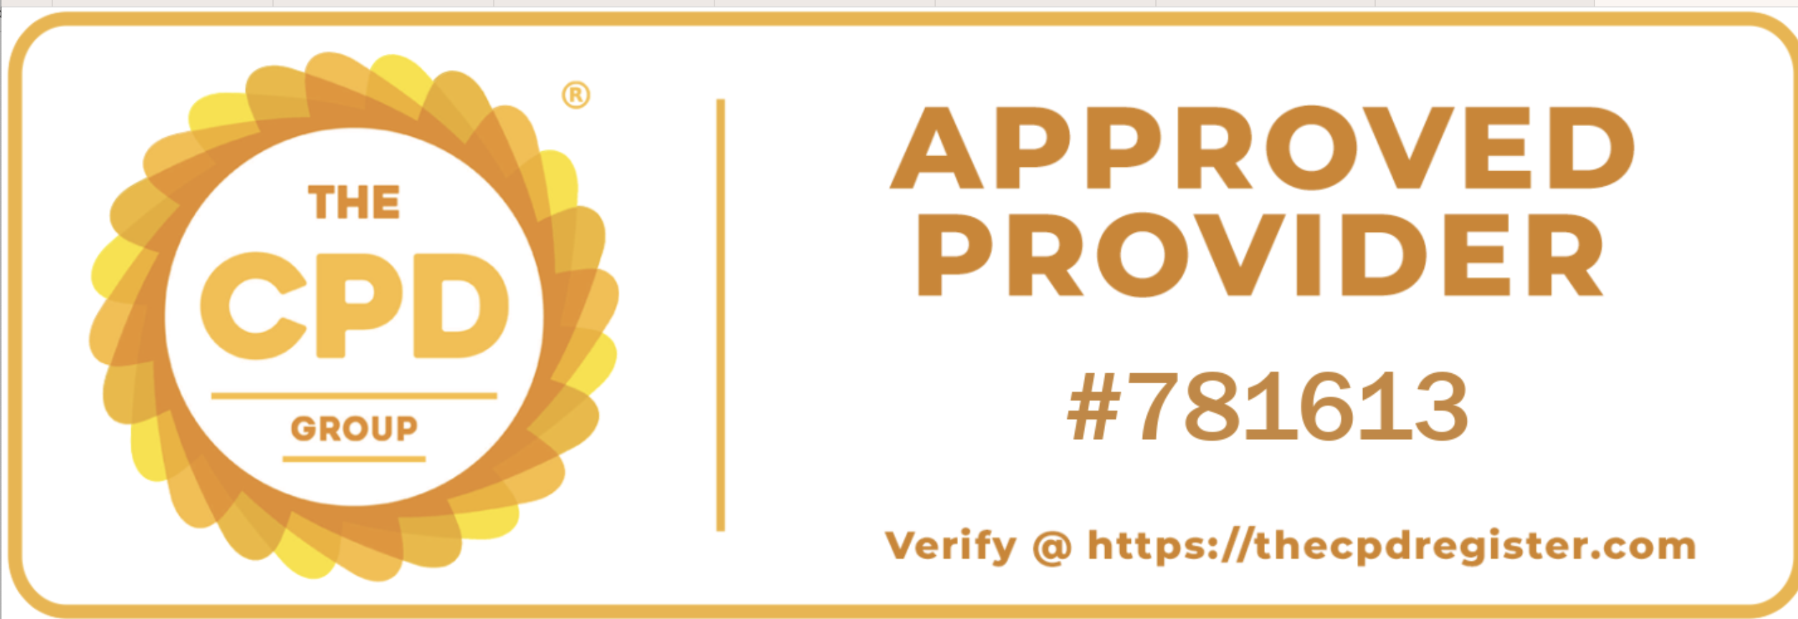
This is to certify that
………………………………………………… attended ARFID awareness and Sense-ational Food Project Course on the / /
Signed-
B.Kitchen

