Slide 1
Internal marketing handbook
Name of course here
Last updated: April 2026

Slide 2
1. Introduction
This handbook is your guide to how the marketing team operates. It's here to ensure everyone – whether new to the team or a seasoned member – understands how we work, what we value, and how we drive business impact.
It aligns us around shared expectations, rhythms, tools, and principles that help us move fast and stay customer-focused.
We treat this as a living document. It evolves with our team, our company goals, and the market we're serving.

Slide 3
2. Marketing vision & principles
Our vision is to be the strategic growth engine of the business – a team that not only delivers campaigns, but drives sustainable, measurable results.
Our guiding principles:
Customer obsession: Know them deeply, speak their language.
Brand + demand: We don’t sacrifice one for the other – both matter.
Data-driven decisions: Use evidence, not ego.
Test > perfect: Launch fast, learn fast, improve continuously.
Think like owners: Take accountability, not just responsibility.

Slide 4
3. Team roles & responsibilities
Clarity on ownership is essential for speed and impact.
Role | Responsibility
Content marketing | Drives content strategy, SEO, blog, newsletters, and gated assets. Owns voice, tone, and editorial calendar.
Product marketing | Develops positioning and messaging. Leads go-to-market strategy, competitive analysis, personas, and enablement materials.
Growth marketing | Runs paid acquisition, landing page testing, conversion rate optimization, and lifecycle marketing.

Slide 5
3. Team roles & responsibilities (cont.)
Role | Responsibility
Brand & creative | Maintains visual identity, creative standards, campaign concepts, and brand storytelling.
Marketing operations | Manages MarTech stack, CRM hygiene, lead scoring, attribution models, reporting, and automation workflows.
Comms & PR | Owns media relationships, thought leadership distribution, internal comms, and reputation management

Slide 6
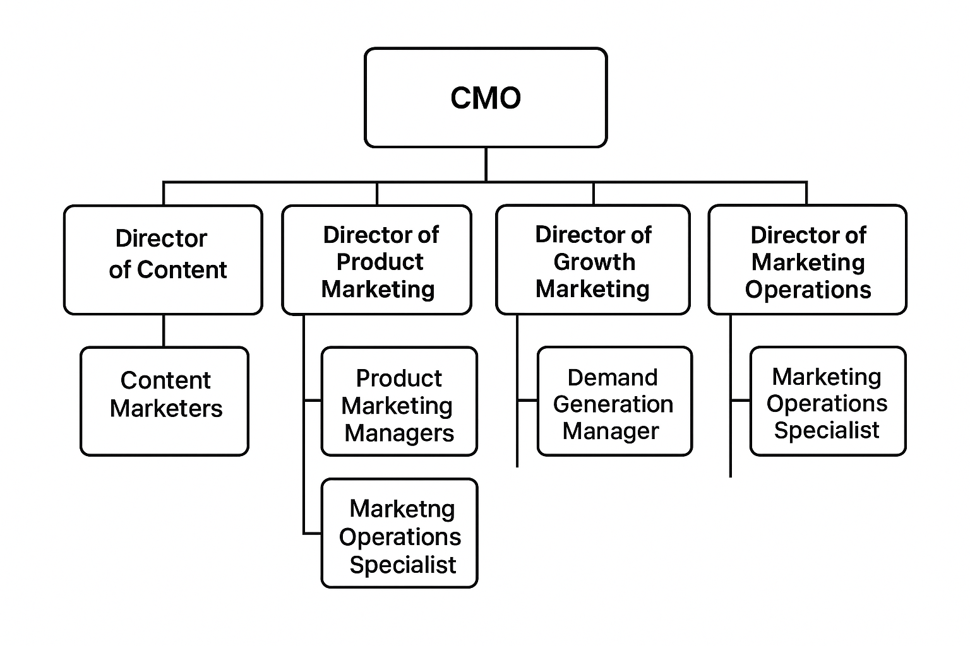
4. Team org chart

Slide 7
5. Team OKRs (quarterly)
We align our goals with company priorities and track them publicly each quarter.
Objective: Increase marketing-sourced pipeline by 30%.
- KR1: Launch 3 integrated campaigns by end of Q2.
- KR2: Increase SQL conversion rate from 15% to 20%.
- KR3: Generate $1.5M in attributable pipeline.
Objective: Strengthen brand visibility in enterprise segment.
- KR1: Publish 10 thought leadership pieces.
- KR2: Secure 3 Tier 1 PR placements.
- KR3: Grow branded search volume by 20%.
Objective: Improve customer retention and engagement through lifecycle marketing
- KR1: Launch automated onboarding email sequence with 40%+ open rate by end of Q2
- KR2: Increase NPS response rate from 18% to 30%
- KR3: Reduce churn rate by 15% in core segment

Slide 8
6. Planning & prioritization
We operate on a quarterly planning cadence. This includes:
End-of-quarter retros
Teamwide input sessions
Prioritization using RICE or ICE framework
Planning workshops with leadership
Final marketing plan share-out
All initiatives must ladder up to team OKRs and must be briefed through the marketing request system (intake form).

Slide 9
7. Briefing & execution
Every great piece of work begins with a solid brief.
A good brief includes:
Business context and problem to solve
Target audience
Channels and assets required
Timeline and dependencies
Success metrics
We use a shared template stored in Confluence or Notion. Execution is tracked in Asana, and we hold weekly standups to resolve blockers.

Slide 10
8. Internal communication
Strong internal communication is key to momentum and trust. Encourage over-communication – silence is never clarity.
Friday updates
Shared by marketing lead. Covers wins, learnings, metrics.
Monthly all-hands
Deep dive on campaigns, retros, and highlights.
Slack
#marketing: general discussion
#launches: upcoming campaigns
#brand-feedback: design reviews

Slide 11
9. Approvals & sign-off
To keep quality high while moving fast:
Content must have two peer reviews.
Design needs brand review for consistency.
Campaigns are approved by initiative owner or channel lead.
For launches involving sales, Product Marketing leads enablement.

Slide 12
10. Tools & systems
Asana: Campaign/project tracking
Slack: Real-time communication
HubSpot/SFDC: CRM and workflows
Looker/GA4: Data dashboards and web analytics
Figma: Design files and feedback
Confluence/Notion: Knowledge base and templates
Documentation lives in Confluence. Always check there before creating something new.

Slide 13
11. Performance & learning
We hold a monthly marketing metrics review, where each team shares:
Each marketer is expected to:
Wins and underperformance
Optimizations run + lessons learned
Hypotheses for next month
Know their KPIs
Learn from tests
Share insights in Slack and reviews

Slide 14
12. Culture & rituals
We value clarity, candor, curiosity, and execution. Our weekly rituals:
Monday | Weekly kickoff (30 mins)
Wednesday | No meeting day
Friday | Demo and shoutouts
We use our values to make decisions, resolve conflicts, and show up consistently.

Slide 15
13. Marketing request & intake process
We use a standard form (in Notion or Forms) for all requests.
Steps:
SLAs
Submit via intake form
Weekly triage meeting
Assign lead + brief development
Review timing + trade-offs
Simple tasks: 3–5 days
Campaigns: Scoped in planning cycle or custom

Slide 16
14. Marketing glossary
MQL: Marketing Qualified Lead
SQL: Sales Qualified Lead
CAC: Customer Acquisition Cost
GTM: Go-to-Market
CTR: Click Through Rate
ICP: Ideal Customer Profile
NPS: Net Promoter Score
Attribution model: Rule for assigning conversion credit
This ensures cross-functional clarity when we speak in acronyms.

Slide 17
15. Brand guidelines
For all public-facing assets, follow:
Brand color palette + typography
Logo usage do’s and don’ts
Approved templates (decks, social, case studies)
Voice and tone: Confident, clear, human
[Link to brand folder or style guide]

Slide 18
16. Legal & compliance rules
Before launch, route through appropriate reviews:
Legal: Product claims, privacy, terms
Brand: Visual compliance
Comms: Crisis risk, public statements

