Slide 1
The way we write
Name of course here
A brand voice and style guide

Slide 2
Our core TOV values.
Across all our business lines, we position ourselves as authoritative, forward-thinking, creative, innovative, and people-first.
So, whether it be in an email, social post, article, landing page, or other, our words should consistently reflect this.
We are not formal and robotic. We’re conversational, contemporary, and human. As they say, it’s not B2B or B2C. It’s B2H. (Business to human)

Slide 3
How we talk in a nutshell.
What we are | What we aren’t
Human | Flat
Authoritative | Outdated
Enthusiastic | Long-winded
Trustworthy | By the book
Fun | Monotonous

Slide 4
Human.

Slide 5
Human.
Type like you talk.
You wouldn’t say ‘thus’ or ‘conversate’ aloud, so don’t include it in your copy. Read everything you write out loud and if it doesn’t sound natural, rework it.
Furthermore, conversely, thereafter (you get the gist) are incredibly academic and essay-like. They don’t belong in our writing.

Slide 6
Human.
Contractions for the win.
One simple apostrophe makes a huge difference to the tone of your text.
‘She’s’ sounds softer than ‘she is’, ‘wouldn’t’ than ‘would not’, ‘hasn’t’ than ‘has not’, etc.
Use contractions often.
You might not want to use contractions when you’re trying to make a point. For example: “Whatever you do, do not steal my candy bar from the fridge.”

Slide 7
Human.
Grammar rules aren’t everything.
If ‘rules’ were anything to go by, you wouldn’t start a sentence with a conjunction.
This isn’t a hard rule and starting sentences with conjunctions is very common, and can actually add impact to our writing.
Don’t be afraid to do it.

Slide 8
Authoritative.

Slide 9
Illustrate expertise.
Let people know we’re the industry experts by drawing on the names, numbers, and experience we’ve got under our belt. But don’t showboat. We're confident, not cocky.
For example, say: “With 1,000+ product marketers and 50 awesome industry speakers, you could say our San Fran event is the place to be this September.”
Not: “We host the best product marketing events and the industry knows it. Our San Fran line-up includes 1,000+ product marketers and only elite speakers.”
We have lots of great brands, names, and stats under our belt. Make the most of them!

Slide 10
Enthusiastic.

Slide 11
Illustrate expertise.
Get people pumped to join our community, courses, membership, or events by choosing words that elicit excitement. These don’t always have to be huge changes, the odd word here and there can make a big difference.
For example, this:
“February’s Product Marketing Summit in Austin just got even better.”
Has more oomph behind it than:
“The Product Marketing Summit Austin agenda is shaping up well for February.”

Slide 12
Trustworthy.

Slide 13
Earn trust.
Before people buy, they trust. Let people know we’re a safe bet by gently reminding them of our industry presence. Again, depending on the context, these can be subtle changes or whole new additions.
Here are some sample scenarios:
• Join us again in New York (if the first was a flop, we wouldn’t be returning)
• See what recent attendees have to say here (social proof)
• Join 6,000+ others (let the numbers do the talking)
• John Doe from Example Ltd said it was “game-changing” (social proof again, the words of our audience will always be way stronger than our own)

Slide 14
Fun.

Slide 15
Have a sense of humor.
There’s a time and a place for fun. Marketing emails? Yes. Frameworks? No. Social posts? Yes. Technical guides? Not so much. Gauge where it’s appropriate and when it is, don’t be afraid to be playful – B2H, remember.
Whether we’re speaking to a VP or Associate, we are speaking to a person and everyone has a sense of humor. Do use it sparingly. Don’t say anything snarky or patronizing.
For example, instead of saying: "We’ve added an extra date onto our Chicago event.”
Why not say: “We only went and did it – our Chicago event’s now extended!

Slide 16
How to say hi and bye.

Slide 17
Type it how you’d say it.
What to say | What not to say
Hey fellow marketers | To [insert name]
Happy Friday all | Dear [insert name]
Hey [insert name] | Hello Mr Example
Until next time, Team MA | Yours sincerely
Many thanks, [insert name] | Kind regards

Slide 18
Call-to-actions.

Slide 19
Make your CTA relevant to the end destination, eye-grabbing, short, and snappy.
Be creative, but don’t forget to make sure it’s intuitive. ‘Download it now’ and ‘Buy it now’ are okay and even needed from time-to-time, but when used over and over again can become stale and un-enticing.
The same concept applies to blog titles too.
If they’re boring people won’t want to click in and read it, so don’t rush this process and always be thinking about clickability. Let's take a look at some CTA inspo...

Slide 20
CTA examples.
Traditional | Alternative ideas
Download it now | Get your copy Find out how See the results Access world-leading tactics Get the stats
Buy now | Yes, I’m in Take the next step I’m ready to join Advance your career Level-up your skills

Slide 21
Exclamation marks.

Slide 22
...Should be used very sparingly.
Too many can look OTT and come across as a bit childish.
Take a look at these two examples:
By integrating artificial intelligence and machine learning, that’s how!
By integrating artificial intelligence and machine learning, that’s how.
One small change can make a huge difference to how your sentence is read.

Slide 23
Emojis.

Slide 24
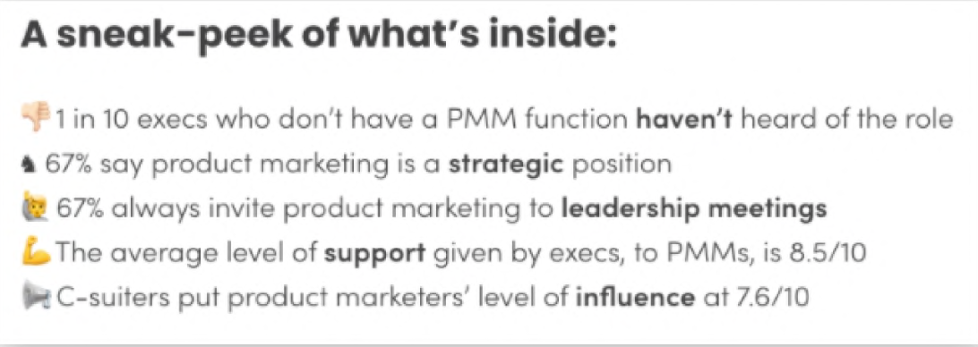
The fun police strike again.
Emojis can be a great way to bring personality to what we’re saying, hammer home that human element, and make plain text less dull.
They’re also a nice way to bring to life lists and visualize their points.

Slide 25
Italics.

Slide 26
One last thing to use sparingly: italics.
When used right, italicizing text is a great way to emphasize certain words, add impact to what you’re saying, and spruce up the aesthetics of your copy.
When used wrong (i.e. excessively), italics make copy look messy and completely lose their impact.
Do use italics when:
Quoting somebody
You want to emphasize a certain word within a point, to really make that point stick.
Don’t use italics:
Willy-nilly.

Slide 27
Know your audience.

Slide 28
Goodbye S, hello Z.
The majority of our audiences are in North America, and so we adopt US English spelling throughout everything we do.
If you’re struggling to get used to the shift, download the Grammarly extension (which I’d recommend anyway for picking up typos, etc.) and flick your preference to English (US), instead of English (British).
Sticking with the geographical theme, bear in mind people in other countries might not get all our English lingo. If in doubt, use Google. If still in doubt, say something else.
And finally, be very sensitive when it comes to religious and gender-related terminology. Stay neutral, my friends.

Slide 29
Flip it: Quotes (and quotes within quotes).
As a standard in US English, use double quotes for the outside quote and single quotes for the inside quote.
A standard quote? It’ll look like this:
“For me, a good product marketer understands, and puts the customer at the forefront of everything they do.”
Wanna write out a quote within a quote? Here’s how it’ll look:
“I've always been a 'product person' and I thrive on unlocking previously untapped opportunities for consumers through a product offering.”

Slide 30
Talk to your reader.

Slide 31
We want to foster a relationship with our readers and talk directly to them.
To do that, we use second person when referring to our audience, i.e., say:
‘When building go-to-market strategies, you should work alongside...’
Not:
‘When building go-to-market strategies, product marketers should work alongside...’

Slide 32
Keep capitalization consistent.

Slide 33
For any titles (blog or presentation) keep your characters lowercase.
For complete clarity:
This is your blog post title right here
Not:
This Is Your Blog Post Title Right Here
Some companies adopt the former, others adopt the latter. We use lowercase because it looks much cleaner.

Slide 34
For job titles:
Only capitalize job titles when using it as a formal job title in a sentence, e.g. "John Smith is a Product Manager at XYZ Company."
When using it in a generic sense without emphasising it as a formal title, it can be written in lowercase, e.g. "The product manager is responsible for product development."

Slide 35
Obvs, still use capitals when/for:
Starting a sentence
Names (individuals, companies, products, countries, places)
Titles (jobs, books, films, songs, etc.)
Days and months
Acronyms.
After a colon, e.g. “TIP: Gathering insights on customers is instrumental to this step.”
NB: Capital letters aren’t used after a semicolon, e.g. “Where competitive intelligence sits in an organization isn't the main concern; it's more about the skill set [...]”

Slide 36
It’s not just about the words.

Slide 37
Pay attention to the aesthetics.
Content design plays a huge role in how copy’s digested, and how engaged readers become. Here are some key points to always keep in mind:
Keep an eye on spacing – i.e. if you’re using an image, a video, or a table, the text above or below it shouldn’t be too close. Padding gives both elements space to breathe and ensures the page doesn’t look too cluttered.
Lengthy paragraphs can look overwhelming and put people off reading. As a rule, try to keep paragraphs at four lines of a Google doc.

Slide 38
Paragraph after paragraph after paragraph can get boring.
Break up your copy with:
Subheadings
Bullet points/lists
Images
Videos
Podcasts
Tables
Quotes
Charts
In-article ads

Slide 39
Number styling.

Slide 40
Here's how we do it.
Type out the numbers one to nine.
From 10 and above, display numbers numerically.
One, two, three, four, five, six, seven, eight, nine.
10, 11, 12, 13, 30, 300, 3,000, 30,000, 3000,000.
When you get into the millions, present the number like this: 3 million.

Slide 41
Mix up your sentences.

Slide 42
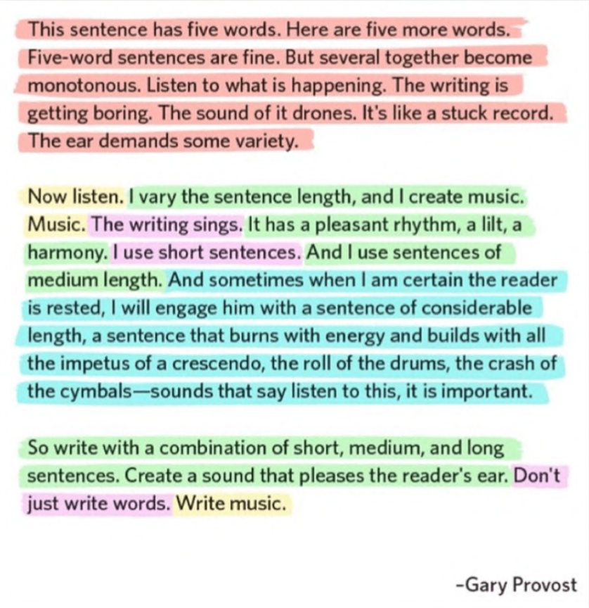
Couldn’t have said it better myself, Gary.

Slide 43
Short and simple.

Slide 44
I’ve saved the most important point till last...
The best copywriters use the simplest language, and you don’t always need to use fancy words to create incredibly impactful copy.
Do use as few words as possible (attention spans are ever-decreasing).
Don’t be convoluted with anything you say (call a fork a fork).

